Slide 1
Computer Graphics
Bing-Yu Chen National Taiwan University

Slide 2
Introduction to Instructors
Instructor & Coordinator: Prof. Bing-Yu Chen (陳炳宇)
E-mail: robin@ntu.edu.tw
the easiest way to contact with me
Office: Mgmt II, Rm. 1112@NTU
Tel/Fax: (02)3366-1193

Slide 3
Introduction to Instructors
Dr. Ming-Fang Weng (翁明昉)
E-mail: mfueng@cmlab.csie.ntu.edu.tw
Mr. Tz-Huan Huang (黃子桓)
E-mail: tzhuan@cmlab.csie.ntu.edu.tw
Mr. Ken-Yi Lee (李根逸)
E-mail: kez@cmlab.csie.ntu.edu.tw

Slide 4
Syllabus
Introduction and Pipelined Rendering
Rasterization
Transformations and Viewing
Geometry and Animation
Illumination and Shading
Texture Mapping
Curves and Surfaces
OpenGL Programming
GPU Programming
OpenGL ES Programming

Slide 5
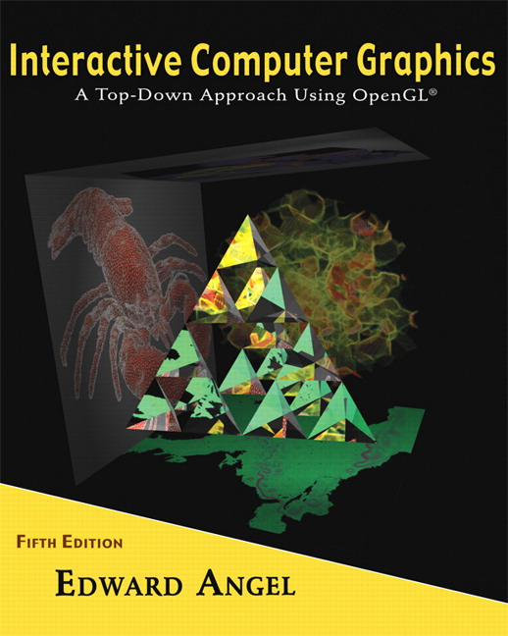
Textbook
E. Angel. Interactive Computer Graphics: A Top-Down Approach with OpenGL™, 5th. ed., Addison-Wesley, 2009.

Slide 6
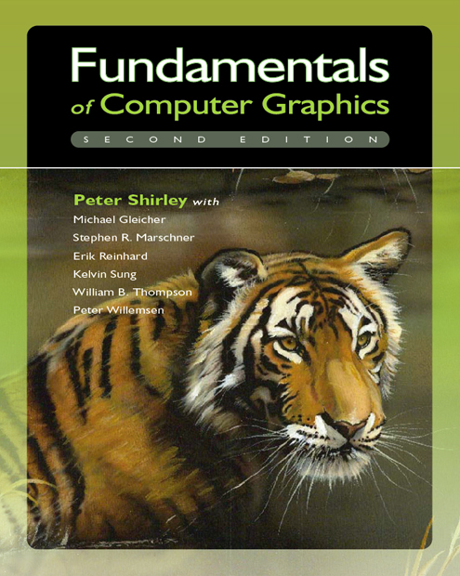
Textbook
P. Shirley, M. Ashikhmin, M. Gleicher, S. Marschner, E. Reinhard, K. Sung, W. Thompson, P. Willemsen. Fundamentals of Computer Graphics, 2nd. ed., A K Peters, 2005.

Slide 7
Textbook
J. D. Foley, A. van Dam, S. K. Feiner, J. F. Hughes, R. L. Phillips. Introduction to Computer Graphics, Addison-Wesley, 1993.

Slide 8
Reference
J. D. Foley, A. van Dam, S. K. Feiner, J. F. Hughes. Computer Graphics: Principles and Practice in C, 2nd ed., Addison-Wesley, 1995.

Slide 9
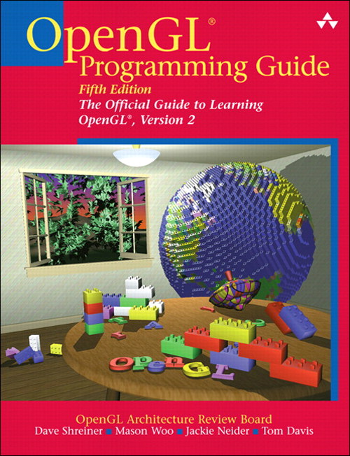
Reference
D. Shreiner, M. Woo, J. Neider, T. Davis. OpenGL® Programming Guide: The Official Guide to Learning OpenGL, ver. 2, 5th. ed., Addison-Wesley, 2005.

Slide 10
Pre-requirements (better-to-have)
Linear Algebra
Data Structures
Algorithms
Programming Skills
C/C++
Java

Slide 11
Requirements
Participants
Three or Four Programming Homework
deadlines = TBA
Examination (maybe)

