Slide 1
Computer Graphics
Bing-Yu Chen National Taiwan University

Slide 2
Introduction
The Graphics Process
Color Models
Triangle Meshes
The Rendering Pipeline

Slide 3
What is Computer Graphics ?
Definition
the pictorial synthesis of real or imaginary objects from their computer-based models
OUTPUT
 | descriptions | images
descriptions |  | Computer Graphics
images | Computer Vision Pattern Recognition | Image Processing
INPUT

Slide 4
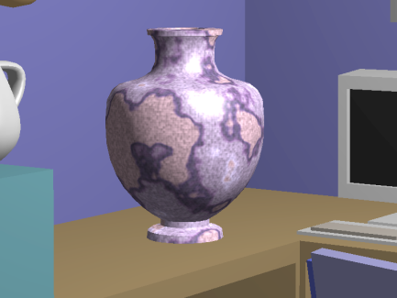
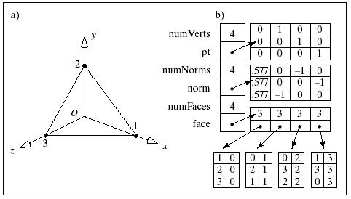
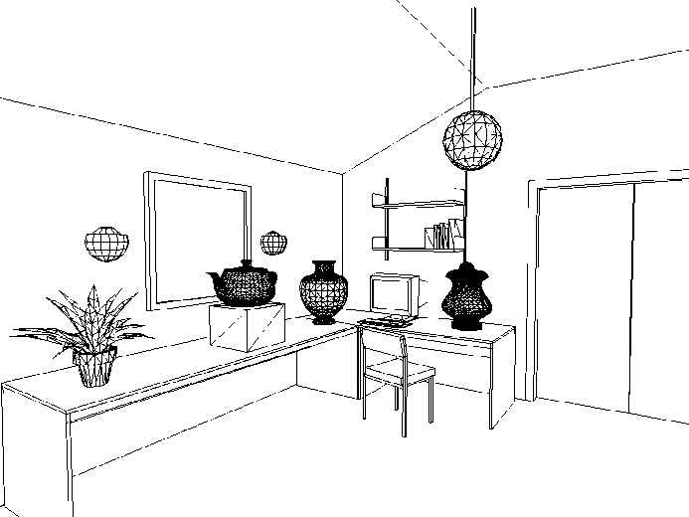
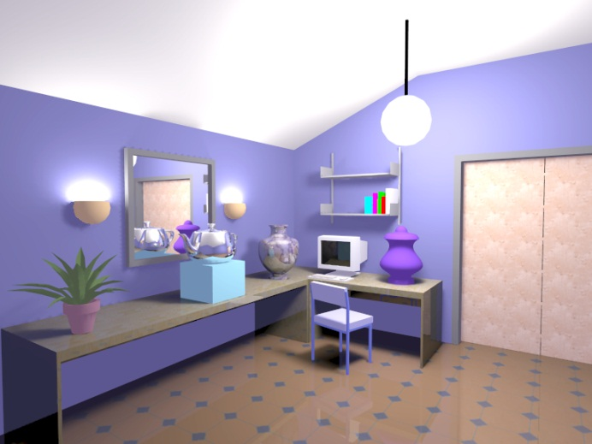
What is Computer Graphics ?
modeling
rendering
animation
Notes:
More academic. Today is the most related to industry.
I am not an expert, it is just my understaning to vfx

Slide 5
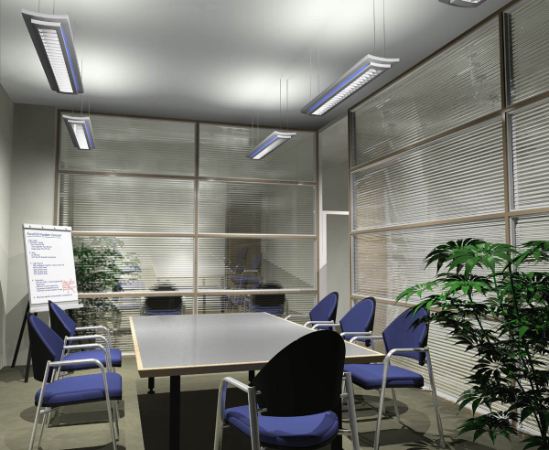
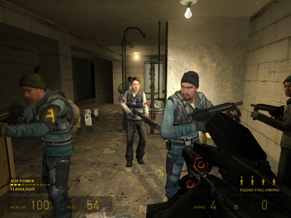
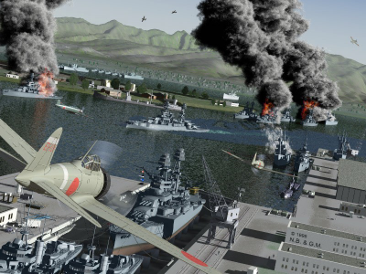
Applications
Movies
Interactive entertainment
Industrial design
Architecture
Culture heritage

Slide 6
The Graphics Process
Lighting
Information
3D Geometric Models
Image Storage & Display
Rendering
3D Animation Definition
Texture
Information

Slide 7
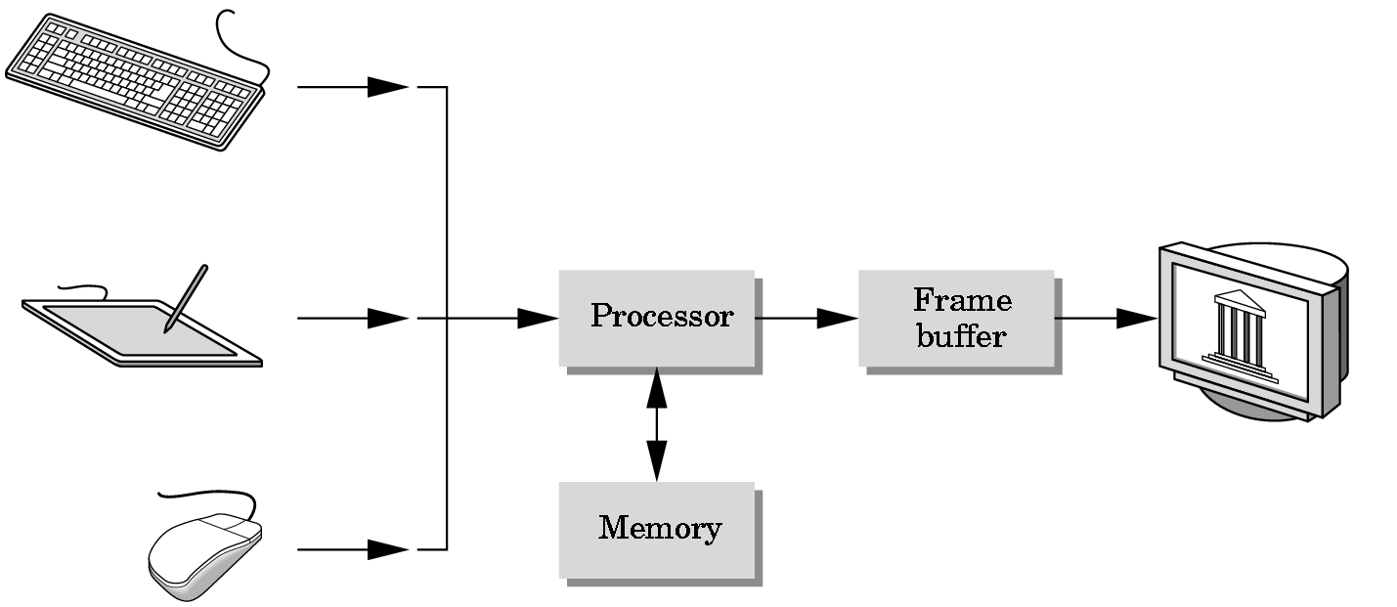
Basic Graphics System
Output device
Input devices
Image formed in FB

Slide 8
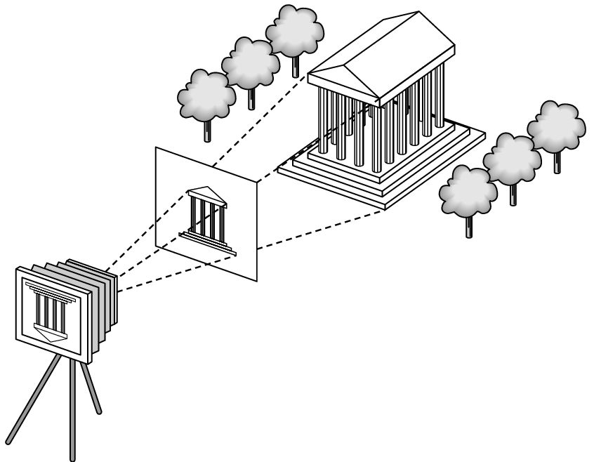
Synthetic Camera Model
view frustrum/view volume
objects/models
projector
lighting
p
image plane/view plane
projection of p
camera

Slide 9
Elements of Image Formation
Objects
Viewer
Light source(s)
Attributes that govern how light interacts with the materials in the scene
Note the independence of the objects, viewer, and light source(s)

Slide 10
Light
Light is the part of the electromagnetic spectrum that causes a reaction in our visual systems
Generally these are wavelengths in the range of about 350-750 nm (nanometers)
Long wavelengths appear as reds and short wavelengths as blues

Slide 11
Luminance and Color Images
Luminance
Monochromatic
Values are gray levels
Analogous to working with black and white film or television
Color
Has perceptional attributes of hue, saturation, and lightness
Do we have to match every frequency in visible spectrum? No!

Slide 12
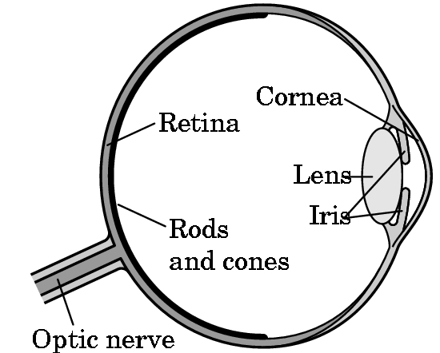
Three-Color Theory
Human visual system has two types of sensors
Rods: monochromatic, night vision
Cones
Color sensitive
Three types of cone
Only three values (the tristimulus
values) are sent to the brain
Need only match these three values
Need only three primary colors

Slide 13
Additive and Subtractive Color
Additive color
Form a color by adding amounts of three primaries
CRTs, projection systems, positive film
Primaries are Red (R), Green (G), Blue (B)
Subtractive color
Form a color by filtering white light with Cyan (C), Magenta (M), and Yellow (Y) filters
Light-material interactions
Printing
Negative film

Slide 14
The RGB Color Model – for CRT
Blue=(0,0,1)
Cyan=(0,1,1)
Magenta=(1,0,1)
White=(1,1,1)
Green=(0,1,0)
Black=(0,0,0)
Red=(1,0,0)
Yellow=(1,1,0)

Slide 15
Color Depth
Can choose number of bits for each of r, g and b
More bits per component means more colors can be distinguished, but image files will be larger
8 bits (1 byte) per component: 24-bit color, millions of colors
If r = g = b, color is a shade of gray, so grayscale can be represented by a single value
8 bits permits 256 grays

Slide 16
The CMY Color Model – for hardcopy
Yellow=(1,1,0)
Red=(1,0,0)
Green=(0,1,0)
Black=(0,0,0)
Magenta=(1,0,1)
White=(1,1,1)
Cyan=(0,1,1)
Blue=(0,0,1)

Slide 17
Undercolor Removal: CMYK System
Real inks do not correspond to ideal subtractive primaries
Combining three inks for black is undesirable
Printers use four process colors, cyan, magenta, yellow and black
CMYK gamut is not the same as RGB
Implications for using images prepared for print (CMYK) on the Web (RGB)

Slide 18
The CMYK Color Model – for hardcopy
C = G+B = W-R
M = R+B = W-G
Y = R+G = W-B
K = min(C,M,Y)
C C-K
M M-K
Y Y-K

Slide 19
The HSV Color Model – for user-oriented
Alternative way of specifying color
Hue (roughly, dominant wavelength)
Saturation (purity)
Value (brightness)
Model HSV as a cylinder: H angle, S distance from axis, V distance along axis
Basis of popular style of color picker

Slide 20
The HSV Color Model – for user-oriented
H : hue
S : saturation
V : value
(or B for blight)
Green
V
Yellow
120°
1.0
Cyan
White
0°
Red
240°
Blue
Magenta
0.0
H
S
Black

Slide 21
Color Models in Video
Largely derive from older analog methods of coding color for TV. Luminance is separated from color information.
YIQ is used to transmit TV signals in North America and Japan. This coding also makes its way into VHS video tape coding in these countries since video tape technologies also use YIQ.
In Europe, video tape uses the PAL or SECAM codings, which are based on TV that uses a matrix transform called YUV.
Digital video mostly uses a matrix transform called YC_{b}C_{r} that is closely related to YUV.

Slide 22
The YUV Color Model – for PAL video
Can be useful to separate brightness and color information, especially for video.
Y is for luminance and U and V are for chrominance which are stored as two color difference values B-Y and R-Y.

Slide 23
The YUV Color Model – for PAL video
For dealing with composite video, it turns out to be convenient to contain U and V within the range −1/3 to +4/3. So U and V are rescaled:
The chrominance signal = the composite signal C:

Slide 24
The YIQ Color Model – for NTSC color-TV
Y : luminance
I and Q : chromaticity (rotated version of U and V)

Slide 25
The YC_{b}C_{r} Color Model – for digital video
scaled to [0-255]

Slide 26
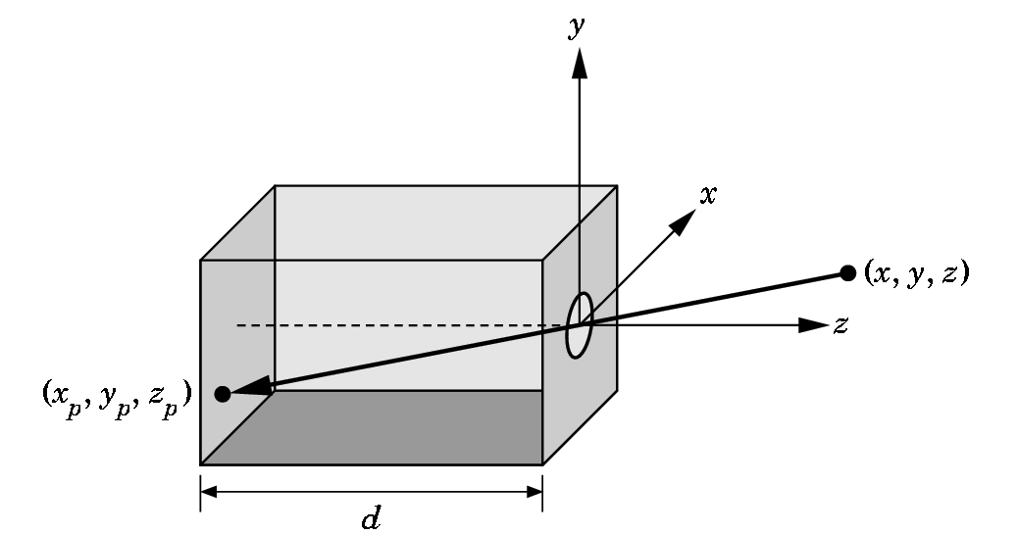
Pinhole Camera
Use trigonometry to find projection of a point
These are equations of simple perspective
x_{p}= -x/z/d
y_{p}= -y/z/d
z_{p}= d

Slide 27
Basics of Rendering
Pipeline Based Rendering
Objects in the scene are rendered in a sequence of steps that form the Rendering Pipeline.
Ray-Tracing
A series of rays are projected thru the view plane and the view plane is colored based on the object that the ray strikes

Slide 28
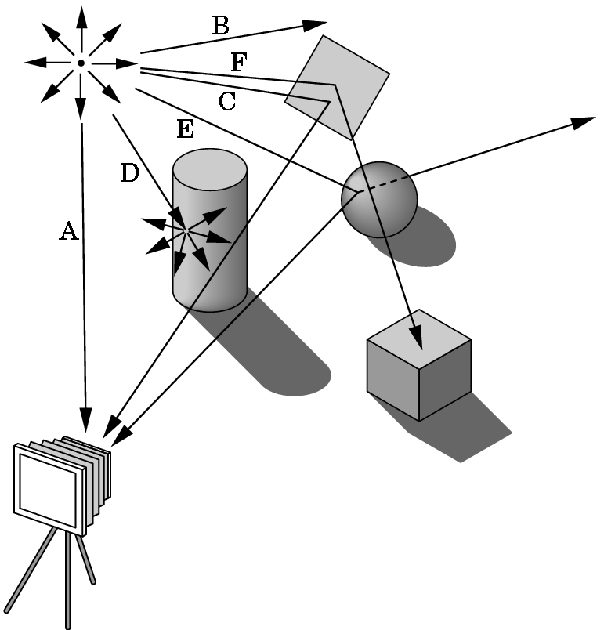
Ray Tracing and Geometric Optics
One way to form an image is to follow rays of light from a point source determine which rays enter the lens of the camera. However, each ray of light may have multiple interactions with objects before being absorbed or going to infinity.

Slide 29
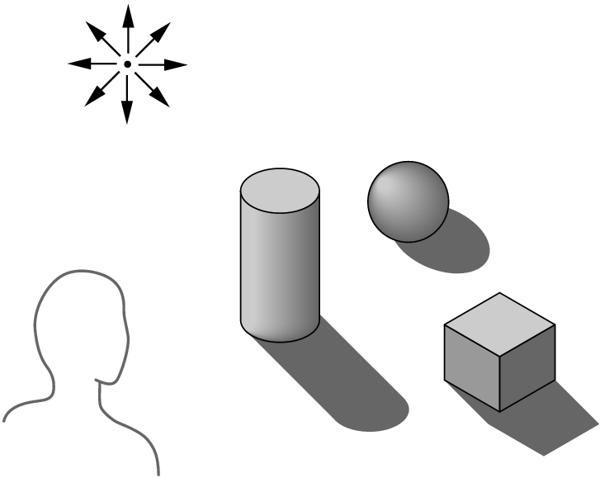
Global vs. Local Lighting
Cannot compute color or shade of each object independently
Some objects are blocked from light
Light can reflect from object to object
Some objects might be translucent

Slide 30
Why not ray tracing?
Ray tracing seems more physically based so why don’t we use it to design a graphics system?
Possible and is actually simple for simple objects such as polygons and quadrics with simple point sources
In principle, can produce global lighting effects such as shadows and multiple reflections but is slow and not well-suited for interactive applications

Slide 31
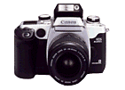
Pipeline Rendering
Transform
Illuminate
Transform
Clip
Project
Rasterize
Model & Camera Parameters
Rendering Pipeline
Framebuffer
Display

Slide 32
Architecture of a Raster Display
Interface with host computer
(Display commands)
(Interaction data)
Display controller (DC)
Keyboard
Mouse
0000000000000000000000000
0000000000000000000111000
0000000000000000011100000
0000000000000000001100000
0000000000000000000011000
0000000000001110000000000
0000000011111111111000000
0001111111111111111111110
0001111111000000011111110
0001111111111111111111110
0001111111000000011111110
0001111111000000011111110
0001111111000000011111110
0001111111000000011111110
0001111111111111111111110
0000000000000000000000000
Video controller
Refresh buffer

Slide 33
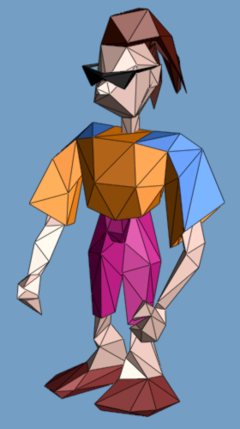
Definitions of Triangle Meshes
{f₁} : { v₁ , v₂ , v₃ } {f₂} : { v₃ , v₂ , v₄ } …
connectivity
{v₁} : (x,y,z) {v₂} : (x,y,z) …
geometry
{f₁} : “skin material” {f₂} : “brown hair” …
face attributes
[Hoppe 99’]
Notes:
In computer graphics, geometric models are commonly represented as triangle meshes.
As shown here, a mesh consists of a set of triangular faces pasted together along their edges and meeting at a common set of vertices.
In a traditional representation, a mesh is represented as a set of vertices containing xyz coordinates, and a set of faces containing indices referring back to the vertices.
Besides geometry, other appearance attributes are often present in a mesh, such as vertex normals, vertex colors, material attributes, and texture maps. These appearance attributes are also associated with the vertices and faces of the mesh.

Slide 34
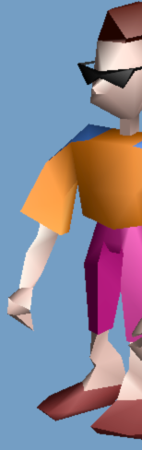
Definitions of Triangle Meshes
{f₁} : { v₁ , v₂ , v₃ } {f₂} : { v₃ , v₂ , v₄ } …
connectivity
{v₁} : (x,y,z) {v₂} : (x,y,z) …
geometry
{f₁} : “skin material” {f₂} : “brown hair” …
face attributes
{v₂,f₁} : (n_{x},n_{y},n_{z}) (u,v) {v₂,f₂} : (n_{x},n_{y},n_{z}) (u,v) …
corner attributes
[Hoppe 99’]

Slide 35
Definitions of Triangle Meshes
vertex
face
boundary
corner
wedge
edge
different normal vectors
(corner attributes)
different material properties
(face attributes)
Notes:
A geometric 3D model is usually represented as triangular meshes. If either an edge is a boundary edge, or its adjacent vertices have different normal vectors, or its two adjacent faces have different material properties, this edge is called a sharp edge, like the blue lines in this figure.
３次元モデルは通常三角形メッシュにより表現されています。[ENTER]もし、あるエッジが境界エッジであるか、[ENTER]このエッジに隣接する２つの頂点が異なる法線ベクトルをもつか、あるいは[ENTER]このエッジに隣接する２つの面が異なる材質属性をもつならば、[ENTER]そのエッジはシャープエッジと定義します。例えば、画面上の青い線です。[ENTER]

Slide 36
Rendering: Transformations
So far, discussion has been in screen space
But model is stored in model space (a.k.a. object space or world space)
Three sets of geometric transformations:
Modeling transforms
Viewing transforms
Projection transforms

Slide 37
The Rendering Pipeline
Scene graph Object geometry
Modeling Transforms
Lighting Calculations
Viewing Transform
Clipping
Projection Transform
Rasterization

Slide 38
Rendering Pipeline for z-buffer & Gouraud shading
db traversal
Modeling transformation
Trivial accept / reject
Lighting
Viewing transformation
Clipping
Divide by W, map to 3D viewport
Rasterization
Display

Slide 39
APPENDIX:
History of Computer Graphics

Slide 40
Computer Graphics: 1950-1960
Computer graphics goes back to the earliest days of computing
Strip charts
Pen plotters
Simple displays using A/D converters to go from computer to calligraphic CRT
Cost of refresh for CRT too high
Computers slow, expensive, unreliable

Slide 41
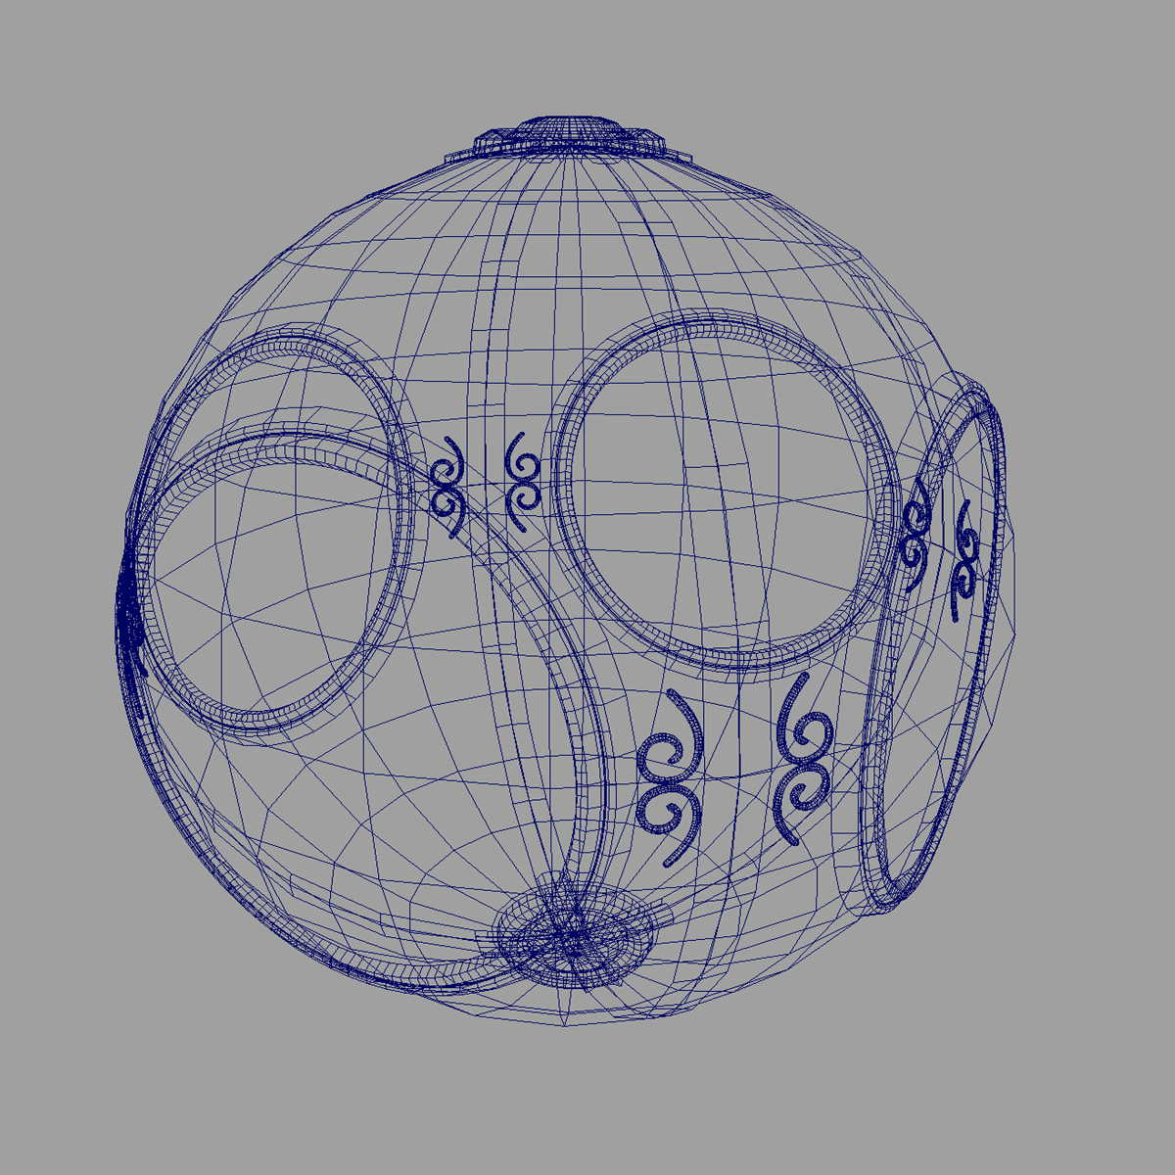
Computer Graphics: 1960-1970
Wireframe graphics
Project Sketchpad
Display Processors
Storage tube

Slide 42
Project Sketchpad
Ivan Sutherland’s PhD thesis at MIT
Recognized the potential of man-machine interaction
Loop
Display something
User moves light pen
Computer generates new display
Sutherland also created many of the now common algorithms for computer graphics

Slide 43
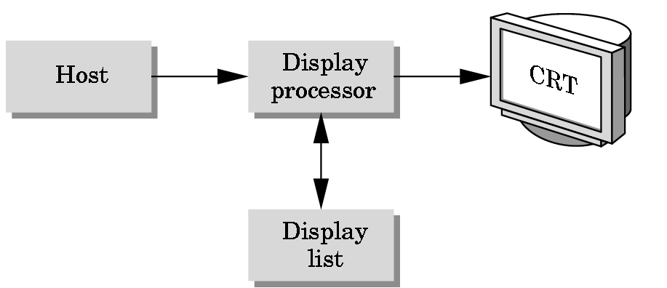
Display Processor
Rather than have host computer try to refresh display use a special purpose computer called a display processor (DPU)
Graphics stored in display list (display file) on display processor
Host compiles display list and sends to DPU

Slide 44
Direct View Storage Tube
Created by Tektronix
Did not require constant refresh
Standard interface to computers
Allowed for standard software
Plot3D in Fortran
Relatively inexpensive
Opened door to use of computer graphics for CAD community

Slide 45
Computer Graphics: 1970-1980
Raster Graphics
Beginning of graphics standards
IFIPS
GKS: European effort
Becomes ISO 2D standard
Core: North American effort
3D but fails to become ISO standard
Workstations and PCs

Slide 46
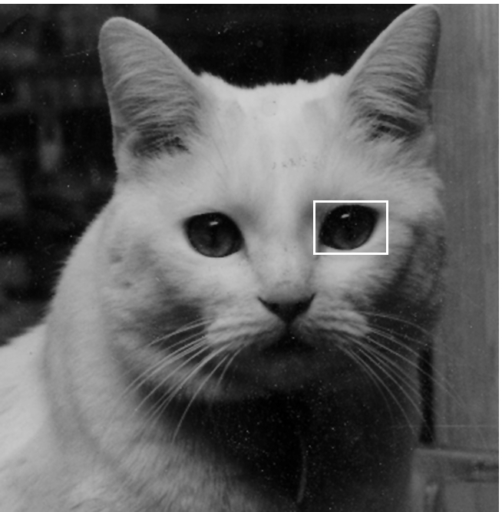
Raster Graphics
Image produced as an array (the raster) of picture elements (pixels) in the frame buffer

Slide 47
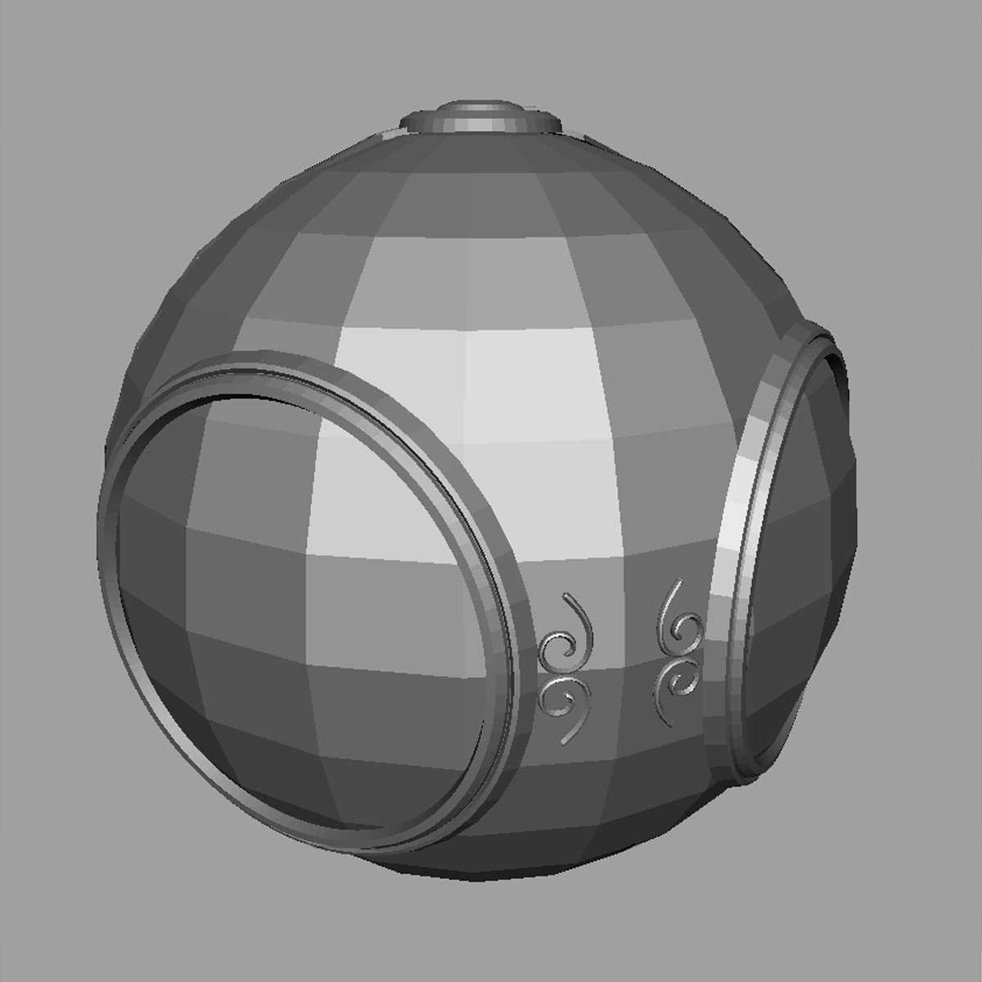
Raster Graphics
Allow us to go from lines and wireframes to filled polygons

Slide 48
PCs and Workstations
Although we no longer make the distinction between workstations and PCs historically they evolved from different roots
Early workstations characterized by
Networked connection: client-server
High-level of interactivity
Early PCs included frame buffer as part of user memory

Slide 49
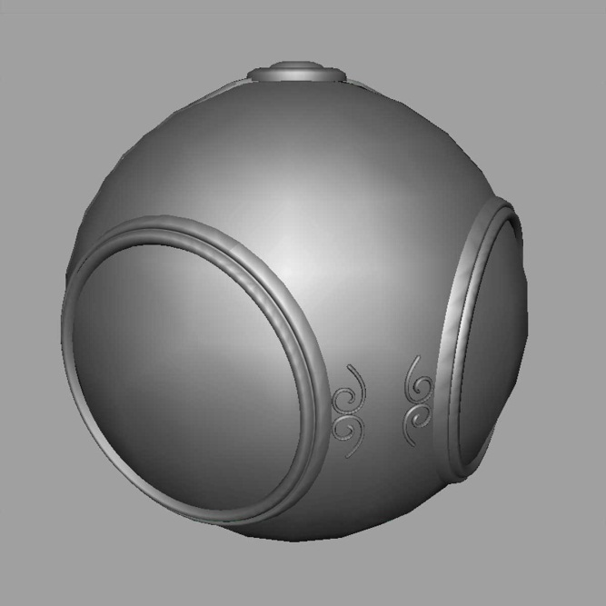
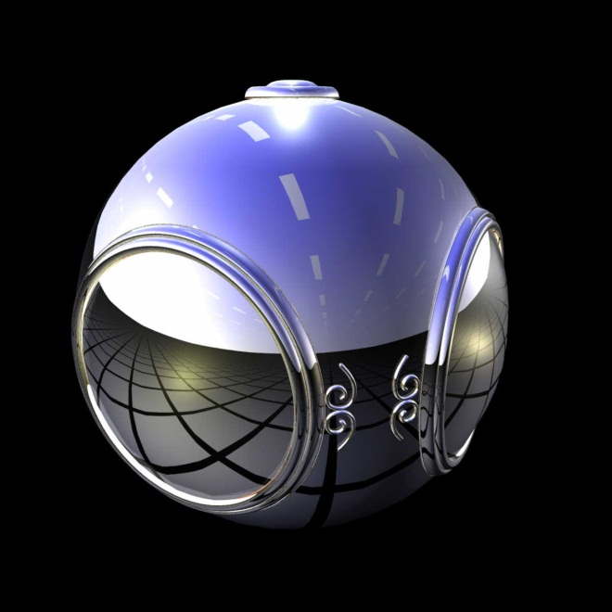
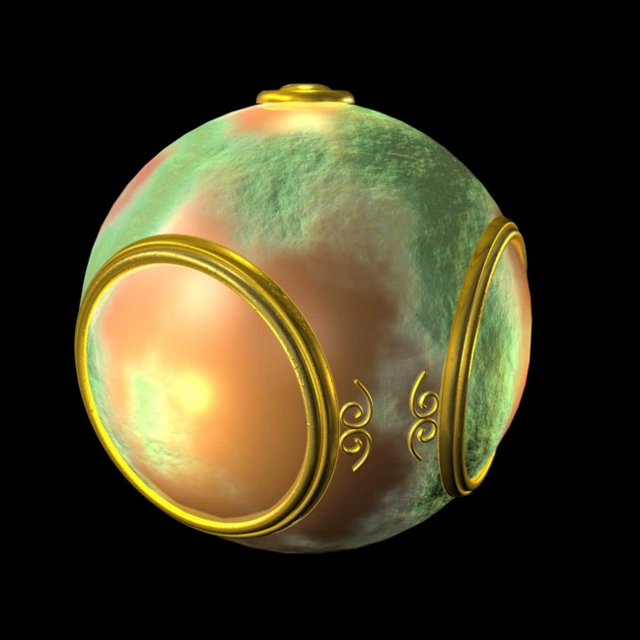
Computer Graphics: 1980-1990
Realism comes to computer graphics
smooth shading
environmental
mapping
bump mapping

Slide 50
Computer Graphics: 1980-1990
Special purpose hardware
Silicon Graphics geometry engine
VLSI implementation of graphics pipline
Industry-based standards
PHIGS
RenderMan
Networked graphics: X Window System
Human-Computer Interface (HCI)

Slide 51
Computer Graphics: 1990-2000
OpenGL API
Completely computer-generated feature-length movies (Toy Story) are successful
New hardware capabilities
Texture mapping
Blending
Accumulation, stencil buffer

Slide 52
Computer Graphics: 2000-
Photorealism
Graphics cards for PCs dominate market
Nvidia, ATI, 3DLabs
Game boxes and game players determine direction of market
Computer graphics routine in movie industry: Maya, Lightwave

