Slide 1
Computer Graphics
Bing-Yu Chen National Taiwan University

Slide 2
Geometrical Transformations
Mathematical Preliminaries
2D Transformations
Homogeneous Coordinates
3D Transformations
Quaternions

Slide 3
Vectors
A vector is an entity that possesses magnitude and direction.
A ray (directed line segment), that possesses position, magnitude, and direction.

Slide 4
Vectors
an n-tuple of real numbers (scalars)
two operations: addition & multiplication
Commutative Laws
a + b = b + a
a • b = b • a
Identities
a + 0 = a
a • 1 = a
Associative Laws
(a + b) + c = a + (b + c)
(a • b) • c = a • (b • c)
Distributive Laws
a • (b + c) = a • b + a • c
(a + b) • c = a • c + b • c
Inverse
a + b = 0 b = -a

Slide 5
Addition of Vectors
parallelogram rule

Slide 6
The Vector Dot Product
length =

Slide 7
Properties of the Dot Product
symmetric
nondegenerate
only when
bilinear
unit vector (normalizing)
angle between the vectors

Slide 8
Projection

Slide 9
Cross Product of Vectors
Definition
where are standard unit vectors
Application
A normal vector to a polygon is calculated from 3 (non-collinear) vertices of the polygon.

Slide 10
Matrices
matrix multiplication
identity matrix
determinant
cross product
matrix transpose
matrix inverse

Slide 11
Matrix Basics
Definition
Transpose
Addition

Slide 12
Matrix Basics
Scalar-matrix multiplication
Matrix-matrix multiplication
Matrix multiplication are not commutative

Slide 13
General Transformations
A transformation maps points to other points and/or vectors to other vectors

Slide 14
Pipeline Implementation
(from application program)
frame
buffer
transformation
rasterizer
vertices
vertices
pixels

Slide 15
Representation
We can represent a point, in the plane
as a column vector
as a row vector

Slide 16
2D Transformations
2D Translation
2D Scaling
2D Reflection
2D Shearing
2D Rotation

Slide 17
Translation
Move (translate, displace) a point to a new location
Displacement determined by a vector d
Three degrees of freedom
P’=P+d
P’
d
P

Slide 18
2D Translation
y
y
(4,5)
(7,5)
(7,1)
(10,1)
x
x

Slide 19
2D Scaling
y
y
(4,5)
(7,5)
(7/2,5/4)
x
x
(2,5/4)

Slide 20
2D Reflection
y
y
(4,5)
(7,5)
(-7,5)
(-4,5)
x
x

Slide 21
2D Shearing
y
y
(4,5)
(7,5)
(9,5)
(12,5)
x
x

Slide 22
2D Rotation
y
y
(4.9,7.8)
(4,5)
(7,5)
(2.1,4.9)
x
x

Slide 23
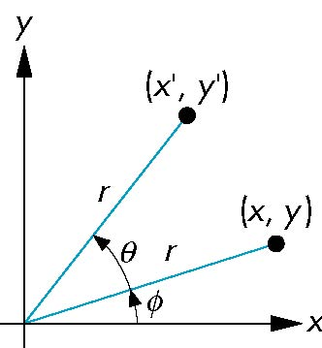
2D Rotation
Consider rotation about the origin by θ degrees
radius stays the same, angle increases by θ
x’ = r cos (φ + θ)
y’ = r sin (φ + θ)
x’=x cos θ –y sin θ
y’ = x sin θ + y cos θ
x = r cos φ
y = r sin φ

Slide 24
Limitations of a 2X2 matrix
Scaling
Rotation
Reflection
Shearing
What do we miss?

Slide 25
Homogeneous Coordinates
Why & What is homogeneous coordinates ?
if points are expressed in homogeneous coordinates, all transformations can be treated as multiplications.
usually 1
can not be 0

Slide 26
Homogeneous Coordinates
W
P
X
W=1 plane
Y

Slide 27
Homogeneous Coordinates for 2D Translation

Slide 28
Homogeneous Coordinates for 2D Translation

Slide 29
Homogeneous Coordinates for 2D Scaling

Slide 30
Homogeneous Coordinates for 2D Rotation

Slide 31
Properties of Transformations
rigid-body transformations
rotation & translation
preserving angles and lengths
affine transformations
rotation & translation & scaling
preserving parallelism of lines

Slide 32
Composition of 2D Transformations
y
y
y
y
P₁
P₁
x
x
x
x
Original
After translation of P₁ to origin
After rotation
After translation to original P₁

Slide 33
Composition of 2D Transformations

Slide 34
The Window-to-Viewport Transformation
Maximum range of screen coordinates
Viewport 2
Window
Viewport 1
World coordinates
Screen coordinates

Slide 35
The Window-to-Viewport Transformation
Maximum range of screen coordinates
y
y
v
v
(x_{max},y_{max})
(u_{max},v_{max})
(x_{min},y_{min})
(u_{min},v_{min})
x
x
u
u
Window in world coordinates
Translated to origin
Scaled to size of viewport
Translated to final position

Slide 36
Right-handed Coordinate System

Slide 37
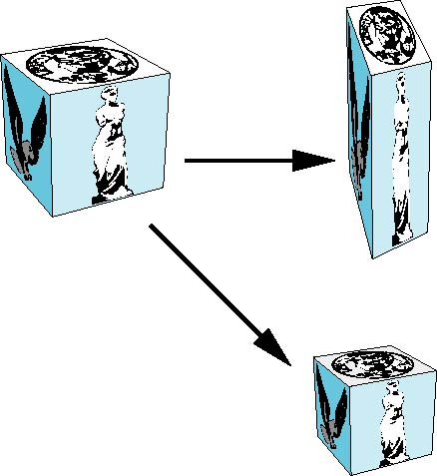
3D Translation & 3D Scaling

Slide 38
3D Reflection & 3D Shearing

Slide 39
3D Rotations

Slide 40
Rotation About a Fixed Point other than the Origin
Move fixed point to origin
Rotate
Move fixed point back

Slide 41
Rotation About an Arbitrary Axis
A rotation by about an arbitrary axis can be decomposed into the concatenation of rotations about the , , and axes
, , are called the Euler angles
Note that rotations do not commute
We can use rotations in another order but with different angles.

Slide 42
Euler Angles
An Euler angle is a rotation about a single axis.
A rotation is described as a sequence of rotations about three mutually orthogonal coordinates axes fixed in space
X-roll, Y-roll, Z-roll
There are 6 possible ways to define a rotation.
3!

Slide 43
Euler Angles & Interpolation
Interpolation happening on each angle
Multiple routes for interpolation
More keys for constrains
R
z
z
y
y
x
x
R

Slide 44
Interpolating Euler Angles
Natural orientation representation:
3 angles for 3 degrees of freedom
Unnatural interpolation:
A rotation of 90º first around Z and then around Y = 120º around (1, 1, 1).
But 30º around Z then Y differs from 40º around (1, 1, 1).
b
a
a
b
a
b
=
a
c
a
c
c
c
b
c
b
b
b
b
a
a
a
c
c
c

Slide 45
Smooth Rotation
From a practical standpoint, we are often want to use transformations to move and reorient an object smoothly
Problem: find a sequence of model-view matrices , ,…, so that when they are applied successively to one or more objects we see a smooth transition
For orientating an object, we can use the fact that every rotation corresponds to part of a great circle on a sphere
Find the axis of rotation and angle
Virtual trackball

Slide 46
Incremental Rotation
Consider the two approaches
For a sequence of rotation matrices , ,…, , find the Euler angles for each and use
Not very efficient
Use the final positions to determine the axis and angle of rotation, then increment only the angle
Quaternions can be more efficient than either

Slide 47
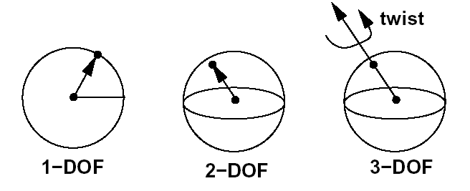
Solution: Quaternion Interpolation
Interpolate orientation on the unit sphere
By analogy: 1-, 2-, 3-DOF rotations as constrained points on 1-, 2-, 3-spheres

Slide 48
1D-Sphere and Complex Plane
Interpolate orientation in 2D
1 angle
but messy because modulo
Use interpolation in (complex) 2D plane
Orientation = complex argument of the number

Slide 49
Quaternions
Quaternions are unit vectors on 3-sphere (in 4D)
Right-hand rotation of radians about is
often noted
Requires one real and three imaginary components , ,
where
is called scalar and is called vector

Slide 50
Quaternions
Extension of imaginary numbers from 2 to 3 dimensions
Requires one real and three imaginary components , ,
where
is called scalar and is called vector
Quaternions can express rotations on sphere smoothly and efficiently. Process:
Model-view matrix → Quaternion
Carry out operations with Quaternions
Quaternion → Model-view matrix

Slide 51
Basic Operations Using Quaternions
Addition
Multiplication
Conjugate
Length
Norm
Inverse
Unit Quaternion
is a unit quaternion if and then
Identity
[1, (0, 0, 0)] (when involving multiplication)
[0, (0, 0, 0)] (when involving addition)

Slide 52
Angle and Axis & Eular Angles
Angle and Axis
Eular Angles

Slide 53
Matrix-to-Quaternion Conversion
MatToQuat (float m[4][4], QUAT * quat) {
float tr, s, q[4];
int i, j, k;
int nxt[3] = {1, 2, 0};
tr = m[0][0] + m[1][1] + m[2][2];
if (tr > 0.0) {
s = sqrt (tr + 1.0);
quat->w = s / 2.0;
s = 0.5 / s;
quat->x = (m[1][2] - m[2][1]) * s;
quat->y = (m[2][0] - m[0][2]) * s;
quat->z = (m[0][1] - m[1][0]) * s;
} else {
i = 0;
if (m[1][1] > m[0][0]) i = 1;
if (m[2][2] > m[i][i]) i = 2;
j = nxt[i];
k = nxt[j];
s = sqrt ((m[i][i] - (m[j][j] + m[k][k])) + 1.0);
q[i] = s * 0.5;
if (s != 0.0) s = 0.5 / s;
q[3] = (m[j][k] - m[k][j]) * s;
q[j] = (m[i][j] + m[j][i]) * s;
q[k] = (m[i][k] + m[k][i]) * s;
quat->x = q[0];
quat->y = q[1];
quat->z = q[2];
quat->w = q[3];
}
}

Slide 54
Quaternion-to-Matrix Conversion
QuatToMatrix (QUAT * quat, float m[4][4]) {
float wx, wy, wz, xx, yy, yz, xy, xz, zz, x2, y2, z2;
x2 = quat->x + quat->x; y2 = quat->y + quat->y;
z2 = quat->z + quat->z;
xx = quat->x * x2; xy = quat->x * y2; xz = quat->x * z2;
yy = quat->y * y2; yz = quat->y * z2; zz = quat->z * z2;
wx = quat->w * x2; wy = quat->w * y2; wz = quat->w * z2;
m[0][0] = 1.0 - (yy + zz); m[1][0] = xy - wz;
m[2][0] = xz + wy; m[3][0] = 0.0;
m[0][1] = xy + wz; m[1][1] = 1.0 - (xx + zz);
m[2][1] = yz - wx; m[3][1] = 0.0;
m[0][2] = xz - wy; m[1][2] = yz + wx;
m[2][2] = 1.0 - (xx + yy); m[3][2] = 0.0;
m[0][3] = 0; m[1][3] = 0;
m[2][3] = 0; m[3][3] = 1;
}

Slide 55
SLERP-Spherical Linear intERPolation
Interpolate between two quaternion rotations along the shortest arc.
where
If two orientations are too close, use linear interpolation to avoid any divisions by zero.

