Slide 1
Computer Graphics
Bing-Yu Chen National Taiwan University

Slide 2
Viewing in 3D
3D Viewing Process
Classical Viewing and Projections
3D Synthetic Camera Model
Parallel Projection
Perspective Projection
3D Clipping for Canonical View Volume

Slide 3
3D Viewing Process
Clip against view volume
Project onto projection plane
Transform into viewport in 2D device coordinates for display
3D world-coordinate output primitives
Clipped world coordinates
2D device coordinates

Slide 4
Classical Viewing
Viewing requires three basic elements
One or more objects
A viewer with a projection surface
Projectors that go from the object(s) to the projection surface
Classical views are based on the relationship among these elements
The viewer picks up the object and orients it how she would like to see it
Each object is assumed to constructed from flat principal faces
Buildings, polyhedra, manufactured objects

Slide 5
Planar Geometric Projections
Standard projections project onto a plane
Projectors are lines that either
converge at a center of projection are parallel
Such projections preserve lines
but not necessarily angles
Nonplanar projections are needed for applications such as map construction

Slide 6
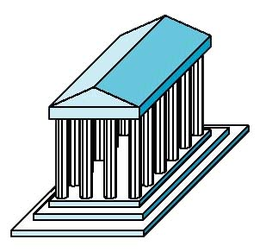
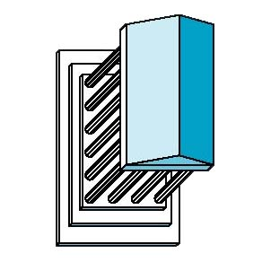
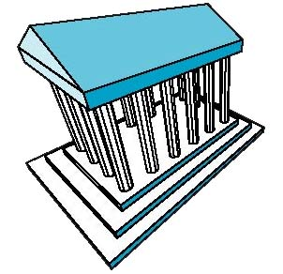
Classical Projections
Front elevation
Elevation oblique
Plan oblique
Isometric
One-point perspective
Three-point perspective

Slide 7
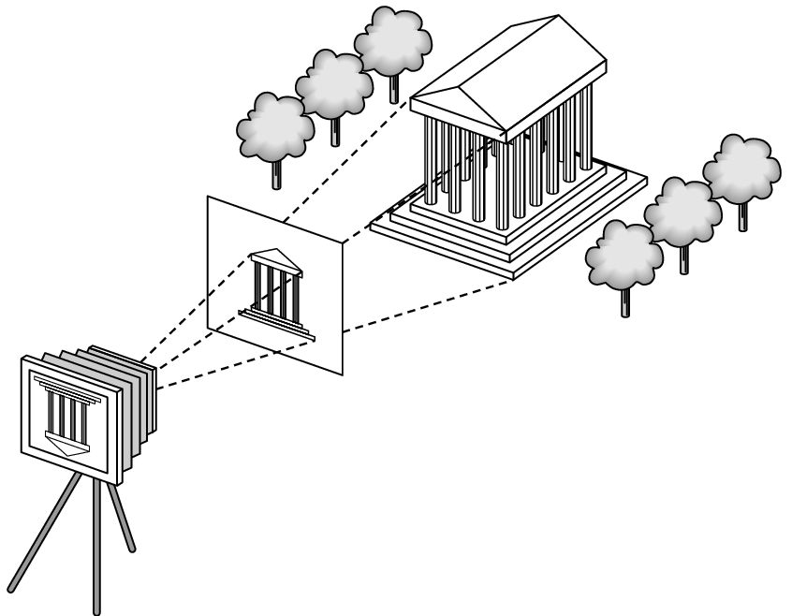
3D Synthetic Camera Model
The synthetic camera model involves two components, specified independently:
objects (a.k.a geometry)
viewer (a.k.a camera)

Slide 8
Imaging with the Synthetic Camera
projector
P
image plane
projection of P
center of projection
The image is rendered onto an image plane or project plane (usually in front of the camera).
Projectors emanate from the center of projection (COP) at the center of the lens (or pinhole).
The image of an object point P is at the intersection of the projector through P and the image plane.

Slide 9
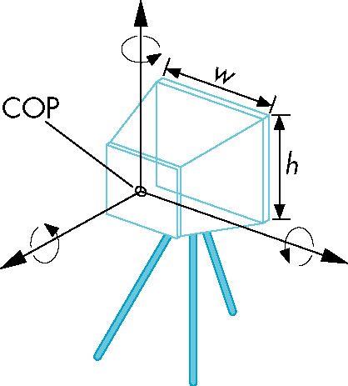
Specifying a Viewer
Camera specification requires four kinds of parameters:
Position: the COP.
Orientation: rotations about axes with origin at the COP.
Focal length: determines the size of the image on the film plane, or the field of view.
Film plane: its width and height, and possibly orientation.

Slide 10
Projections
Projections transform points in n-space to m-space, where m < n.
In 3D, we map points from 3-space to the projection plane (PP) along projectors emanating from the center of projection (COP).
There are two basic type of projections:
Perspective – distance from COP to PP finite
Parallel – distance from COP to PP infinite
PP
COP

Slide 11
Perspective vs. Parallel Projections
Computer graphics treats all projections the same and implements them with a single pipeline
Classical viewing developed different techniques for drawing each type of projection
Fundamental distinction is between parallel and perspective viewing even though mathematically parallel viewing is the limit of perspective viewing

Slide 12
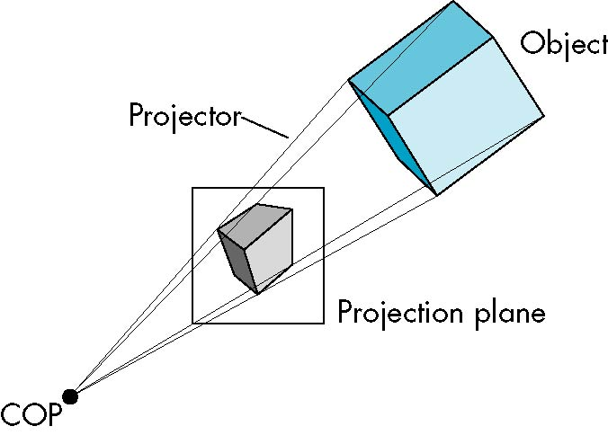
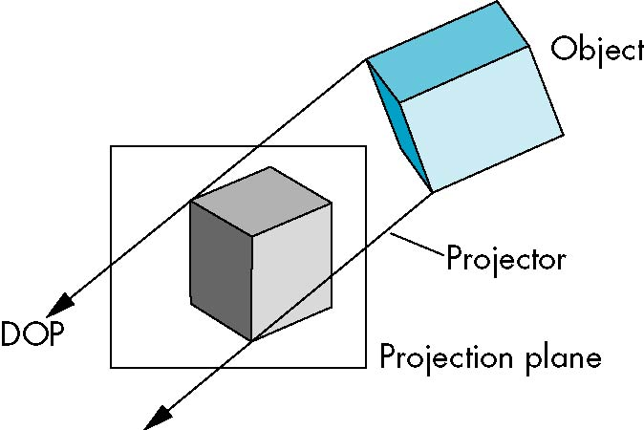
Perspective vs. Parallel Projections

Slide 13
Taxonomy of Planar Geometric Projections
planar geometric projections
parallel
perspective
1 point
2 point
3 point
multiview
orthographic
axonometric
oblique
isometric
dimetric
trimetric

Slide 14
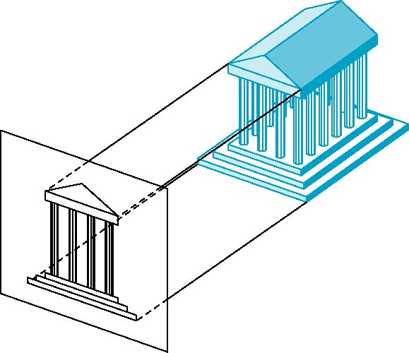
Orthographic Projection
Projectors are orthogonal to projection surface

Slide 15
Multiview Orthographic Projection
Projection plane parallel to principal face
Usually form front, top, side views
isometric (not multiview
orthographic view)
front
in CAD and architecture,
we often display three
multiviews plus isometric
side
top

Slide 16
Advantages and Disadvantages
Preserves both distances and angles
Shapes preserved
Can be used for measurements
Building plans
Manuals
Cannot see what object really looks like because many surfaces hidden from view
Often we add the isometric

Slide 17
Axonometric Projections
Allow projection plane to move relative to object
classify by how many angles of
a corner of a projected cube are
the same
none: trimetric
two: dimetric
three: isometric
θ ₁
θ ₂
θ ₃

Slide 18
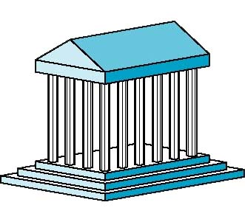
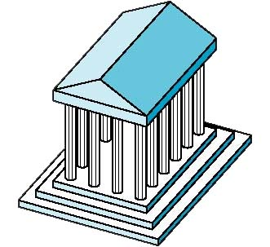
Types of Axonometric Projections
Dimetric
Trimetric
Isometric

Slide 19
Advantages and Disadvantages
Lines are scaled (foreshortened) but can find scaling factors
Lines preserved but angles are not
Projection of a circle in a plane not parallel to the projection plane is an ellipse
Can see three principal faces of a box-like object
Some optical illusions possible
Parallel lines appear to diverge
Does not look real because far objects are scaled the same as near objects
Used in CAD applications

Slide 20
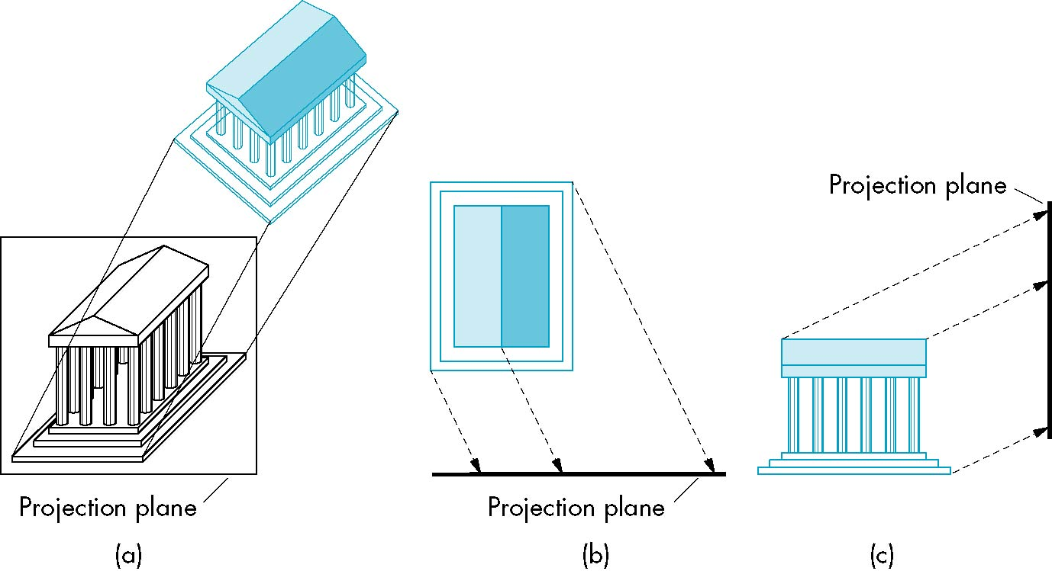
Oblique Projection
Arbitrary relationship between projectors and projection plane

Slide 21
Advantages and Disadvantages
Can pick the angles to emphasize a particular face
Architecture: plan oblique, elevation oblique
Angles in faces parallel to projection plane are preserved while we can still see “around” side
In physical world, cannot create with simple camera; possible with bellows camera or special lens (architectural)

Slide 22
Specification of an Arbitrary 3D View
v
View plane
VUP
VRP
VPN
u
n
VRP: view reference point
VPN: view-plane normal
VUP: view-up vector

Slide 23
VRC: the viewing-reference coordinate system
v
(u_{max},v_{max})
View plane
(u_{min},v_{min})
CW
VRP
VPN
u
n
CW: center of the window

Slide 24
Infinite Parallelepiped View Volume
DOP
View plane
CW
PRP
VRP
VPN
n
DOP: direction of projection
PRP: projection reference point

Slide 25
Truncated View Volume for an Orthographic Parallel Projection
Back
Clipping
plane
View
plane
Front
Clipping
plane
VRP
VPN
DOP
B
F

Slide 26
The Mathematics of Orthographic Parallel Projection
Projection
plane
x
x_{p}
P(x, y, z)
z
View along y axis
View along x axis
z
y_{p}
P(x, y, z)
Projection
plane
y

Slide 27
The Steps of Implementation of Orthographic Parallel Projection
Translate the VRP to the origin
Rotate VRC such that the VPN becomes the z axis
Shear such that the DOP becomes parallel to the z axis
Translate and scale into the parallel-projection canonical view volume

Slide 28
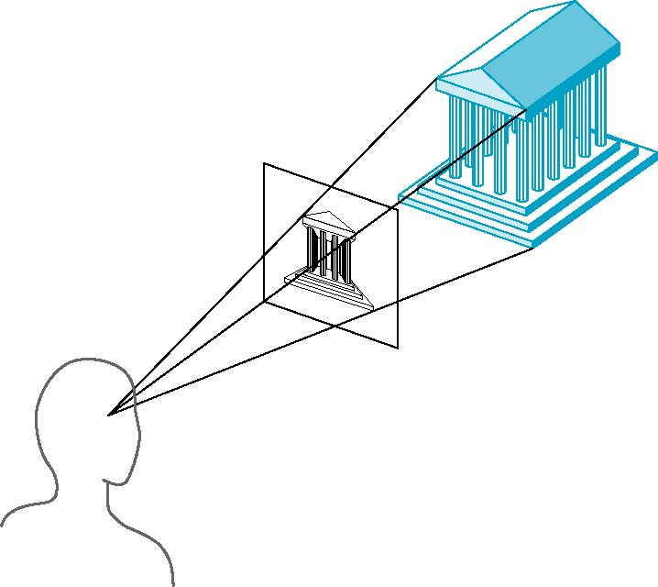
Perspective Projection
Projectors converge at center of projection

Slide 29
Truncated View Volume for an Perspective Projection
Back
Clipping
plane
View
plane
Front
Clipping
plane
VRP
VPN
F
B

Slide 30
Perspective Projection (Pinhole Camera)
Projection
plane
x
P(x, y, z)
x_{p}
z
d
View along y axis
View along x axis
d
z
y_{p}
Projection
plane
P(x, y, z)
y

Slide 31
Perspective Division
However W ≠ 1, so we must divide by W to return from homogeneous coordinates

Slide 32
The Steps of Implementation of Perspective Projection
Translate the VRP to the origin
Rotate VRC such that the VPN becomes the z axis
Translate such that the PRP is at the origin
Shear such that the DOP becomes parallel to the z axis
Scale such that the view volume becomes the canonical perspective view volume

Slide 33
Alternative Perspective Projection
Projection
plane at z=0
P(x, y, z)
x_{p}
z
d
View along y axis
View along x axis
d
z
y_{p}
Projection
plane at z=0
P(x, y, z)
y

Slide 34
Vanishing Points
Parallel lines (not parallel to the projection plan) on the object converge at a single point in the projection (the vanishing point)
Drawing simple perspectives by hand uses these vanishing point(s)
vanishing point

Slide 35
Three-Point Perspective
No principal face parallel to projection plane
Three vanishing points for cube

Slide 36
Two-Point Perspective
On principal direction parallel to projection plane
Two vanishing points for cube

Slide 37
One-Point Perspective
One principal face parallel to projection plane
One vanishing point for cube

Slide 38
Advantages and Disadvantages
Objects further from viewer are projected smaller than the same sized objects closer to the viewer (diminuition)
Looks realistic
Equal distances along a line are not projected into equal distances (nonuniform foreshortening)
Angles preserved only in planes parallel to the projection plane
More difficult to construct by hand than parallel projections (but not more difficult by computer)

Slide 39
Canonical View Volume for Orthographic Parallel Projection
x or y
Back
plane
1
Front
plane
-z
-1
-1
x = -1, y = -1, z = 0
x = 1, y = 1, z = -1

Slide 40
The Extension of the Cohen-Sutherland Algorithm
bit 1 – point is above view volume y > 1
bit 2 – point is below view volume y < -1
bit 3 – point is right of view volume x > 1
bit 4 – point is left of view volume x < -1
bit 5 – point is behind view volume z < -1
bit 6 – point is in front of view volume z > 0

Slide 41
Intersection of a 3D Line
a line from to can be represented as
so when y = 1

Slide 42
Canonical View Volume for Perspective Projection
x or y
Back
plane
1
Front
plane
-z
-1
-1
x = z, y = z, z = -z_{min}
x = -z, y = -z, z = -1

Slide 43
The Extension of the Cohen-Sutherland Algorithm
bit 1 – point is above view volume y > -z
bit 2 – point is below view volume y < z
bit 3 – point is right of view volume x > -z
bit 4 – point is left of view volume x < z
bit 5 – point is behind view volume z < -1
bit 6 – point is in front of view volume z > z_{min}

Slide 44
Intersection of a 3D Line
so when y = z

Slide 45
Clipping in Homogeneous Coordinates
Why clip in homogeneous coordinates ?
it is possible to transform the perspective-projection canonical view volume into the parallel-projection canonical view volume

Slide 46
Clipping in Homogeneous Coordinates
The corresponding plane equations are
X = -W
X = W
Y = -W
Y = W
Z = -W
Z = 0

