Slide 1
Computer Graphics
Bing-Yu Chen National Taiwan University

Slide 2
Geometry
Graph and Meshes
Surface Properties
Bounding Volumes
Level-of-Details

Slide 3
Standard Graph Definitions
G=<V,E>
V=vertices={A,B,C,D,E,F,G,H,I,J,K,L}
E=edges=
{(A,B),(B,C),(C,D),(D,E),(E,F),(F,G),
(G,H),(H,A),(A,J),(A,G),(B,J),(K,F),
(C,L),(C,I),(D,I),(D,F),(F,I),(G,K),
(J,L),(J,K),(K,L),(L,I)}
Vertex degree (valence)=number of edges incident on vertex
Ex. deg(J)=4, deg(H)=2
k-regular graph=graph whose vertices all have degree k
Face: cycle of vertices/edges which cannot be shortened
F=faces=
{(A,H,G),(A,J,K,G),(B,A,J),(B,C,L,J),(C,I,J),(C,D,I),
(D,E,F),(D,I,F),(L,I,F,K),(L,J,K),(K,F,G)}

Slide 4
Meshes
Mesh: straight-line graph embedded in R³
Boundary edge: adjacent to exactly one face
Regular edge: adjacent to exactly two faces
Singular edge: adjacent to more than two faces
Corners ⊆ V x F
Half-edges ⊆ E x F
Closed Mesh: mesh with no boundary edges
Manifold Mesh: mesh with no singular edges

Slide 5
Manifold
Non-Manifold
Closed Manifold
Open Manifold

Slide 6
1-Manifolds
What is 1-manifolds ?
every point on a 1-manifold has some arbitrarily small neighborhood of points around it that can be considered topologically the same as a line

Slide 7
2-Manifolds
What is 2-manifolds ?
every point on a 2-manifold has some arbitrarily small neighborhood of points around it that can be considered topologically the same as a disk in the plane
every edge is shared by exactly two triangles and every triangle shares an edge with exactly three neighboring triangles

Slide 8
1-Manifold & 2-Manifold Examples
1-Manifolds
line
circle
...
2-Manifolds
sphere
torus
cylinder
...

Slide 9
Euler’s Formula
Polyhedron
a solid that is bounded by a set of polygons whose edges are each a member of an even number of polygons
Simple Polyhedron
a polyhedron that can be deformed into a sphere
Euler’s Formula
a simple polyhedron satisfies

Slide 10
Simple Polyhedra Example

Slide 11
Euler’s Formula
states necessary but not sufficient conditions for a simple polyhedron
additional constraints are needed
1 edge must connect 2 vertices
1 edge must be shared by exactly 2 faces
at least 3 edges must meet at 1 vertex
faces must not interpenetrate

Slide 12
Euler’s Formula Applies to 2-Manifolds with Holes
: the number of holes in the faces
: the number of holes that pass through the object
: the number of separate components
if is its genus

Slide 13
Orientability
Orientation of a face is clockwise or anticlockwise order in which its vertices and edges are lists
This defines the direction of face normal
Straight line graph is orientable if orientations of its faces can be chosen so that each edge is oriented in both directions
x
B
A
Oriented F={(L,J,B),(B,C,L),(L,C,I), (I,K,L),(L,K,J)}
Not Oriented
F={(B,J,L),(B,C,L),(L,C,I), (L,I,K),(L,K,J)}
C
D
E
F
H
z
G
Back Face Culling = Front Facing

Slide 14
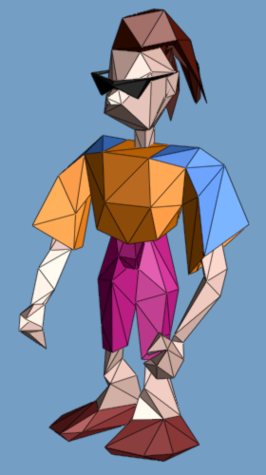
Definitions of Triangle Meshes
{f₁} : { v₁ , v₂ , v₃ } {f₂} : { v₃ , v₂ , v₄ } …
connectivity
{v₁} : (x,y,z) {v₂} : (x,y,z) …
geometry
{f₁} : “skin material” {f₂} : “brown hair” …
face attributes
[Hoppe 99’]
Notes:
In computer graphics, geometric models are commonly represented as triangle meshes.
As shown here, a mesh consists of a set of triangular faces pasted together along their edges and meeting at a common set of vertices.
In a traditional representation, a mesh is represented as a set of vertices containing xyz coordinates, and a set of faces containing indices referring back to the vertices.
Besides geometry, other appearance attributes are often present in a mesh, such as vertex normals, vertex colors, material attributes, and texture maps. These appearance attributes are also associated with the vertices and faces of the mesh.

Slide 15
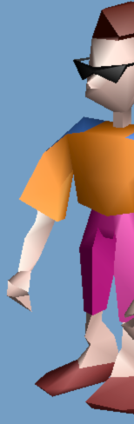
Definitions of Triangle Meshes
{f₁} : { v₁ , v₂ , v₃ } {f₂} : { v₃ , v₂ , v₄ } …
connectivity
{v₁} : (x,y,z) {v₂} : (x,y,z) …
geometry
{f₁} : “skin material” {f₂} : “brown hair” …
face attributes
{v₂,f₁} : (n_{x},n_{y},n_{z}) (u,v) {v₂,f₂} : (n_{x},n_{y},n_{z}) (u,v) …
corner attributes
[Hoppe 99’]

Slide 16
Definitions of Triangle Meshes
vertex
face
boundary
corner
wedge
edge
different normal vectors
(corner attributes)
different material properties
(face attributes)
Notes:
A geometric 3D model is usually represented as triangular meshes. If either an edge is a boundary edge, or its adjacent vertices have different normal vectors, or its two adjacent faces have different material properties, this edge is called a sharp edge, like the blue lines in this figure.
３次元モデルは通常三角形メッシュにより表現されています。[ENTER]もし、あるエッジが境界エッジであるか、[ENTER]このエッジに隣接する２つの頂点が異なる法線ベクトルをもつか、あるいは[ENTER]このエッジに隣接する２つの面が異なる材質属性をもつならば、[ENTER]そのエッジはシャープエッジと定義します。例えば、画面上の青い線です。[ENTER]

Slide 17
Data Structure
Mesh :
Vertex array
Wedge array
Face array
Material array
Vertex :
Vertex attributes
Wedge :
Vertex index
Wedge attributes
Face :
Wedge index x 3
Material index
Material :
Material attributes

Slide 18
Data Structure
Mesh :
Vertex array
Face array
Material array
Vertex :
Vertex attributes
Face :
Vertex index x 3
Material index
Material :
Material attributes

Slide 19
Mesh Data Structures
Uses of mesh data:
Rendering
Geometry queries
What are the vertices of face #3?
Are vertices i and j adjacent?
Which faces are adjacent face #7?
Geometry operations
Remove/add a vertex/face
Mesh simplification
Vertex split, edge collapse
Storage of generic meshes
hard to implement efficiently
Assume: orientable, manifold and triangular

Slide 20
Storing Mesh Data
How “good” is a data structure?
Time to construct – preprocessing
Time to answer a query
Time to perform an operation
update the data structure
Space complexity
Redundancy

Slide 21
1. List of Faces
List of vertices (coordinates)
List of faces
triplets of pointers to face vertices (c₁,c₂,c₃)
Queries:
What are the vertices of face #3?
O(1) – checking the third triplet
Are vertices i and j adjacent?
A pass over all faces is necessary – NOT GOOD

Slide 22
1. List of Faces
Example
v₃
v₆
f₃
f₁
f₂
f₄
v₁
v₄
vertex | coordinate
v₁ | (x₁,y₁,z₁)
v₂ | (x₂,y₂,z₂)
v₃ | (x₃,y₃,z₃)
v₄ | (x₄,y₄,z₄)
v₅ | (x₅,y₅,z₅)
v₆ | (x₆,y₆,z₆)
v₅
v₂
face | vertices (ccw)
f₁ | (v₁,v₂,v₃)
f₂ | (v₂,v₄,v₃)
f₃ | (v₃,v₄,v₆)
f₄ | (v₄,v₅,v₆)

Slide 23
1. List of Faces
Pros:
Convenient and efficient (memory wise)
Can represent non-manifold meshes
Cons:
Too simple – not enough information on relations between vertices and faces

Slide 24
OBJ File Format (simple ver.)
v x y z
vn i j k
f v1 // vn1 v2 // vn2 v3 // vn3

Slide 25
2. Adjacency matrix
View mesh as connected graph
Given n vertices build nxn matrix of adjacency information
Entry (i,j) is TRUE value if vertices i and j are adjacent
Geometric info
list of vertex coordinates
Add faces
list of triplets of vertex indices (v₁,v₂,v₃)

Slide 26
2. Adjacency matrix
Example
v₃
v₆
vertex | coordinate
v₁ | (x₁,y₁,z₁)
v₂ | (x₂,y₂,z₂)
v₃ | (x₃,y₃,z₃)
v₄ | (x₄,y₄,z₄)
v₅ | (x₅,y₅,z₅)
v₆ | (x₆,y₆,z₆)
f₃
f₁
f₂
f₄
v₁
v₄
v₅
v₂
 | v₁ | v₂ | v₃ | v₄ | v₅ | v₆
v₁ |  | 1 | 1
v₂ | 1 |  | 1 | 1
v₃ | 1 | 1 |  | 1 |  | 1
v₄ |  | 1 | 1 |  | 1 | 1
v₅ |  |  |  | 1 |  | 1
v₆ |  |  | 1 | 1 | 1
face | vertices (ccw)
f₁ | (v₁,v₂,v₃)
f₂ | (v₂,v₄,v₃)
f₃ | (v₃,v₄,v₆)
f₄ | (v₄,v₅,v₆)

Slide 27
2. Adjacency matrix
Queries:
What are the vertices of face #3?
O(1) – checking the third triplet of faces
Are vertices i and j adjacent?
O(1) – checking adjacency matrix at location (i,j)
Which faces are adjacent of vertex j?
Full pass on all faces is necessary

Slide 28
2. Adjacency matrix
Pros:
Information on vertices adjacency
Stores non-manifold meshes
Cons:
Connects faces to their vertices, BUT NO connection between vertex and its face

Slide 29
3. DCEL (Doubly-Connected Edge List)
Record for each face, edge and vertex
Geometric information
Topological information
Attribute information
aka Half-Edge Structure

Slide 30
3. DCEL
next(e)
IncFace(e)
prev(e)
e
twin(e)
Vertex record:
Coordinates
Pointer to one half-edge that has v as its origin
Face record:
Pointer to one half-edge on its boundary
Half-edge record:
Pointer to its origin, origin(e)
Pointer to its twin half-edge, twin(e)
Pointer to the face it bounds, IncidentFace(e)
face lies to left of e when traversed from origin to destination
Next and previous edge on boundary of IncidentFace(e)
origin(e)

Slide 31
3. DCEL
Operations supported:
Walk around boundary of given face
Visit all edges incident to vertex v
Queries:
Most queries are O(1)

Slide 32
3. DCEL
v₂
v₅
Example
e_{5,1}
f₂
e_{4,1}
e_{3,1}
e_{3,2}
e_{7,1}
f₃
e_{1,1}
f₁
e_{4,2}
e_{6,1}
v₄
v₁
e_{2,1}
v₃
vertex | coordinate | IncidentEdge
v₁ | (x₁,y₁,z₁) | e_{2,1}
v₂ | (x₂,y₂,z₂) | e_{1,1}
v₃ | (x₃,y₃,z₃) | e_{4,1}
v₄ | (x₄,y₄,z₄) | e_{7,1}
v₅ | (x₅,y₅,z₅) | e_{5,1}
face | edge
f₁ | e_{1,1}
f₂ | e_{3,2}
f₃ | e_{4,2}

Slide 33
3. DCEL
v₂
v₅
Example
e_{5,1}
f₂
e_{4,1}
e_{3,1}
e_{3,2}
e_{7,1}
f₃
e_{1,1}
f₁
e_{4,2}
e_{6,1}
v₄
v₁
e_{2,1}
v₃
Half-edge | origin | twin | IncidentFace | next | prev
e_{3,1} | v₃ | e_{3,2} | f₁ | e_{1,1} | e_{2,1}
e_{3,2} | v₂ | e_{3,1} | f₂ | e_{4,1} | e_{5,1}
e_{4,1} | v₃ | e_{4,2} | f₂ | e_{5,1} | e_{3,2}
e_{4,2} | v₅ | e_{4,1} | f₃ | e_{6,1} | e_{7,1}

Slide 34
3. DCEL
Pros:
All queries in O(1) time
All operations are (usually) O(1)
Cons:
Represents only manifold meshes

Slide 35
Geometry Data
Vertex position
(x, y, z, w)
in model space or screen space
Vertex normal
(n_{x}, n_{y}, n_{z})
Vertex color
(r, g, b) or (diffuse, specular)
Texture coordinates on vertex
(u₁, v₁), (u₂, v₂), …
Skin weights
(bone₁, w₁, bone₂, w₂, …)
Tangent and bi-normal
N
T
Bn

Slide 36
Topology Data
Lines
Line segments
Polyline
Open / closed
Indexed triangles
Triangle strips/fans
Surfaces
Non-Uniform Rational B-Spline (NURBS)
Subdivision

Slide 37
Indexed Triangles
polygon normal
v₀
vertex normal
Geometric data
Vertex data
v₀, v₁, v₂, v₃, …
(x, y, z, n_{x}, n_{y}, n_{z}, t_{u}, t_{v})
or (x, y, z, c_{r}, c_{g}, c_{b}, t_{u}, t_{v}, …)
Topology
Face v₀ v₃ v₆ v₇
right-hand rule for index
Edge table
v₇
v₃
v₆

Slide 38
Triangle Strips/Fans
v₀
v₂
v₄
v₆
v₂
v₁
T₀
T₄
v₃
T₂
T₅
v₄
T₃
T₁
v₅
v₁
v₀
v₇
v₅
v₃
v₀ , v₁ , v₂ , v₃ , v₄ , v₅ , v₆ , v₇
v₀ , v₁ , v₂ , v₃ , v₄ , v₅
Get great performance to use triangle strips/fans for rendering on current hardware

Slide 39
Surface Properties
Material
Textures
Shaders

Slide 40
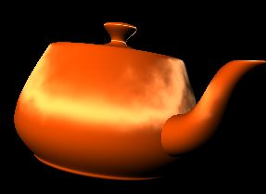
Materials
Material
Ambient
Environment
Non-lighted area
Diffuse
Dynamic lighting
Emissive
Self-lighting
Specular with shineness
Hi-light
View-dependent
Not good for hardware rendering
Local illumination

Slide 41
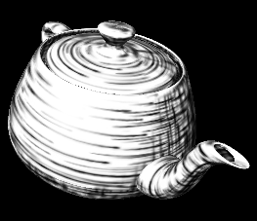
Textures
Textures
Single texture
Texture coordinate animation
Texture animation
Multiple textures
Alphamap
Lightmap
Base color texture
Material or vertex colors

Slide 42
Shaders
Programmable shading language
Vertex shader
Pixel shader
Procedural way to implement some process of rendering
Transformation
Lighting
Texturing
BRDF
Rasterization
Pixel fill-in
Post-processing for rendering

Slide 43
Shader Pipeline
Vertex Data
Topology Data
Classic
Transform &
Lighting
Vertex Shader
Geometry
Stage
Clipping & Viewport Mapping
Texturing
Pixel Shader
Rasterizer
Stage
Fog
Alpha, Stencil, Depth Testing

Slide 44
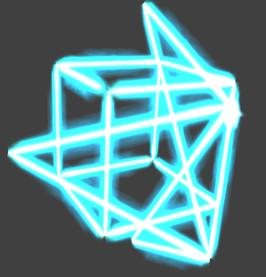
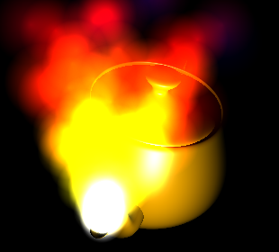
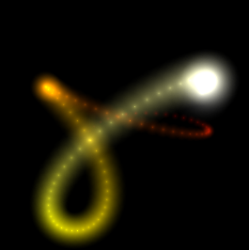
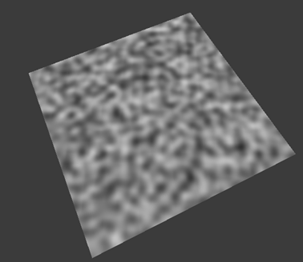
Powered by Shaders
Per-pixel lighting
Motion blur
Volume / Height fog
Volume lines
Depth of field
Fur rendering
Reflection / Refraction
NPR
Shadow
Linear algebra operators
Perlin noise
Quaternion
Sparse matrix solvers
Skin bone deformation
Normal map
Displacement map
Particle shader
Procedural Morphing
Water Simulation

Slide 45
Motion Data
Time-dependent data
Transformation data
Position
Orientation
Formats
Pivot
Position vector
Quaternion
Eurler angles
Angular displacement

Slide 46
Bounding Volumes
Bounding sphere
Bounding cylinder
Axis-aligned bounding box (AABB)
Oriented bounding box (OBB)
Discrete oriented polytope (k-DOP)
Bounding Sphere
AABB
k-DOP
Bounding Cylinder
OBB

Slide 47
Bounding Volume - Application
Collision detection
Visibility culling
Hit test
Steering behavior
in “Game AI”

Slide 48
Application Example – Bounding Sphere
B₂
B₁
D
c₂
c₁
Bounding sphere B₁(c₁, r₁), B₂(c₂, r₂)
If the distance between two bounding spheres is
larger than the sum of radius of the spheres, than
these two objects have no chance to collide.
D > Sum(r₁, r₂)

Slide 49
Application Example - AABB
Axis-aligned bounding box (AABB)
Simplified calculation using axis-alignment feature
But need run-timely to track the bounding box
AABB

Slide 50
Application Example - OBB
Oriented bounding box (OBB)
Need intersection calculation using the transformed OBB geometric data
3D containment test
Line intersection with plane
For games, ☺
OBB

Slide 51
Level-of-Details
Discrete LOD
Switch multiple resolution models run-timely
Continuous LOD
Use progressive mesh to dynamically reduce the rendered polygons
View-dependent LOD
Basically for terrain

Slide 52
Level of Detail: The Basic Idea
One solution:
Simplify the polygonal geometry of small or distant objects
Known as Level of Detail or LOD
a.k.a. polygonal simplification, geometric simplification, mesh reduction, multiresolution modeling, …

Slide 53
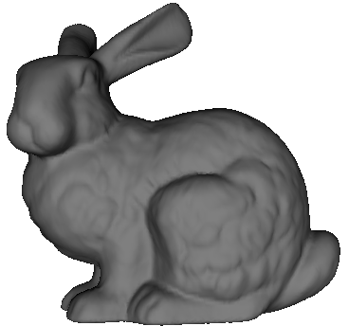
Level of Detail: Traditional Approach
Create levels of detail (LODs) of objects:
69,451 polys
2,502 polys
251 polys
76 polys

Slide 54
Level of Detail: Traditional Approach
Distant objects use coarser LODs:

Slide 55
Traditional Approach: Discrete Level of Detail
Traditional LOD in a nutshell:
Create LODs for each object separately in a preprocess
At run-time, pick each object’s LOD according to the object’s distance (or similar criterion)
Since LODs are created offline at fixed resolutions, this can be referred as Discrete LOD

Slide 56
Discrete LOD: Advantages
Simplest programming model; decouples simplification and rendering
LOD creation need not address real-time rendering constraints
Run-time rendering need only pick LODs

Slide 57
Discrete LOD: Advantages
Fits modern graphics hardware well
Easy to compile each LOD into triangle strips, display lists, vertex arrays, …
These render much faster than unorganized polygons on today’s hardware (3-5 x)

Slide 58
Discrete LOD: Disadvantages
So why use anything but discrete LOD?
Answer: sometimes discrete LOD not suited for drastic simplification
Some problem cases:
Terrain flyovers
Volumetric isosurfaces
Super-detailed range scans
Massive CAD models

Slide 59
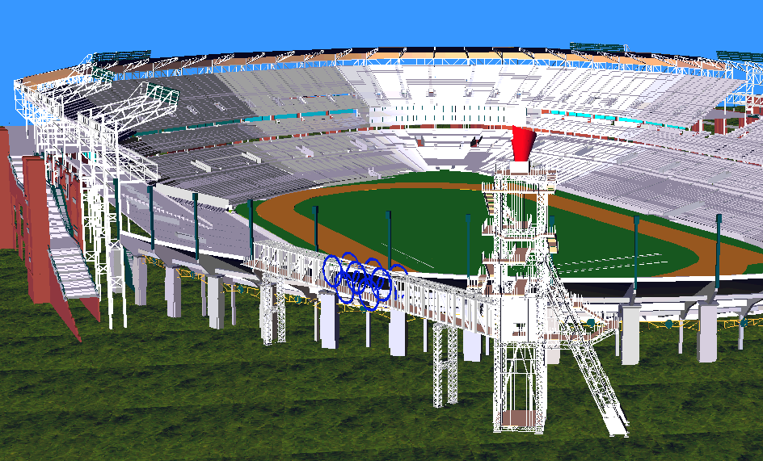
Drastic Simplification: The Problem With Large Objects
Courtesy IBM and ACOG

Slide 60
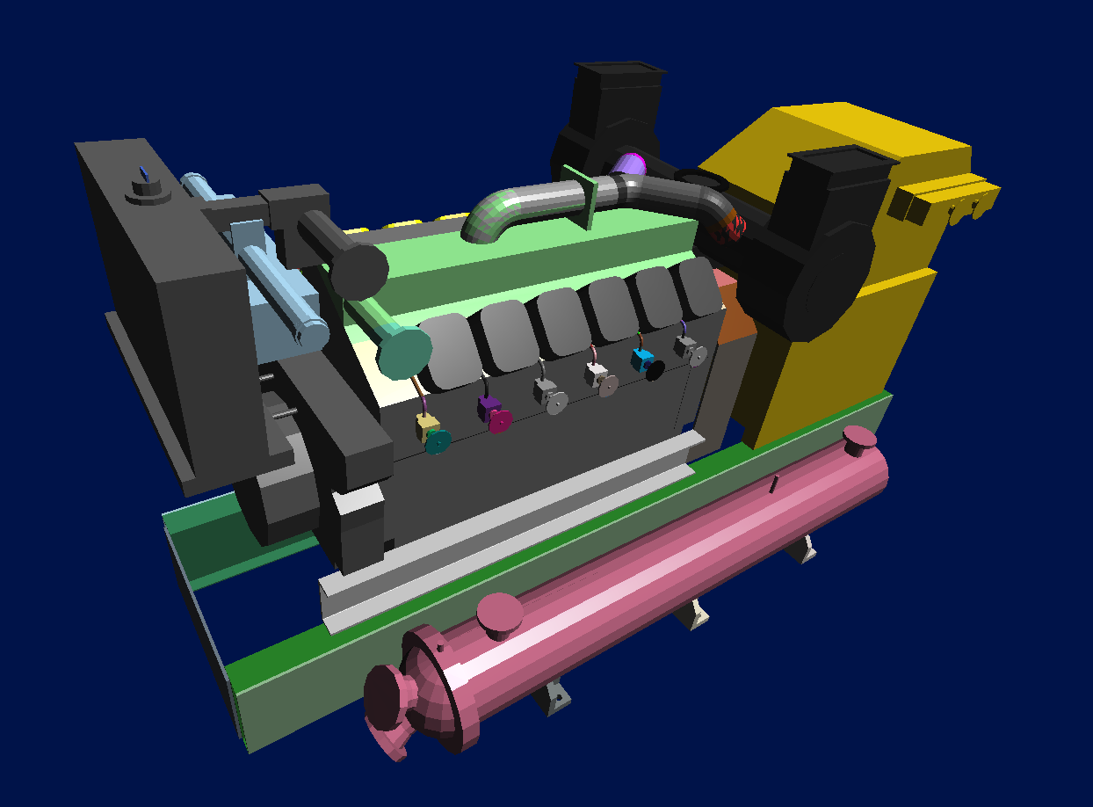
Drastic Simplification: The Problem With Small Objects
Courtesy Electric Boat

Slide 61
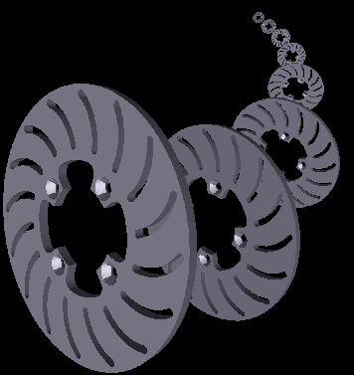
Drastic Simplification: The Problem With Topology
Courtesy University of Utah

Slide 62
Drastic Simplification
For drastic simplification:
Large objects must be subdivided
Small objects must be combined
Topology must be simplified
Difficult or impossible with discrete LOD

Slide 63
Continuous Level of Detail
A departure from the traditional static approach:
Discrete LOD: create individual LODs in a preprocess
Continuous LOD: create data structure from which a desired level of detail can be extracted at run time.

Slide 64
Continuous LOD: Advantages
Better granularity → better fidelity
LOD is specified exactly, not chosen from a few pre-created options
Thus objects use no more polygons than necessary, which frees up polygons for other objects
Net result: better resource utilization, leading to better overall fidelity/polygon

Slide 65
Continuous LOD: Advantages
Better granularity → smoother transitions
Switching between traditional LODs can introduce visual “popping” effect
Continuous LOD can adjust detail gradually and incrementally, reducing visual pops
Can even geomorph the fine-grained simplification operations over several frames to eliminate pops [Hoppe 96, 98]

Slide 66
Continuous LOD: Advantages
Supports progressive transmission
Progressive Meshes [Hoppe 97]
Progressive Forest Split Compression [Taubin 98]
Leads to view-dependent LOD
Use current view parameters to select best representation for the current view
Single objects may thus span several levels of detail

Slide 67
Methodology
Sequence of local operations
Involve near neighbors - only small patch affected in each operation
Each operation introduces error
Find and apply operation which introduces the least error

Slide 68
Simplification Operations
Decimation
Vertex removal
v ← v-1
f ← f-2
Remaining vertices - subset of original vertex set

Slide 69
Simplification Operations
Decimation
Edge collapse
v ← v-1
f ← f-2
Triangle collapse
v ← v-2
f ← f-4
Vertices may move

Slide 70
Simplification Operations
Contraction
Pair contraction
Cluster contraction (set of vertices)
Vertices may move

Slide 71
Simplification Error Metrics
Measures
Distance to plane
Curvature
Usually approximated
Average plane
Discrete curvature

Slide 72
The Basic Algorithm
Repeat
Select the element with minimal error
Perform simplification operation
(remove/contract)
Update error
(local/global)
Until mesh size / quality is achieved

Slide 73
Implementation Details
Vertices/Edges/Faces data structure
Easy access from each element to neighboring elements
Use priority queue (e.g. heap)
Fast access to element with minimal error
Fast update

Slide 74
Progressive Meshes
Render a model in different Level-of-Detail at run time
User-controlledly or automatically change the percentage of rendered vertices
Use collapse map to control the simplification process
Index | 0 | 1 | 2 | 3 | 4 | 5 | 6 | 7 | 8
Map | 0 | 1 | 1 | 2 | 3 | 0 | 4 | 5 | 6
Collapse map
Vertex list
Triangle list
0 | 1 | 2 | 3 | 4 | 5 | 6 | 7 | 8
0 | 2 | 5 | 0 | 1 | 2 | 3 | 5 | 8
0
0
6
4

Slide 75
View-dependent LOD for Terrain - ROAM
Real-time Optimal Adapting Meshes (ROAM)
Use height map
Run-timely to re-construct the active (for rendering) geometric topology (re-mesh) to get an optimal mesh (polygon count) to improve the rendering performance
Someone calls this technique as the view-dependent level-of-detail
Very good for fly-simulation-like application

Slide 76
Vertex Tree & Active Triangle List
The Vertex Tree
represents the entire model
a hierarchical clustering of vertices
queried each frame for updated scene
The Active Triangle List
represents the current simplification
list of triangle to be displayed

Slide 77
The Vertex Tree
Each vertex tree node contains:
a subset of model vertices
a representative vertex or repvert
Folding a node collapses its vertices to the repvert
Unfolding a node splits the repvert back into vertices

Slide 78
Vertex Tree Example
8
7
R
2
10
I
II
9
6
3
1
10
A
B
C
3
1
2
7
4
5
6
8
9
4
5
Triangles in Active List
Vertex Tree

Slide 79
Vertex Tree Example
8
7
R
2
A
10
I
II
9
6
3
1
10
A
B
C
3
1
2
7
4
5
6
8
9
4
5
Triangles in Active List
Vertex Tree

Slide 80
Vertex Tree Example
8
R
A
10
I
II
9
6
3
10
A
B
C
3
1
2
7
4
5
6
8
9
4
5
Triangles in Active List
Vertex Tree

Slide 81
Vertex Tree Example
8
R
A
10
I
II
9
6
3
10
A
B
C
3
B
1
2
7
4
5
6
8
9
4
5
Triangles in Active List
Vertex Tree

Slide 82
Vertex Tree Example
8
R
A
10
I
II
9
3
10
A
B
C
3
B
1
2
7
4
5
6
8
9
Triangles in Active List
Vertex Tree

Slide 83
Vertex Tree Example
8
R
C
A
10
I
II
9
3
10
A
B
C
3
B
1
2
7
4
5
6
8
9
Triangles in Active List
Vertex Tree

Slide 84
Vertex Tree Example
R
C
A
10
I
II
3
10
A
B
C
3
B
1
2
7
4
5
6
8
9
Triangles in Active List
Vertex Tree

Slide 85
Vertex Tree Example
R
C
A
II
10
I
II
3
10
A
B
C
3
B
1
2
7
4
5
6
8
9
Triangles in Active List
Vertex Tree

Slide 86
Vertex Tree Example
R
A
II
10
I
II
10
A
B
C
3
B
1
2
7
4
5
6
8
9
Triangles in Active List
Vertex Tree

Slide 87
Vertex Tree Example
R
A
II
10
I
II
I
10
A
B
C
3
B
1
2
7
4
5
6
8
9
Triangles in Active List
Vertex Tree

Slide 88
Vertex Tree Example
R
II
I
II
I
10
A
B
C
3
B
1
2
7
4
5
6
8
9
Triangles in Active List
Vertex Tree

Slide 89
Vertex Tree Example
R
II
I
II
I
R
10
A
B
C
3
B
1
2
7
4
5
6
8
9
Triangles in Active List
Vertex Tree

Slide 90
Vertex Tree Example
R
I
II
R
10
A
B
C
3
1
2
7
4
5
6
8
9
Triangles in Active List
Vertex Tree

Slide 91
The Vertex Tree: Folding & Unfolding
8
7
Fold node A
8
2
A
A
10
10
9
6
9
6
3
3
1
Unfold node A
4
5
4
5

Slide 92
The Vertex Tree: Tris & Subtris
8
7
Fold node A
8
2
A
10
10
9
6
9
6
3
3
1
Unfold node A
4
5
4
5
Tris: triangles that change shape upon folding
Subtris: triangles that disappear completely

Slide 93
Level-of-detail Suggestion
Apply progressive mesh for multi-resolution model generation
Use in-game discrete LOD for performance tuning
Why ?
For modern game API / platform, dynamic vertex update is costly on performance
Lock video memory stall CPU/GPU performance

