Slide 1
Computer Graphics
Bing-Yu Chen
National Taiwan University

Slide 2
Computer Animation
Traditional Animation
Key-Frame Animation
Hierarchical Modeling
(Inverse) Kinematics
Character Animation
Free-From Deformation

Slide 3
What is Animation ?
The creation of moving pictures one frame at a time
  Literally 'to bring to life'
  e.g. make a sequence of drawings on paper, in which a character's position changes slightly in each drawing
  Photograph drawings in sequence, using movie camera that advances one frame at a time
  Play back resulting film – character will move

Slide 4
What is Animation ?
Additional definitions
  Animation is defined as the act of making something come alive.
  It is concerned with the visual or aesthetic aspect of the project.
  Animation is an object moving across or into or out of the screen.
  Animation is possible because of a biological phenomenon known as persistence of vision and a psychological phenomenon called phi.
  In animation, a series of images are rapidly changed to create an illusion of movement.

Slide 5
Animation Space
Animation can be rendered in:
  2D space
    2-D animations are very simple and static.
  2½D space
    An illusion of depth is created through shadowing, highlighting, and forced perspective, though in reality the image rests in two dimensions.
  3D space
    Complicated and realistic animations are done in 3-D space.

Slide 6
Traditional Methods
Drawings/paintings on paper
  1440 drawings for every minute of film
Cel
Painted or scratched film
Cut-outs
Clay animation (Claymation)
etc…

Slide 7
Cel Animation
Cel animation is a technique in which a series of progressively different graphics are used on each frame of movie film.
The term "cel" is derived from the clear celluloid sheets that were used for drawing each frame.
Cel animation begins with keyframes.
Keyframes refer to the first and the last frame of an action.
The frames in between the keyframes are drawn in the tweening process.
Tweening depicts the action that takes place between keyframes.
Tweening is followed by the pencil test.

Slide 8
Captured Animation
Computer + Video Camera + traditional technique
Frame grabbing
  record each frame to disk
Can also use scanner or digital still camera, or create each frame in a graphics program (e.g. Painter)

Slide 9
Digital Cel
Use layers like sheets of acetate in traditional cel animation
  e.g. static background on one layer, moving simple object on a layer in front of it. Make the object move by repositioning the layer
  More complex cases, just need to change those layers where movement or other change occurs between frames

Slide 10
Sprite Animation
Store a single copy of all static elements and moving objects (sprites) and a description of how the objects move
Each sprite can be a collection of images called sprite faces, which can be substituted in sequence to produce composite motion

Slide 11
Key-Frame Animation
Traditional:
  key frames drawn by chief animators at important points in the animation
  In-between frames drawn by less skilled animators
Computer-based:
  key frames drawn explicitly
  In-between frames interpolated by software

Slide 12
Key-Frame Animation
The most common method for character animation in production is key-frame animation.
  Each joint specified at various key frames (not necessarily the same as other joints)
  System does interpolation or in-betweening
Doing this well requires:
  A way of smoothly interpolating key frames: splines
  A good interactive system
  A lot of skill on the part of the animator

Slide 13
Linear Interpolation
Constant velocity
  Motion begins and ends instantaneously
displacement
velocity
1
kf₁
kf₂
kf₁
kf₂

Slide 14
Easing In
Object accelerates, gradual transition from stasis to motion
2
displacement
velocity
kf₁
kf₂
kf₁
kf₂

Slide 15
Easing Out
Object decelerates, gradual transition from motion to stasis
2
displacement
velocity
kf₁
kf₂
kf₁
kf₂

Slide 16
Symbols and Instances
Reusable objects stored in a library
  Graphic symbols
  Movie clip symbols (self-contained animations within a movie)
  If symbol is edited, all its instances updated.
Most graphics APIs support a few geometric primitives:
  spheres
  cubes
  cylinders
These symbols are instanced using an instance transformation.

Slide 17
Motion Tweening
Object is placed in a key frame
Create Motion Tween
  Object is turned into a symbol
Add key frame at end of tweened sequence and move or transform object
Motion in intermediate frames is interpolated (tweened)

Slide 18
Shape Tweening
Also called morphing
  Shapes of graphical objects are transformed in between key frames
  Have to generate the interpolated frames, so resulting animation file is bigger than when motion tweening is used

Slide 19
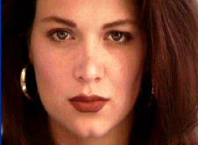
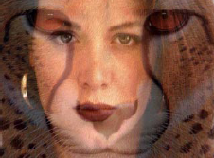
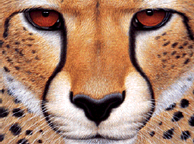
Image Morphing
The goal is to synthesize a fluid transformation from one image to another.
Cross dissolving is a common transition between cuts, but it is not good for morphing because of the ghosting effects.
image #1
dissolving
image #2

Slide 20
Image Morphing
Why ghosting?
Morphing = warping + cross-dissolving
shape
(geometric)
color
(photometric)

Slide 21
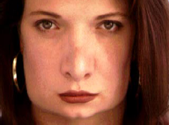
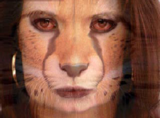
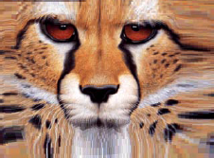
Image Morphing
image #1
cross-dissolving
image #2
warp
morphing
warp

Slide 22
Motion Graphics
Like time-based graphic design
Move, transform, alter layers of a bitmapped image between frames
Apply time-varying filters and effects
  Linear and Bézier interpolation in both space and time (rate of change)
  Can have new effects that only make sense in time, e.g. shatter, particle effects

Slide 23
3D Animation
"Easy to describe but much harder to do"
Properties of 3D models (shape, size, position, rotation, surface characteristics, etc), light sources and cameras are numerically defined
Animate a scene by changing the numbers, rendering a new frame, changing further …
Can make objects move, or move the camera
Requires 3D visualization and animation skills and great amount of processing power

Slide 24
Hierarchical Modeling
Connected primitives

Slide 25
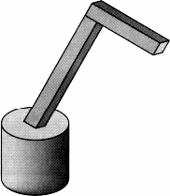
3D Example: A robot arm
Consider this robot arm with 3 degrees of freedom:
  Base rotates about its vertical axis by
  Upper arm rotates in its xy-plane by
  Lower arm rotates in its xy-plane by
Lower arm
Upper arm
Base

Slide 26
First implementation
The robot arm can be displayed by keeping a global matrix and computing it at each step:
Matrix M_model;
main()
{
…
…
robot_arm();
…
}
robot_arm()
{
M_model = R_y(theta);
base();
M_model = R_y(theta)*T(0,h1,0)*R_z(phi);
upper_arm();
M_model = R_y(theta)*T(0,h1,0)*R_z(phi)*T(0,h2,0)*R_z(psi);
lower_arm();
}

Slide 27
Better implementation
Instead of recalculating the global matrix each time, we can just update it in place:
Matrix M_model;
main()
{
…
M_model = Identity();
robot_arm();
…
}
robot_arm()
{
M_model *= R_y(theta);
base();
M_model *= T(0,h1,0)*R_z(phi);
upper_arm();
M_model *= T(0,h2,0)*R_z(psi);
lower_arm();
}

Slide 28
Hierarchical Modeling
Directed Acyclic Graph
Hierarchical models can be composed of instances using trees or DAGs:
  edges contain geometric transformations
  nodes contain geometry (and possibly drawing attributes)
Chassis
Right-front
wheel
Right-rear
wheel
Left-front
wheel
Left-rear
wheel

Slide 29
Kinematics
Forward Kinematics (angles to position)
  What you are given:
    The length of each link
    The angle of each joint
  What you can find:
    The position of any point
    i.e. it’s (x, y, z) coordinates
Inverse Kinematics (position to angles)
  What you are given:
    The length of each link
    The position of some point on the robot
  What you can find:
    The angles of each joint needed to obtain that position

Slide 30
Forward Kinematics
Also called Hierarchical Animation
Y³
₃
Y²
2
X³
3
₂
X²
Y⁰
1
X¹
Y¹
₁
X⁰

Slide 31
Inverse Kinematics
Useful for animating jointed structures, especially limbs of human or animal figures
Model must obey kinematic constraints
  e.g. if upper arm moves, lower arm and hand must move with it
Inverse kinematics follows chain in reverse (easier for the animator)
  e.g. position the hand, then compute motion of the rest of the arm move to accommodate it

Slide 32
Inverse Kinematics
follow mouse
p₁
Goal
  Drag in realtime with mouse
  Maintain multiple constraints
  Figure responds in “reasonable” ways
root
p₂
p₃
stay put

Slide 33
Inverse Kinematics
Given: l₁, l₂ , x , y
Find: ₁, ₂
Redundancy:
  A unique solution to this problem does not exist. Notice, that using the “givens” two solutions are possible.
Sometimes no solution is possible.
(x , y)
₂
l₂
l₂
(x , y)
l₁
₁
l₂
l₁
l₁

Slide 34
A Complex Example: Human figure
torso
head
left upper
arm
right upper
arm
left upper
leg
right upper
leg
left lower
arm
right lower
arm
left lower
leg
right lower
leg

Slide 35
Articulated Animation
The above examples are called articulated models:
  rigid parts
  connected by joints
They can be animated by specifying the joint angles (or other display parameters) as functions of time.

Slide 36
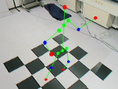
Skeleton
Hierarchical kinematic chain
Bones connected by joints (transformations)
Segments define own local coordinate systems
2 layers of representation

Slide 37
Scene Graphs
The idea of hierarchical modeling can be extended to an entire scene, encompassing:
  many different objects
  lights
  camera position
This is called a scene tree or scene graph.
Scene
Camera
Object1
Light1
Light2
Object2
Object3

Slide 38
A Segmented Character
A character is composed by a set of models with motion data to simulate a live creature in real world

Slide 39
A Mesh Character
Vertex animation on skins
  Animated positional data on skins
  3D warping

Slide 40
A Bone-skin Character
Bone-Skin Skeleton
  Hierarchical bones
  Skin deformation run-timely
Bone A
Skin
Bone B

Slide 41
Motion Data
Euler angles
Angular displacement
Quaternion
  Can achieve the interpolation by “Slerp”
But finally they will be converted into “matrix”

Slide 42
Optical Motion Capture
Device
Data acquired
  From skin to joint (Mocap)
  From joint to skeleton (Post-processing)
  From skeleton to skin (In-game)
The shooting plan

Slide 43
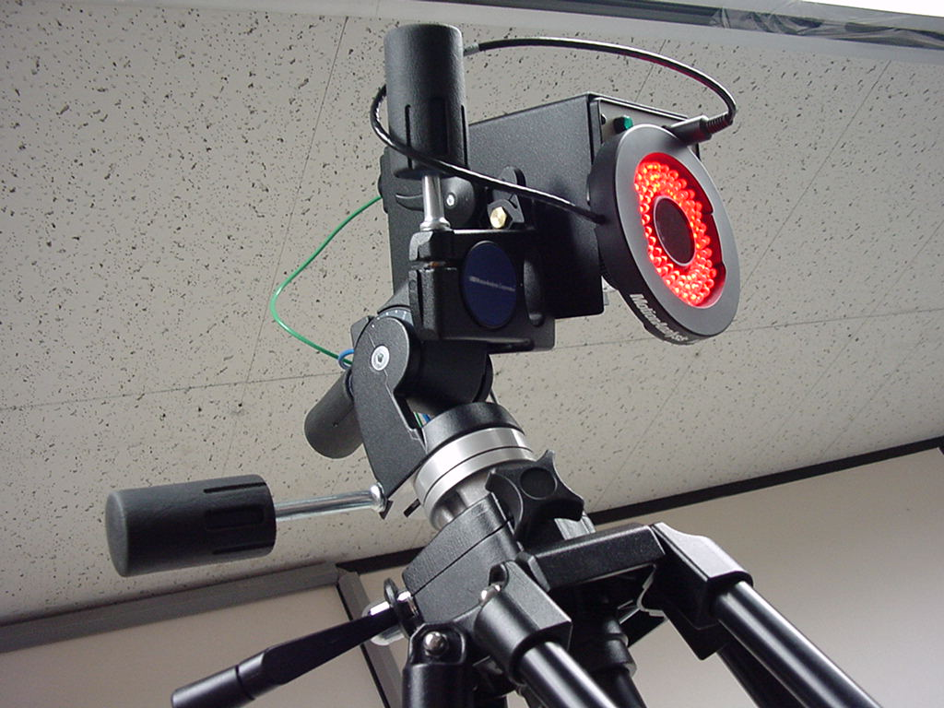
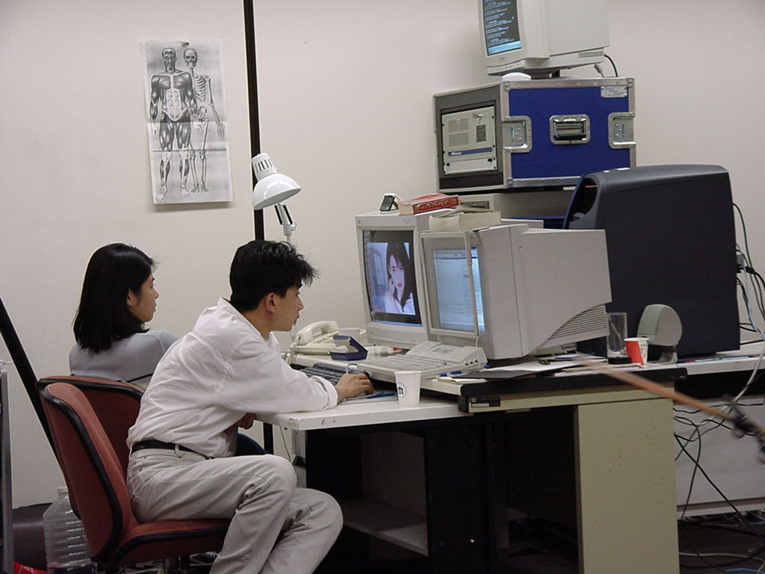
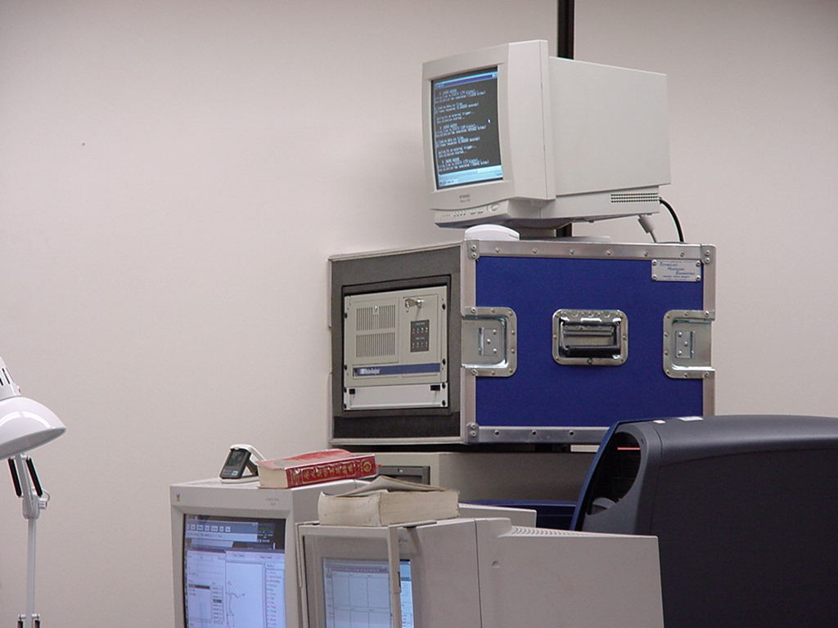
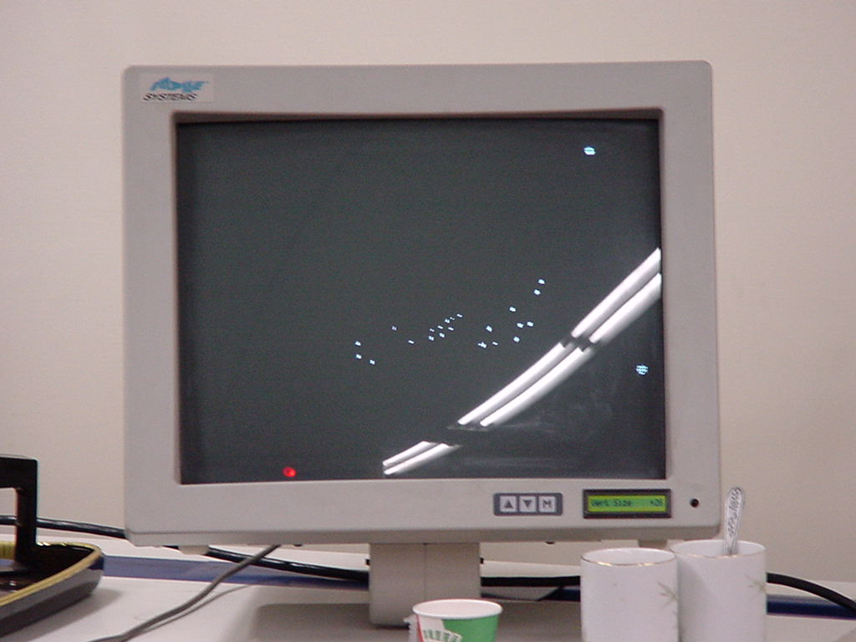
Mocap Devices

Slide 44
Data Acquirement During the Mocap
Raw Data (Positional Data)
Bio-Data
Joint
End Point

Slide 45
Bone-skin Implementation in Game
Skin
Skeletons
Bone-Skin
Skeletons

Slide 46
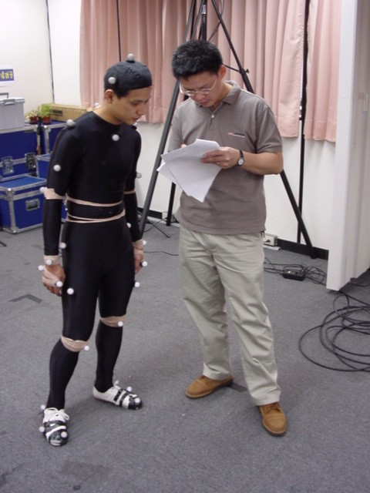
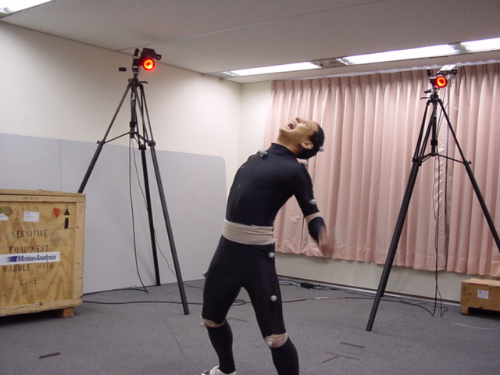
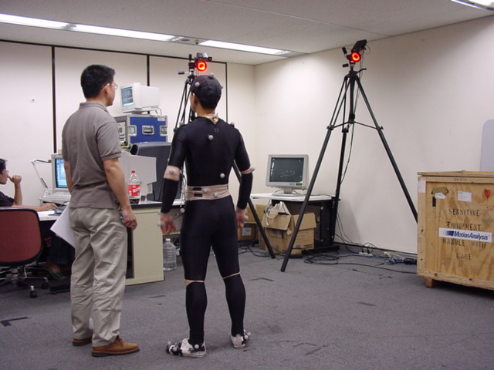

Slide 47
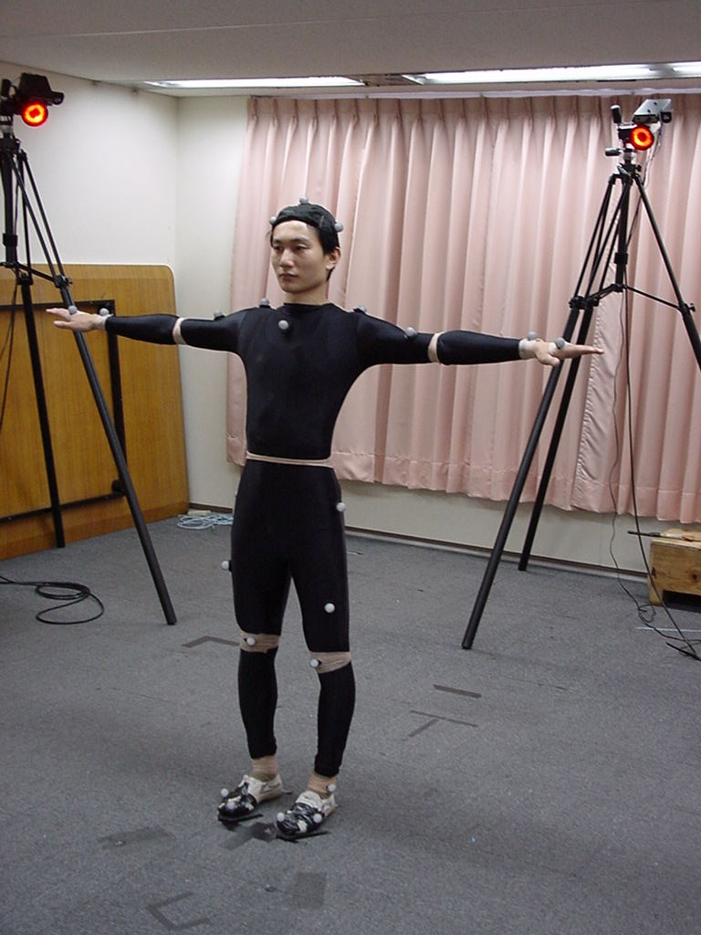
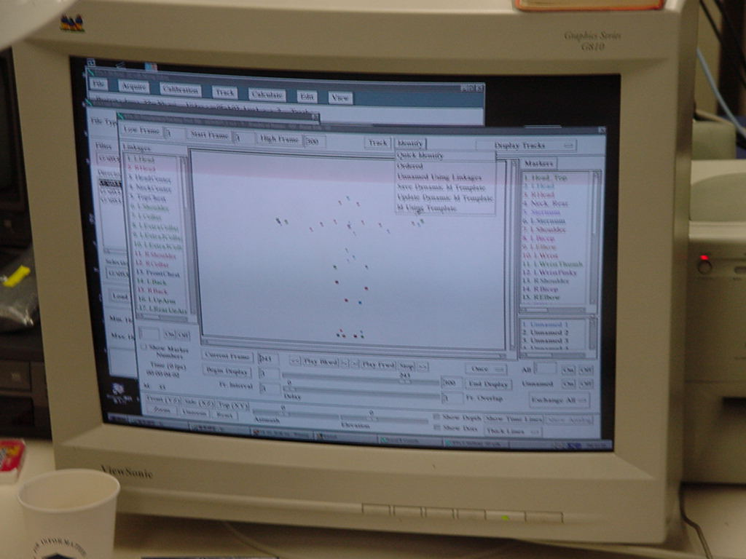
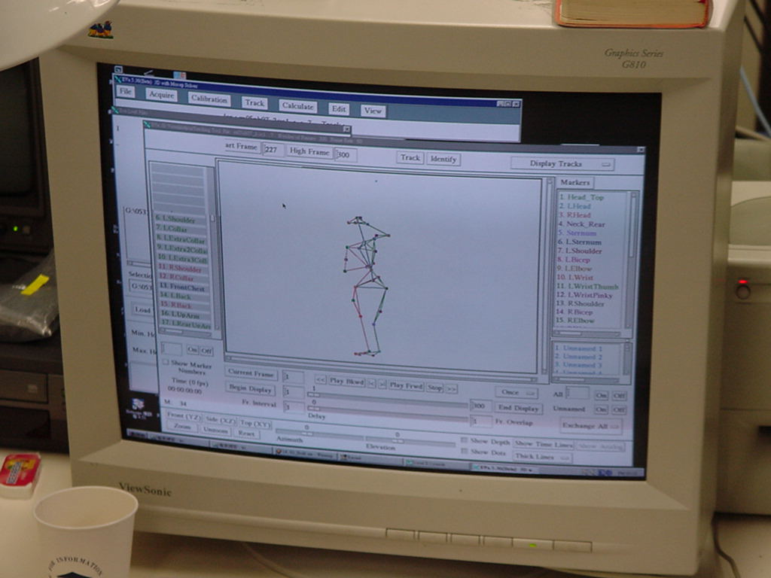
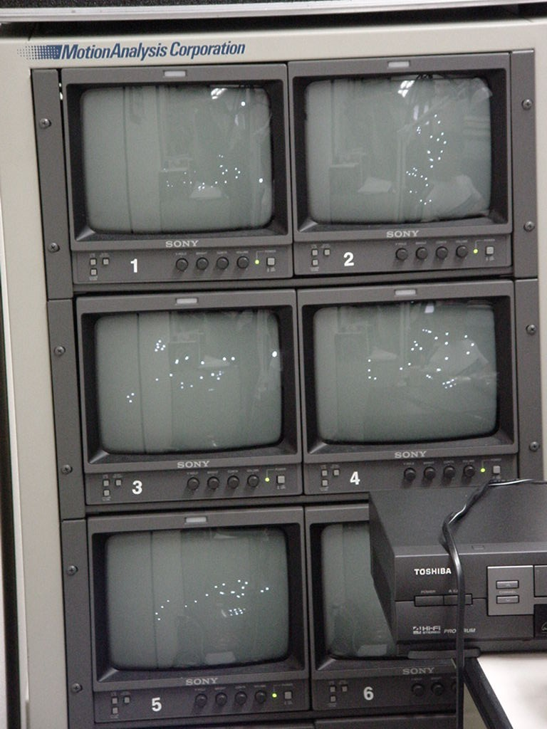
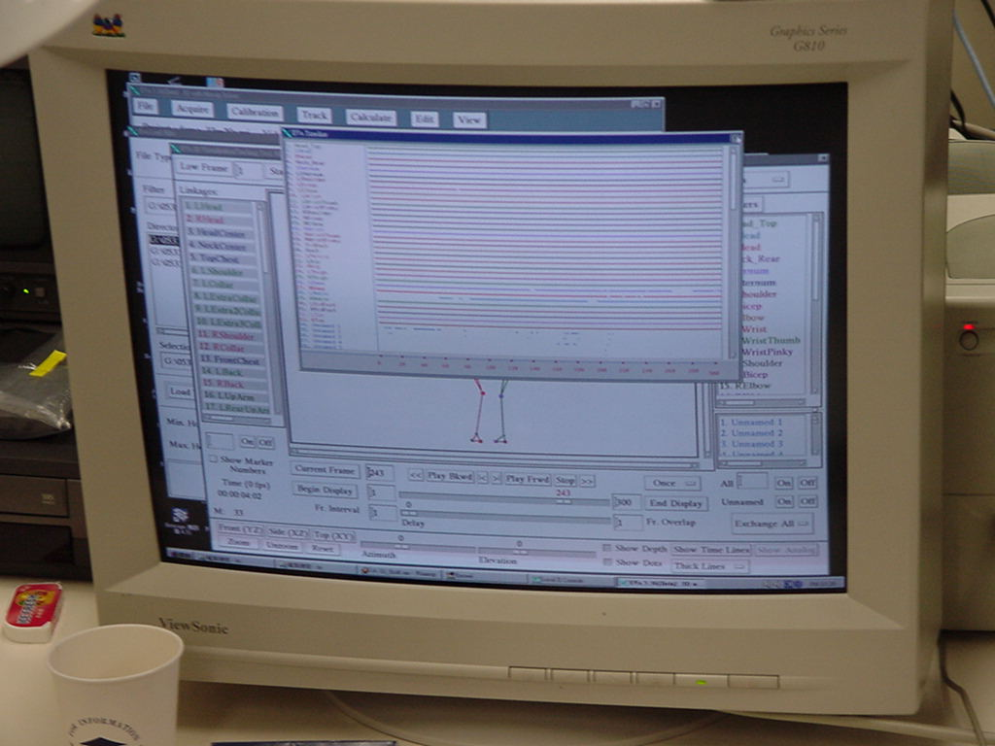

Slide 48
Apply Motion for Characters
Apply motion data on bones
(x,y,z,θ,axis)
A
(θ,axis)
Joint = pivot(p_{x},p_{y},p_{z}) in A
B
<v’> = <V> [R_{B}][T_{B}][R_{A}][T_{A}]
From pivot
From position

Slide 49
Motion Editing
To create more animation from limited work
Run-time or pre-processing
Issues :
  Motion re-targeting
    Pre-processing / Run-time
  Re-key-framing
    Pre-processing
  Interpolation between frames
    Run-time
  Motion blending
    Run-time
  Motion connection
    Run-time

Slide 50
A Pose Definition Example
start_frame
end_frame
walk
raw_start_frame
raw_end_frame
Parameter {
raw_start_frame
raw_end_frame
start_frame
end_frame
cut_frame
play_speed
length
transition_mode
}
cut_frame

Slide 51
Play a Pose
walk
0
4
8
Frame 5.3
If the motion data is in quaternion form
Get the motion data on frame 5 & 6
Convert the data into quaternion format
Apply slerp(5, 6, 0.3) to get the interpolation on frame 5.3
Convert the result of step 3 into a rotation matrix
Apply the matrix to the object for its transformation

Slide 52
Pose Connection
cut_frame
Pose 1
start_frame
Pose 2
length

Slide 53
Pose Blending
Motion blending in run-time
Quaternion is used
“Blend Tree”
  Cross fade
  Countinuous blending
  Feather blending

Slide 54
Cross Fade
1
Pose 1
0
1
Pose2
0

Slide 55
Continuous Blending
1
Pose 1
0
1
Pose 2
0

Slide 56
Skin Deformation
Weights to assign the influences of the deformation by bones on skin vertices
  1-weight
  2-weight
  N-weight
CPU cost
Another way to perform the skin deformation calculation is using vertex shader

Slide 57
Bone A
(root object)
base
base
Bone B
(Bone A’s child)
Apply motion data to bones
Convert the vertex from “base” space to its associated bone’s space using the natural pose’s inverse transformation
Multiple the influence weight
Accumulate all influences
Then the vertex is deformed by the bone in “base” space

Slide 58
3D Model Deformation
For different purposes
  Global deformation
    change the overall shape of the given model
      bend a dolphin model, etc
  Local deformation
    change some region of the given model
      enlarge the fin of a dolphin model, etc
For different types of models
  Polygonal surfaces
    Editing at coarse level
  Parametric surfaces
    Moving and adding control points

Slide 59
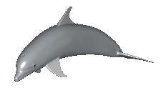
Free-Form Deformation (FFD)
Steps of FFD
  [ Sederberg and Parry ’86 ]
  embed a model in a lattice structure
  adjust some control points of the lattices
original

Slide 60
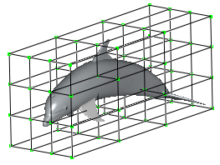
Free-Form Deformation (FFD)
Steps of FFD
  [ Sederberg and Parry ’86 ]
  embed a model in a lattice structure
  adjust some control points of the lattices
original

Slide 61
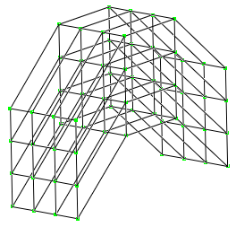
Free-Form Deformation (FFD)
Steps of FFD
  [ Sederberg and Parry ’86 ]
  embed a model in a lattice structure
  adjust some control points of the lattices
original
deformed

Slide 62
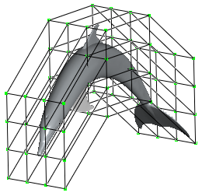
Free-Form Deformation (FFD)
Steps of FFD
  [ Sederberg and Parry ’86 ]
  embed a model in a lattice structure
  adjust some control points of the lattices
    DEFORM
original
deformed

Slide 63
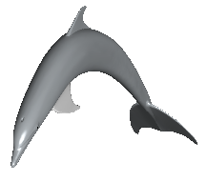
Free-Form Deformation (FFD)
Steps of FFD
  [ Sederberg and Parry ’86 ]
  embed a model in a lattice structure
  adjust some control points of the lattices
    DEFORM
original
deformed

