Slide 1
Computer Graphics
Tz-Huan Huang National Taiwan University
(Slides are based on Prof. Chen’s)

Slide 2
Basic Raster Graphics Algorithms for Drawing 2D Primitives
Architecture of a Raster Display
Scan Converting Lines
Filling Rectangles
Filling Polygons
Clipping Lines
Clipping Polygons
Antialiasing
Image Processing

Slide 3
Architecture of a Raster Display
Interface with host computer
(Display commands)
(Interaction data)
Display controller (DC)
Keyboard
Mouse
0000000000000000000000000
0000000000000000000111000
0000000000000000011100000
0000000000000000001100000
0000000000000000000011000
0000000000001110000000000
0000000011111111111000000
0001111111111111111111110
0001111111000000011111110
0001111111111111111111110
0001111111000000011111110
0001111111000000011111110
0001111111000000011111110
0001111111000000011111110
0001111111111111111111110
0000000000000000000000000
Video controller
Refresh buffer

Slide 4
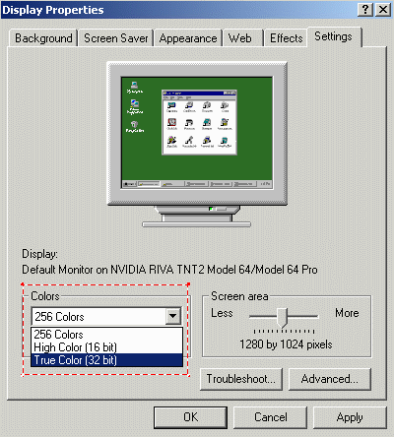
Definitions
Pixel
a screen consists of N x M pixels
Bilevel
= monochrome, 1 bit / pixel
Color: RGB model
8 bits / pixel
256 colors, color map, indexing
16bits / pixel
R, G, B each 5 bits, 1 bit overlay
24(32)bits / pixel
R, G, B(, A) each 8 bits

Slide 5
Definitions
Bitmap / pixmap
bitmap
1-bit-per-pixel bilevel systems
pixmap
multiple-bit-per-pixel systems
Frame buffer
an array of data in memory mapped to screen

Slide 6
Scan Converting Lines
A scan-converted line showing intensified pixels as black circles

Slide 7
The Basic Incremental Algorithm
Desired line
(x_{i}+1,Round(y_{i}+m))
(x_{i},y_{i})
(x_{i}+1,y_{i}+m)
(x_{i},Round(y_{i}))

Slide 8
The Basic Incremental Algorithm
void Line(int x0, int y0, int x1, int y1, value) {
float dx = x1-x0, dy = y1-y0;
float m = dy/dx;
float y = y0;
for (int x = x0; x <= x1; ++x) {
WritePixel(x, round(y), value);
y += m;
}
}

Slide 9
Midpoint Line Algorithm
NE
Q
M
E
P=(x_{P},y_{P})
Notes:
Bresenham's line algorithm
The algorithm was developed by Jack E. Bresenham in 1962 at IBM. In 2001 Bresenham wrote:
I was working in the computation lab at IBM's San Jose development lab. A Calcomp plotter had been attached to an IBM 1401 via the 1407 typewriter console. [The algorithm] was in production use by summer 1962, possibly a month or so earlier. Programs in those days were freely exchanged among corporations so Calcomp (Jim Newland and Calvin Hefte) had copies. When I returned to Stanford in Fall 1962, I put a copy in the Stanford comp center library. A description of the line drawing routine was accepted for presentation at the 1963 ACM national convention in Denver, Colorado. It was a year in which no proceedings were published, only the agenda of speakers and topics in an issue of Communications of the ACM. A person from the IBM Systems Journal asked me after I made my presentation if they could publish the paper. I happily agreed, and they printed it in 1965.

Slide 10
Midpoint Line Algorithm
NE
E
P=(x_{P},y_{P})
old
new

Slide 11
Midpoint Line Algorithm
void MidpointLine(int x0, int y0, int x1, int y1, value){
int dx = x1-x0, dy = y1-y0;
int incrE = dy*2, incrNE = (dy-dx)*2;
int d = dy*2 - dx;
int x = x0, y = y0;
WritePixel(x, y, value);
while (x < x1) {
if (d <= 0) {
d += incrE; ++x;
} else {
d += incrNE; ++x; ++y;
}
WritePixel(x, y, value);
}
}
NE
E

Slide 12
Faster Line Algorithms?
Recall the basic incremental algorithm
float m = dy/dx;
float y = y0;
for (int x = x0; x <= x1; ++x) {
WritePixel(x, round(y), value);
y += m;
}
Performance issues:
floating point operations
round()

Slide 13
Extremely Fast Line algorithm
Idea:
Use large integer instead of floating point
round(x) = int(x+0.5)
void FastLine(int x0, int y0, int x1, int y1, value) {
int dy = y1-y0, dx = x1-x0;
int m = (dx<<16) / dy;
for (int x = x0, y = 0x8000+(y0<<16); x <= x1; ++x) {
WritePixel (x, (y>>16), value);
y += m;
}
}
Copyright (c) 2005, By Po-Han Lin, http://www.edepot.com/algorithm.html

Slide 14
Filling Rectangles
for (int y = ymin; y <= ymax; y++) {
for (int x from xmin to xmax) {
WritePixel(x, y, value);
}
}

Slide 15
Filling Polygons
12
D
10
F
8
Scan line
a
b
c
d
6
E
C
4
2
A
B
2
4
6
8
10
12
14

Slide 16
Filling Polygons
Span extrema
Other pixels in the span

Slide 17
Filling Polygons
find the intersections of the scan line with all edges of the polygon
sort the intersections by increasing x coordinate
fill in all pixels between pairs of intersections that lie interior to the polygon

Slide 18
Some Issues
Silvers
Horizontal lines
Shared points

Slide 19
Clipping Lines
F
D
D’
D’
B
H
B
C
H’
C
H’
E
J
A
A
G’
J’
G’
G
I’
Clip rectangle
I

Slide 20
The Cohen-Sutherland Line-Clipping Algorithm
1001
1000
1010
0
1
2
3
X_{min}
0001
0000
0010
X_{max}
Y_{min}
Y_{max}
0101
0100
0110
Clip rectangle

Slide 21
The Cohen-Sutherland Line-Clipping Algorithm
1001
0000
D
1001
1000
1010
1010
0100
C
I
0001
0000
0010
B
H
1001
0101
A
0101
0100
0110
G
F
0
1
2
3
X_{min}
Clip rectangle
E
X_{max}
Y_{min}
Y_{max}

Slide 22
Clipping Polygons
Clip rectangle

Slide 23
The Sutherland-Hodgman Polygon-Clipping Algorithm
Clip rectangle
Right clip boundary
Top clip boundary
Bottom clip boundary
Left clip boundary

Slide 24
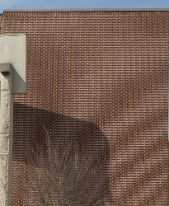
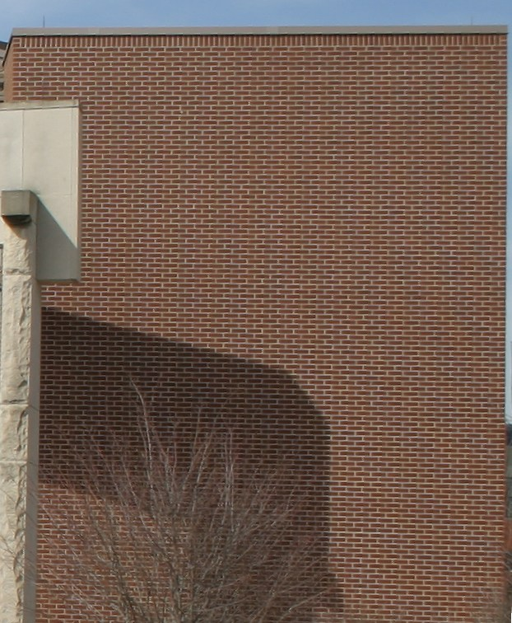
Antialiasing

Slide 25
Jagged Edges

Slide 26
Unweighted Area Sampling
5
4
3
2
1
0
0
1
2
3
4
5
6
7
8
9
10
11

Slide 27
Unweighted Area Sampling
5
4
3
2
1
0
0
1
2
3
4
5
6
7
8
9
10
11

Slide 28
Xiaolin Wu's line algorithm
Idea:
intensity is based on rfpart and fpart
rfpart
fpart

Slide 29
Xiaolin Wu's line algorithm
ipart(x): integer part of x
fpart(x): fraction part of x
rfpart(x): 1 – fpart(x)
void WuLine(float x0, float y0, float x1, float y1, value) {
/* handle both endpoints here */
/* and determine the xbegin and xend */
float dx = x1-x0, dy = y1-y0;
float m = dy/dx;
float intery = y1 + m(xbegin-x);
for (int x = xbegin; x <= xend; ++x) {
WritePixel(x, ipart(intery), value*rfpart(intery));
WritePixel(x, ipart(intery)+1, value*fpart(intery));
intery += m;
}
Xiaolin Wu, An efficient antialiasing technique, SIGGRAPH 1991.

Slide 30
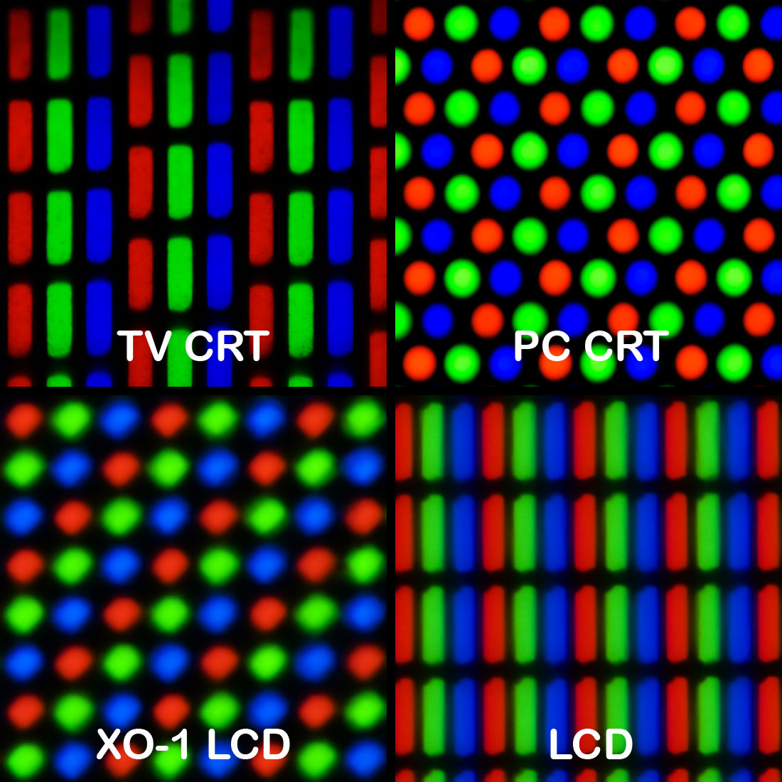
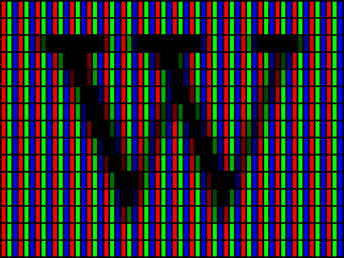
Subpixel rendering

Slide 31
Aliasing

Slide 32
Nyquist–Shannon sampling theorem
If a function x(t) contains no frequencies higher than B hertz, it is completely determined by giving its ordinates at a series of points spaced 1/(2B) seconds apart.
Notes:
Harry Nyquist: AT&T and Bell lab
Claude Shannon: The father of the information theory and cryptography.

Slide 33
Full-Screen Anti-Aliasing (FSAA)
Ordered Grid Multi-Sampling (OGMS)
Rotate Grid Multi-Sampling (OGMS)
Ordered Grid Super Sampling (OGSS)
Rotate Grid Super Sampling (RGSS)
Super sampling
Low-pass filter
Down-sampling

