Slide 1
Computer Graphics
Bing-Yu Chen National Taiwan University

Slide 2
Texture Mapping
Texture Mapping
Texture Aliasing
MIPmaps
Environment Mapping
Bump Mapping
Displacement Mapping
Shadow Maps
Solid Textures

Slide 3
The Quest for Visual Realism
Model with Shading and Textures
Model
Model with Shading
Copyright©1997, Jeremy Birn

Slide 4
The Limits of Geometric Modeling
Although graphics cards can render over 10 million polygons per second, that number is insufficient for many phenomena
Clouds
Grass
Terrain
Skin

Slide 5
Texture Mapping
Previously, we assume that reflection properties such as are constant within each triangle.
However, some objects have complex appearance which arises from variation in reflection properties.
The common technique to handle this kind of variation is to store it as a function or a pixel-based image and “map” it onto a surface.
The function is called texture map and the process is called texture mapping.

Slide 6
History
1974 basic idea (Catmull/Williams)
1976 reflection maps (Blinn/Newell)
1978 bump mapping (Blinn)
1983 mipmap (Williams)
1984 illumination (Miller/Hoffman)
1985 solid texture (Perlin)

Slide 7
Texture Maps

Slide 8
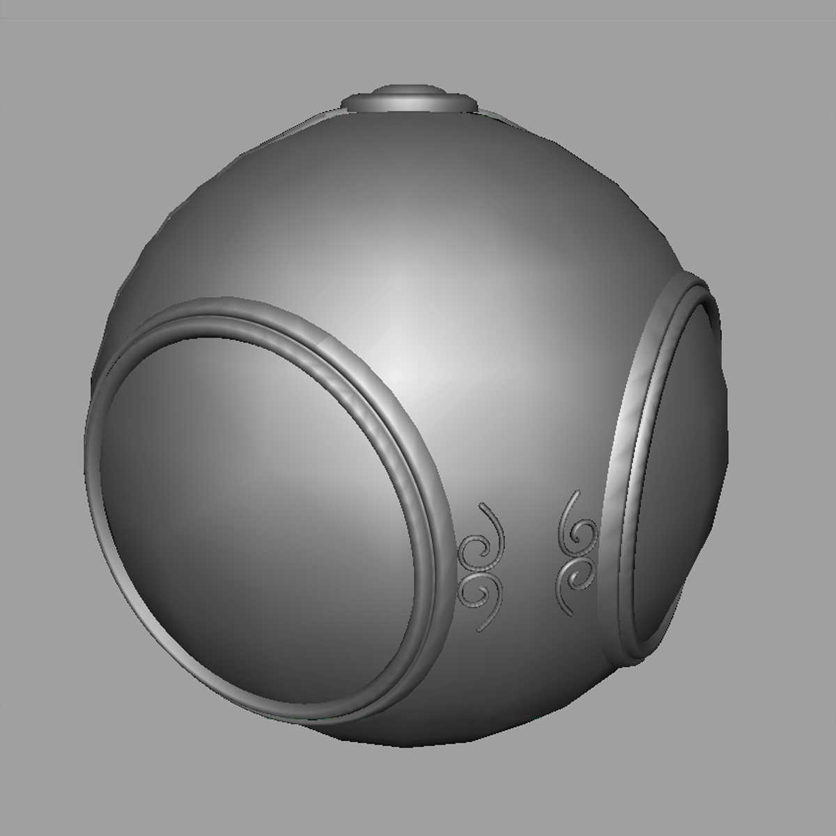
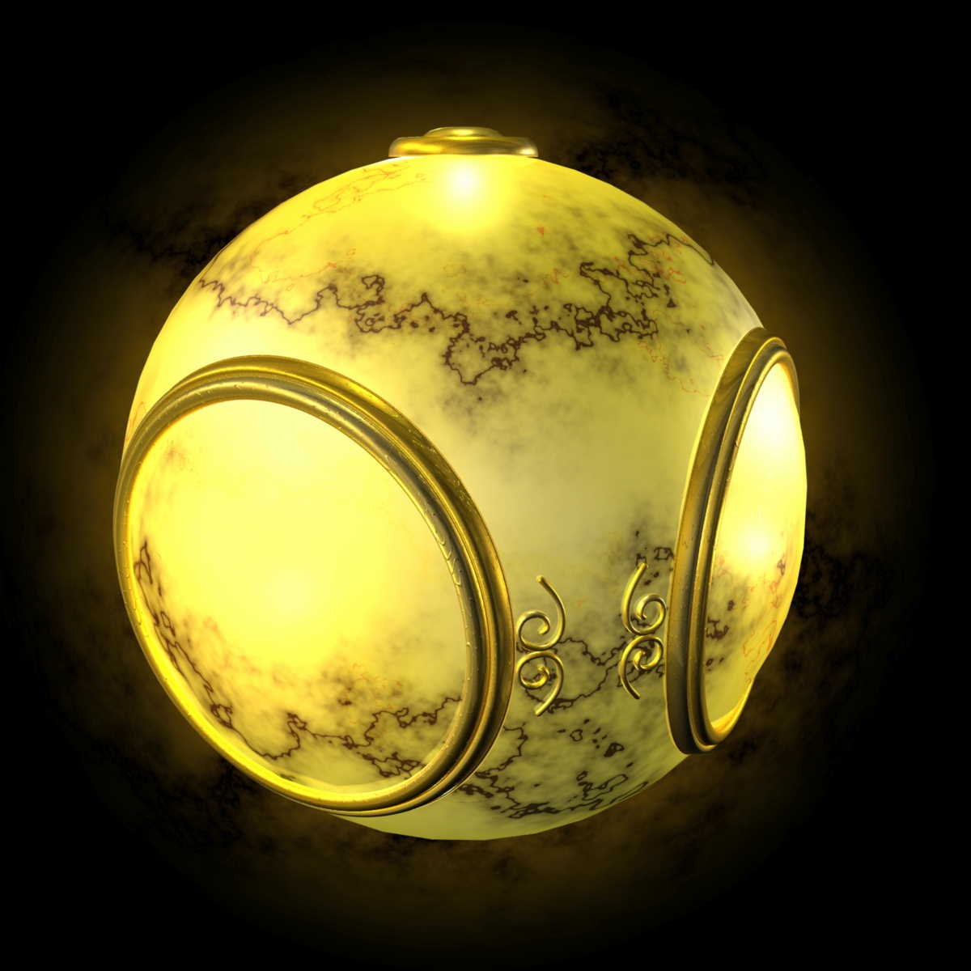
Texture Mapping
geometric model
texture mapped

Slide 9
Texture Maps
How is texture mapped to the surface?
Dimensionality: 1D, 2D (image), 3D (solid)
Procedural v.s. table look-up
Texture coordinates (s,t)
Surface parameters (u,v)
Projection: spherical, cylindrical, planar
Reparameterization
What does texture control?
Surface color and transparency
Illumination: environment maps, shadow maps
Reflection function: reflectance maps
Geometry: displacement and bump maps

Slide 10
Texture Mapping
2D mapping
3D mapping

Slide 11
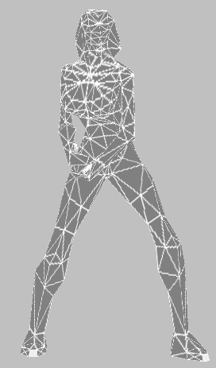
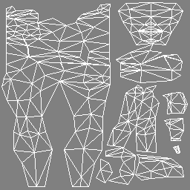
Example
domains of the 3D model
Parametric surfaces come with a 2D domain. Meshes: flatten parts to create a 2D domain.

Slide 12
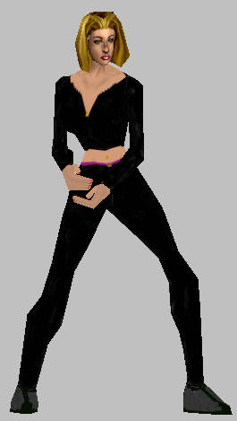
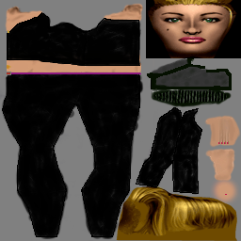
Textured

Slide 13
Decal Textures
+
=
Copyright©2003, Technion-Israel Institute of Technology

Slide 14
Where does mapping take place?
Mapping techniques are implemented at the end of the rendering pipeline
Very efficient because few polygons pass down the geometric pipeline
Geometric processing
Rasterization
Display
Vertices
Pixel operations
Pixels

Slide 15
Simple Texture Mapping
y
z
x
geometry
screen
t
image
s

Slide 16
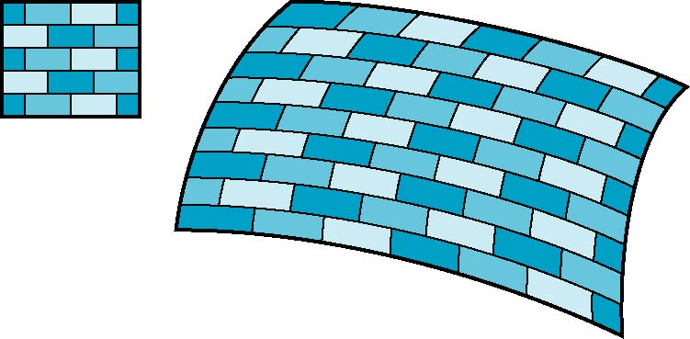
Is it simple?
Although the idea is simple---map an image to a surface---there are 3 or 4 coordinate systems involved
2D image
3D surface

Slide 17
Coordinate Systems
Parametric Coordinates
may be used to model curved surfaces
Texture Coordinates
used to identify points in the image to be mapped
World Coordinates
conceptually, where the mapping takes place
Screen Coordinates
where the final image is really produced

Slide 18
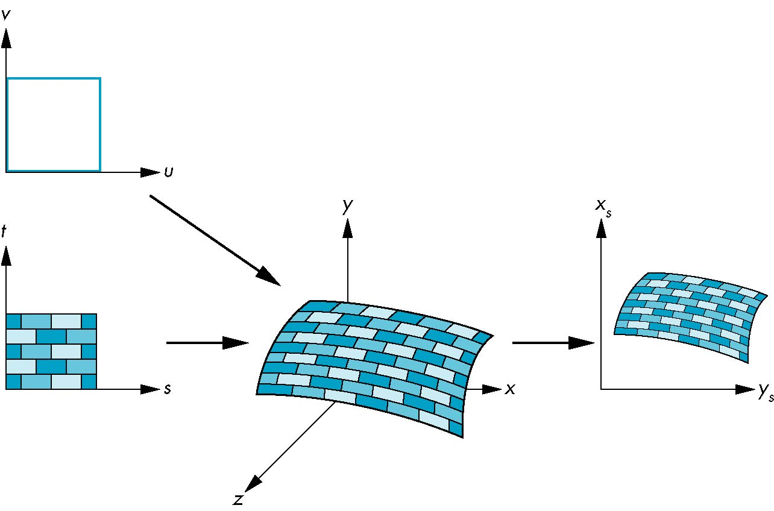
Texture Mapping
parametric coordinates
texture coordinates
screen coordinates
world coordinates

Slide 19
Texture Mapping = Pattern Mapping
y
v
u
surface of object
x
texture map
four corners of pixel on screen

Slide 20
Mapping Functions
Basic problem is how to find the maps
Consider mapping from texture coordinates to a point a surface
Appear to need three functions
x = x(s,t)
y = y(s,t)
z = z(s,t)
But we really want to go the other way
(x,y,z)
t
s

Slide 21
Backward Mapping
We really want to go backwards
Given a pixel, we want to know to which point on an object it corresponds
Given a point on an object, we want to know to which point in the texture it corresponds
Need a map of the form s = s(x,y,z) t = t(x,y,z)
Such functions are difficult to find in general

Slide 22
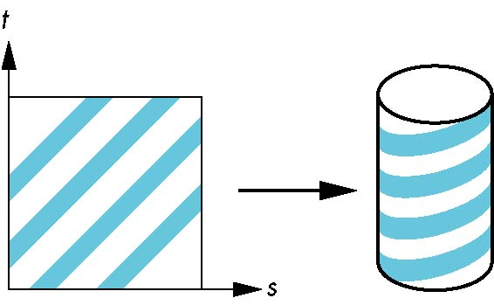
Two-part mapping
One solution to the mapping problem is to first map the texture to a simple intermediate surface
Example: map to cylinder

Slide 23
Cylindrical Mapping
parametric cylinder
x = r cos 2πu
y = r sin 2πu
z = v/h
maps rectangle in u, v space to cylinder of radius r and height h in world coordinates
s = u
t = v
maps from texture space

Slide 24
Cylindrical mapping

Slide 25
Spherical Map
We can use a parametric sphere
x = r cos 2πu
y = r sin 2πu cos 2πv
z = r sin 2πu sin 2πv
in a similar manner to the cylinder but have to decide where to put the distortion
Spheres are use in environmental maps

Slide 26
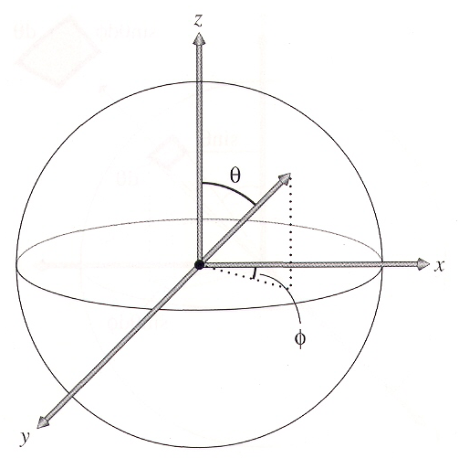
Spherical mapping

Slide 27
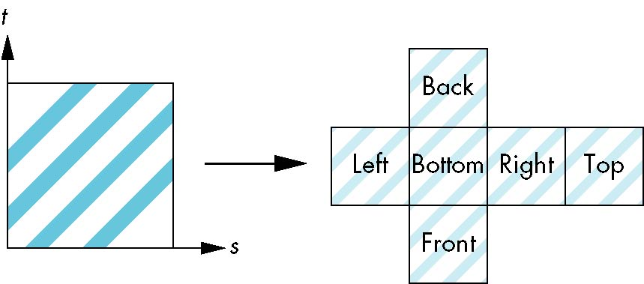
Box Mapping
Easy to use with simple orthographic projection
Also used in environmental maps

Slide 28
Planar mapping

Slide 29
Second Mapping
Map from intermediate object to actual object
Normals from intermediate to actual
Normals from actual to intermediate
Vectors from center of intermediate
actual
intermediate

Slide 30
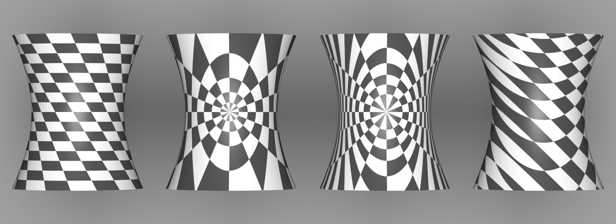
Texture Mapping
(u,v)
spherical
cylindrical
planar

Slide 31
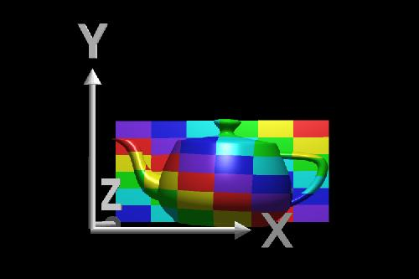
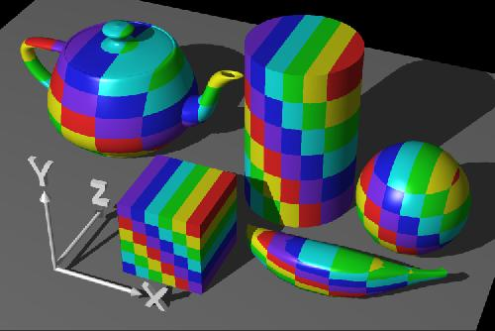
Planar Mapping

Slide 32
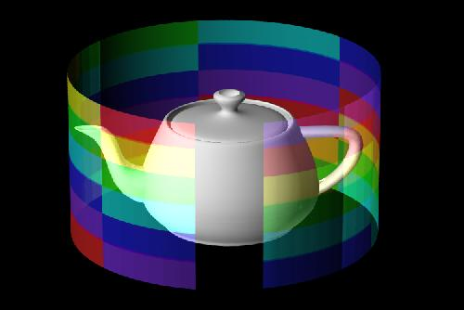
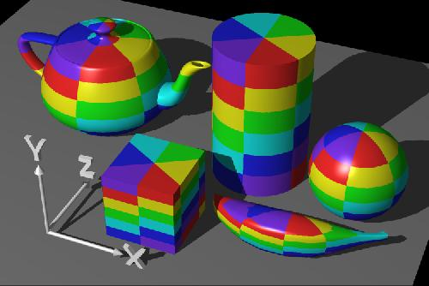
Cylindrical Mapping

Slide 33
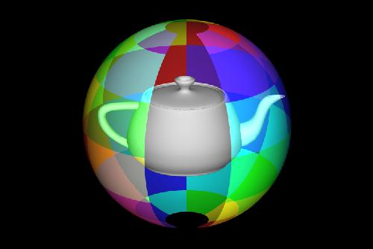
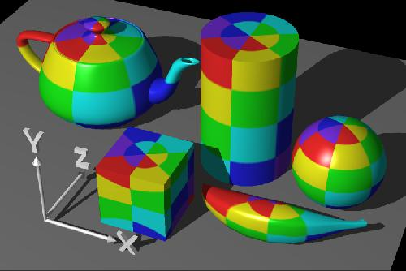
Spherical Mapping

Slide 34
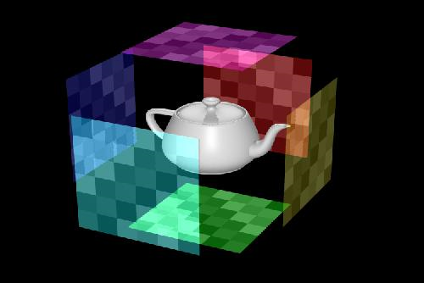
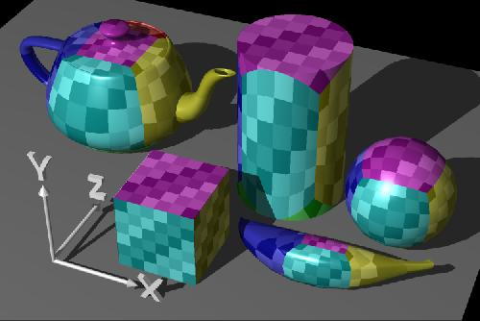
Box Mapping

Slide 35
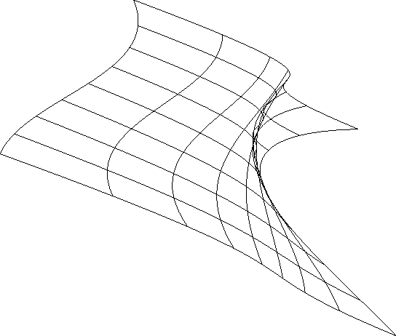
Parameterization
A parameterization of a surface is a one-to-one mapping from a suitable domain to the surface.
parametric surface:
surface parameterization:

Slide 36
Parameterization
v
z
P
S
y
x
u
How to get P from S ?
for each vertex of S, find its (u,v)
from (u,v) of P, map image to S
A parameterization of a surface is a mapping ρ: (x,y,z)->(u,v) from 3D space to 2D space

Slide 37
Texture Mapping & Polygon Rasterization
Problems of linearly interpolating texture coordinates in screen space.
Similar problems in the interpolations of colors for Gouraud shading and normals for Phong shading.
Problems in antialiasing
Expanding and shrinking

Slide 38
Linear Interpolation of Textures

Slide 39
Perspective Correction
Dividing the texture coordinates by w
Linearly interpolating (u/w, v/w, 1/w)
At each pixel, dividing (interpolated) u/w and v/w by (interpolated) 1/w

Slide 40
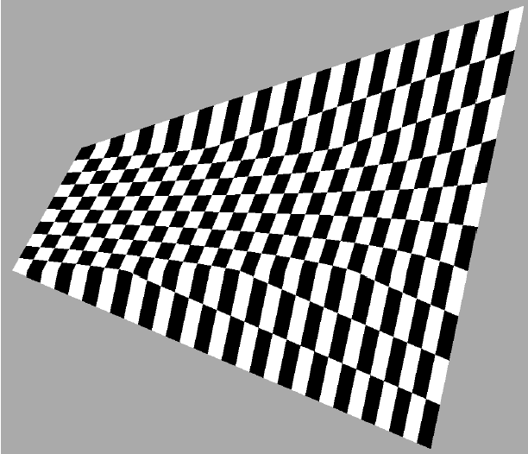
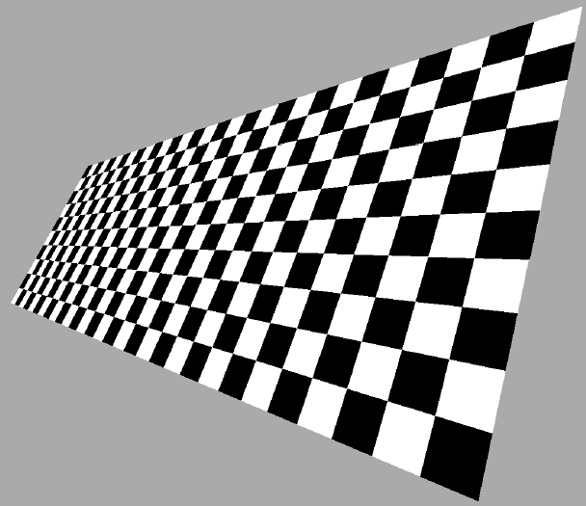
Example

Slide 41
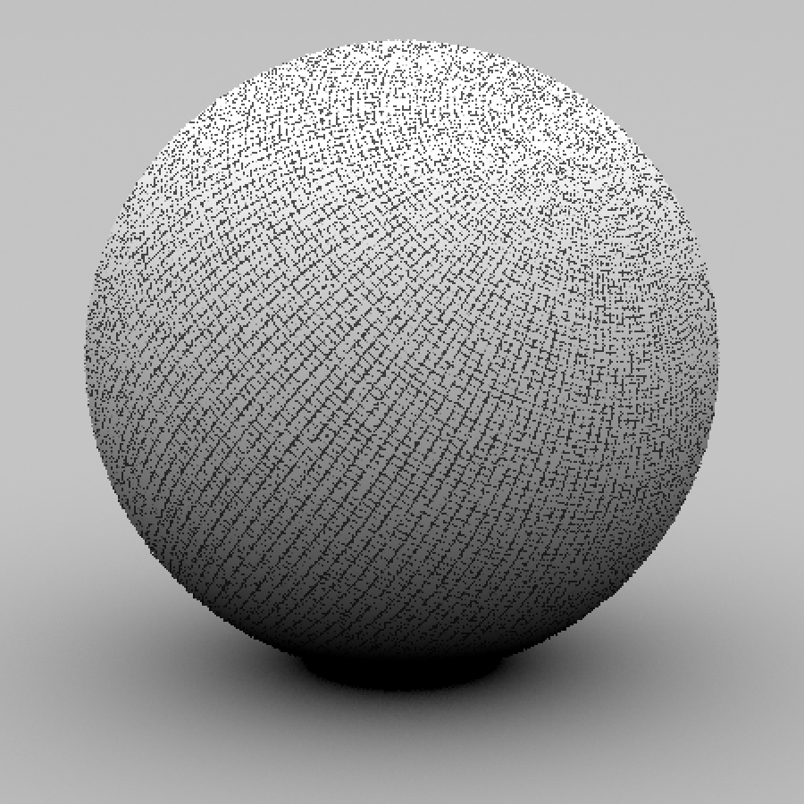
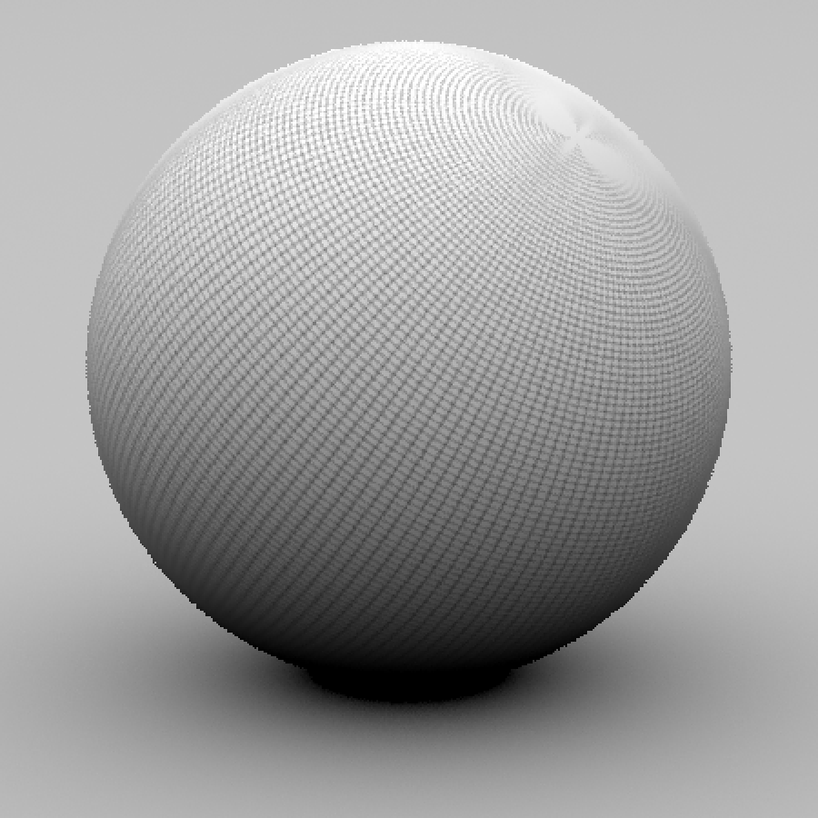
Antialiasing

Slide 42
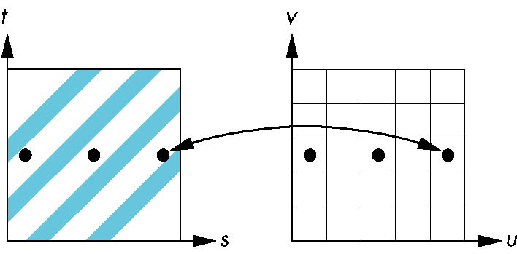
Aliasing
Point sampling of the texture can lead to aliasing errors
point samples in u,v
(or x,y,z) space
miss blue stripes
point samples in texture space

Slide 43
Magnification and Minification
Example:
Texture
Polygon
Texture
Polygon
Magnification
Minification
Notes:
Filter modes control how pixels are minified or magnified. Generally a color is computed using the nearest texel or by a linear average of several texels.
The filter type, above is one of GL_TEXTURE_MIN_FILTER or GL_TEXTURE_MAG_FILTER.
The mode is one of GL_NEAREST, GL_LINEAR, or special modes for mipmapping. Mipmapping modes are used for minification only, and have values of: GL_NEAREST_MIPMAP_NEAREST
GL_NEAREST_MIPMAP_LINEAR
GL_LINEAR_MIPMAP_NEAREST
GL_LINEAR_MIPMAP_LINEAR
Full coverage of mipmap texture filters is outside the scope of this course.

Slide 44
Sampling Texture Maps
over-sampling
under-sampling

Slide 45
Over-sampling
indicative of aliasing
high-frequency details showing up in areas where we expect to see low frequencies

Slide 46
Spatial Filtering
prefilter the texture to remove the high frequencies that show up as artifacts

Slide 47
Changing Resolution
?

Slide 48
Nearest Neighbor
a.k.a. zero order interpolation
use 1 nearest neighbor
?

Slide 49
Bilinear
a.k.a. first order interpolation
use 4 nearest neighbors
?

Slide 50
Bicubic
a.k.a. second order interpolation
use 16 nearest neighbors
?

Slide 51
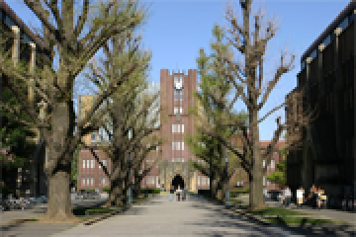
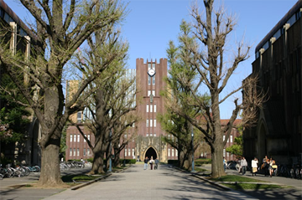
Example
nearest neighbor
bilinear
x2
bicubic
ground truth

Slide 52
Example
nearest neighbor
bicubic
bilinear

Slide 53
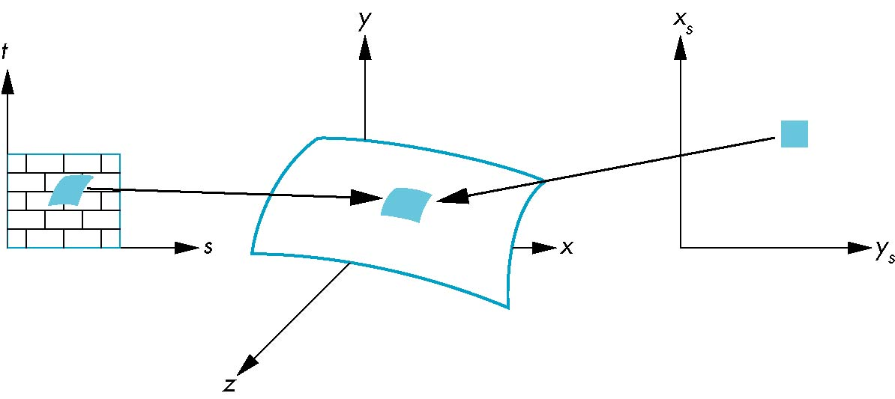
Area Averaging
A better but slower option is to use area averaging
Note that preimage of pixel is curved
pixel
preimage

Slide 54
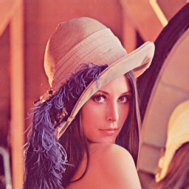
MIP Mapping
MIP Mapping is one popular technique for precomputing and performing this prefiltering
Computing this series of filtered images requires only a small fraction of additional storage over the original texture

Slide 55
Storing MIP Maps

Slide 56
Finding the MIP Level

Slide 57
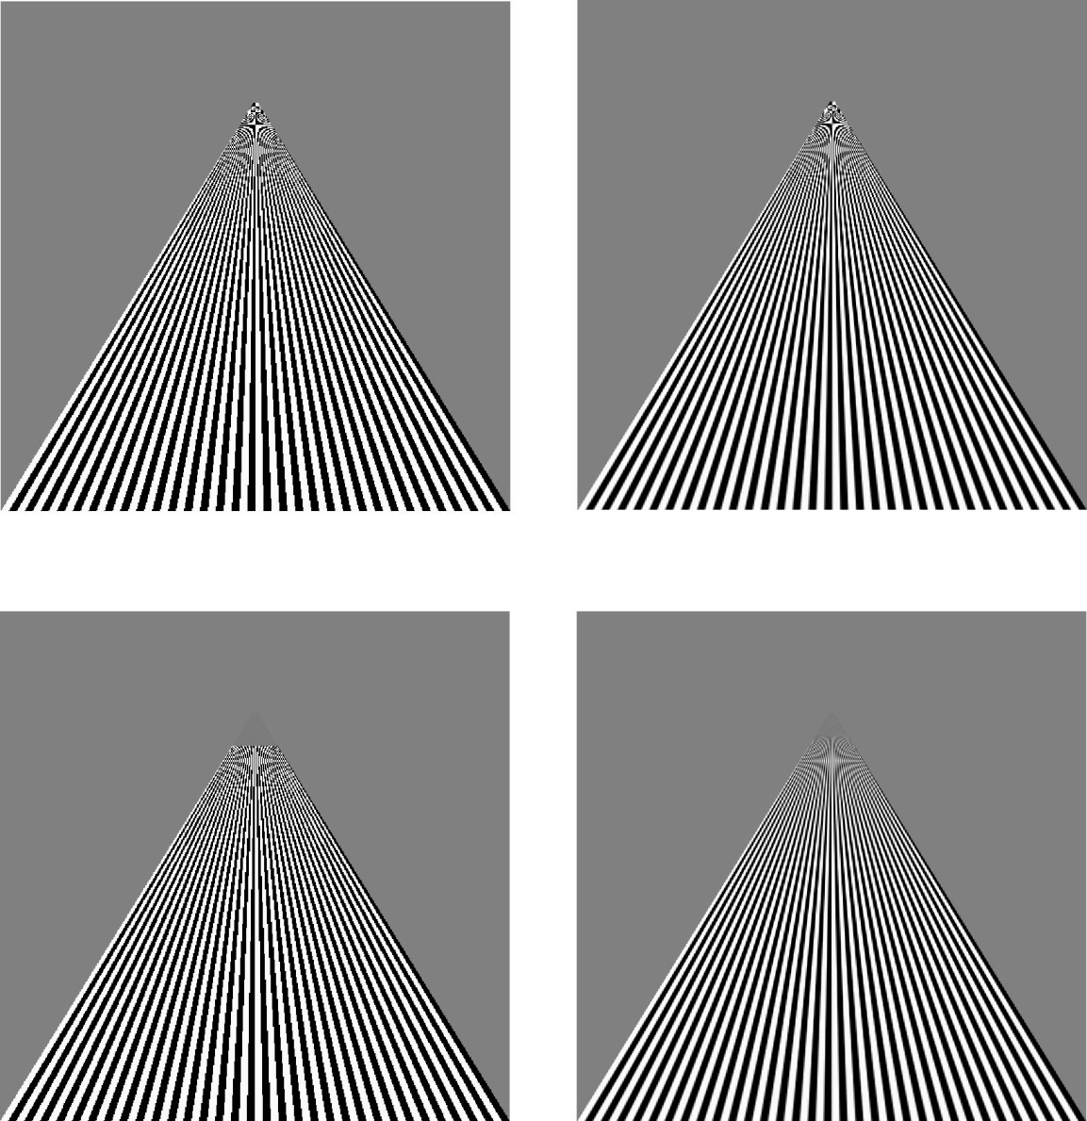
Example
point
sampling
linear
filtering
mipmapped
point
sampling
mipmapped
linear
filtering

Slide 58
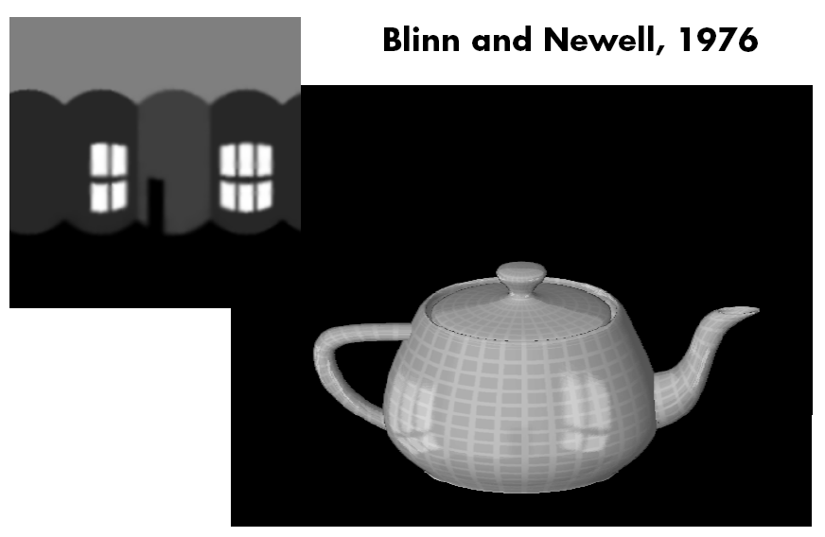
Reflection Maps

Slide 59
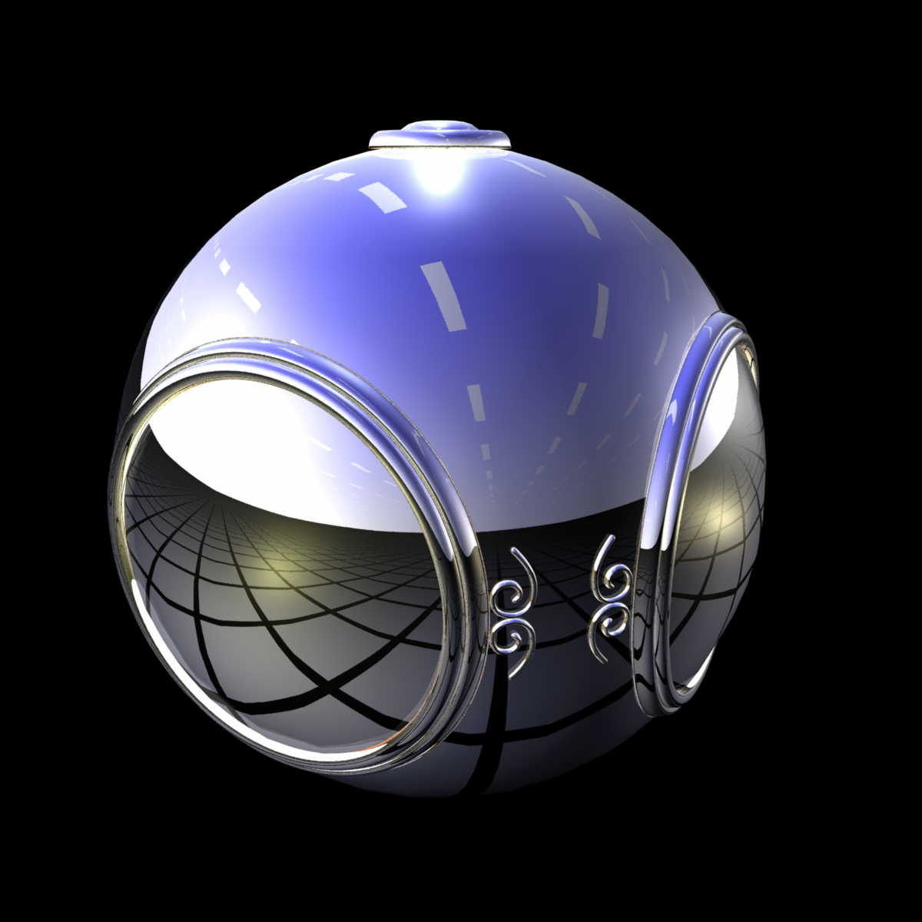
Environment Mapping

Slide 60
Sphere Mapping
Copyright©1999, Paul Debevec

Slide 61
Box Maps
Copyright©1999, Paul Debevec

Slide 62
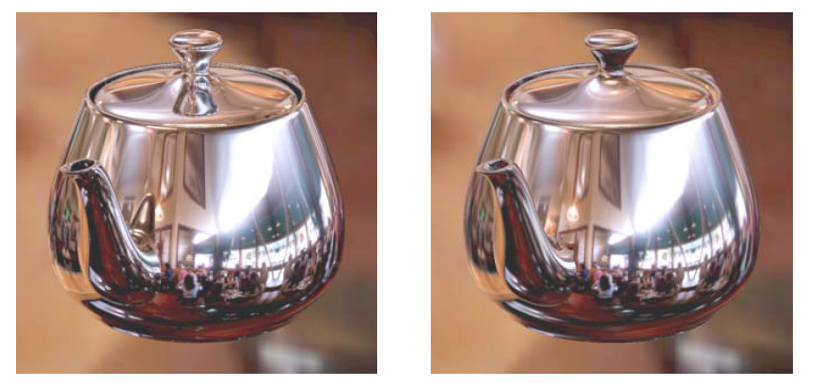
Environment Maps
ray traced
environment map

Slide 63
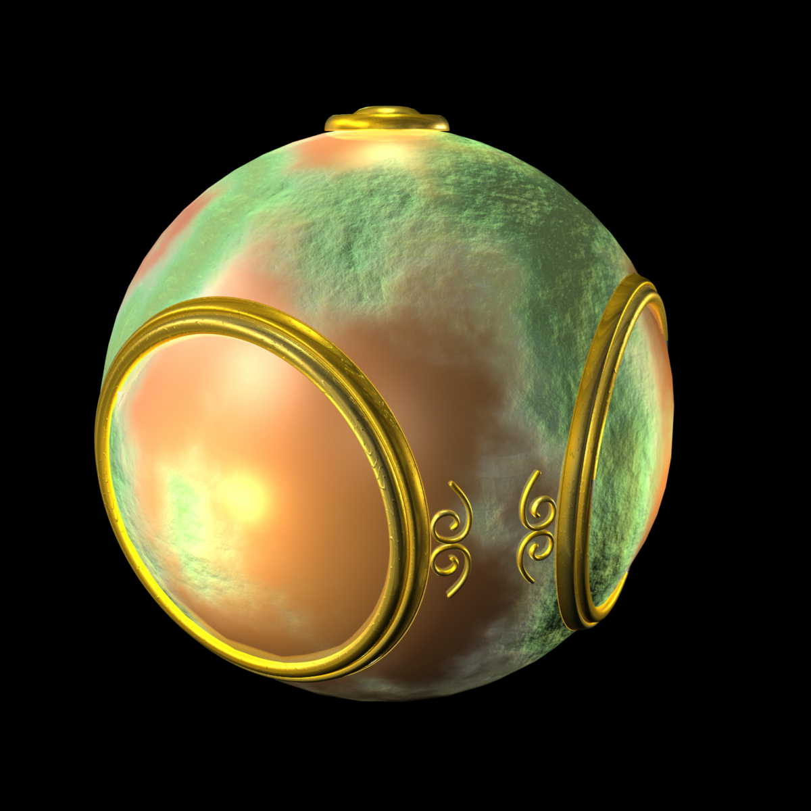
Bump Mapping

Slide 64
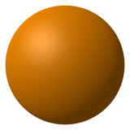
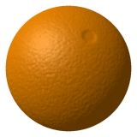
Bump Mapping

Slide 65
Bump Mapping
Textures can be used for more than just color
In bump mapping, a texture is used to perturb the normal:
The normal is perturbed in each parametric direction according to the partial derivatives of the texture.

Slide 66
Bump Mapping

Slide 67
Bump Mapping

Slide 68
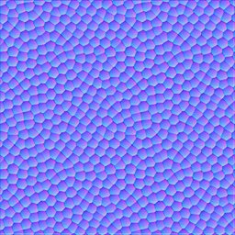
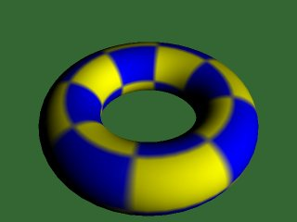
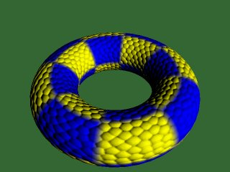
Bump Mapping

Slide 69
Displacement Mapping
In displacement mapping, a texture is used to perturb the surface geometry itself
Silhouettes are correct
Requires doing additional hidden surface calculations

Slide 70
Displacement Mapping

Slide 71
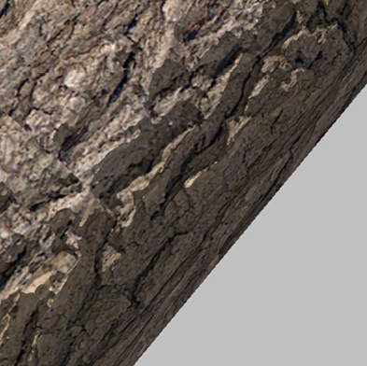
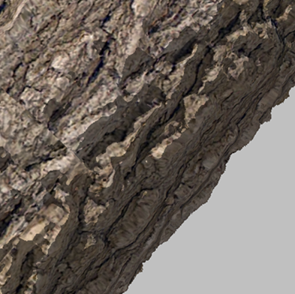
Bump Mapping & Displacement Mapping
Copyright©2003, Microsoft

Slide 72
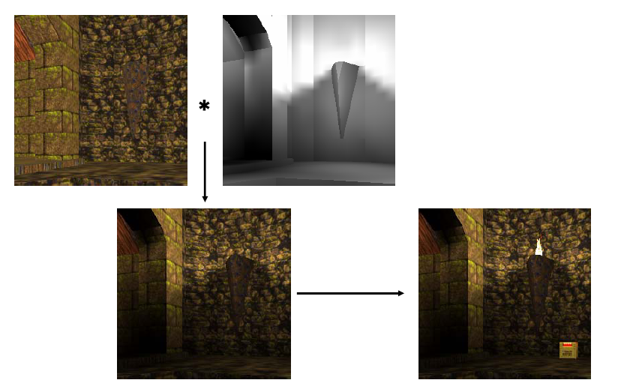
Illumination Maps

Slide 73
Texture Mapping in Quake
Texture Only
Texture & Light Maps
Light Map

Slide 74
Shadow Maps

Slide 75
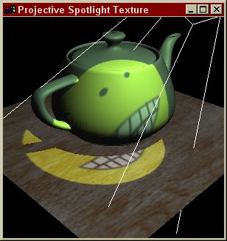
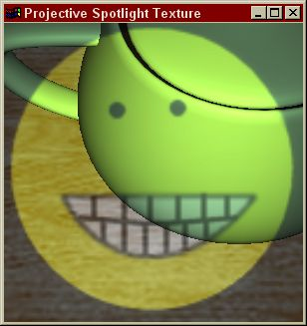
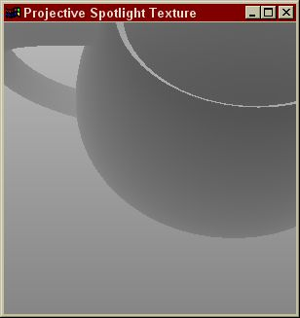
Basic Steps of Shadow Maps
Render the scene from the light’s point of view,
Use the light’s depth buffer as a texture (shadow map),
Projectively texture the shadow map onto the scene,
Use “texture color” (comparison result) in fragment shading.
Eye’s View
Light’s View
Depth/Shadow Map

Slide 76
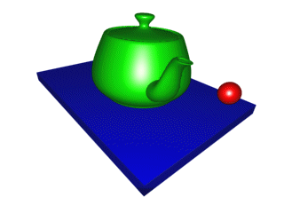
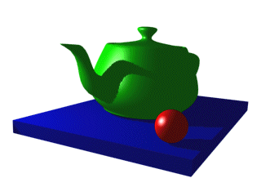
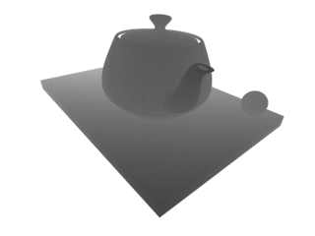
Shadow Buffer

Slide 77
Three Dimensional or Solid Textures
Copyright©1985, Ken Perlin

Slide 78
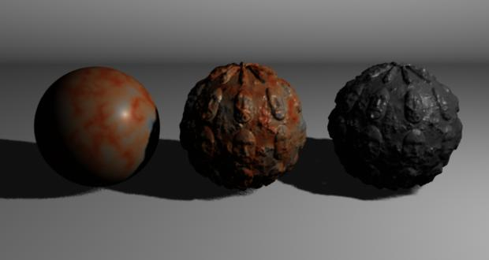
Solid Textures

Slide 79
Solid Textures

Slide 80
Noise (Tri-linear) Interpolation

Slide 81
Evaluating Noise

Slide 82
Turbulence

