Slide 1
Computer Graphics
Ken-Yi Lee National Taiwan University

Slide 2
OpenGL Shading Language
Graphics Pipeline and Shader Programming
Introduction to GLSL
Language basics
Built-in variables
Built-in functions
OpenGL Shading Language APIs
More Examples

Slide 3
Fixed Functionality Pipeline
API
Triangles/Lines/Points
Primitive
Processing
Vertices
Transform
and
Lighting
Primitive
Assembly
Rasterizer
Vertex
Buffer
Objects
Texture
Environment
Color
Sum
Fog
Alpha
Test
Depth
Stencil
Color
Buffer
Blend
Dither
Frame Buffer
Notes:
The slides are from http://people.freedesktop.org/~idr/GLSL_presentation/GLSL-Portland-Benj.PPT

Slide 4
Programmable Shader Pipeline
API
Triangles/Lines/Points
Primitive
Processing
Vertices
Vertex
Shader
Primitive
Assembly
Rasterizer
Vertex
Buffer
Objects
Fragment
Shader
Alpha
Test
Depth
Stencil
Color
Buffer
Blend
Dither
Frame Buffer

Slide 5
Programming Model
Attributes
(m * vec4)
Vertex Uniforms
(p * vec4)
Vertex
Shader
Primitive
Assembly
& Rasterize
Varyings
(n * vec4)
Fragment Uniforms
(q * vec4)
Fragment
Shader
Per-Sample
Operations

Slide 6
Vertex Shader Environment
Uniforms
Textures
Varying 0
Attribute 0
Varying 1
Attribute 1
Vertex Shader
Varying 2
Attribute 2
Varying 3
Attribute 3
Varying 4
Attribute 4
Varying 5
Attribute 5
…
…
Varying n
Attribute m
Position
Attributes
(m * vec4)
Clip Position
Temporary variables
Point size
Vertex Uniforms
(p * vec4)
Vertex
Shader
Primitive
Assembly
& Rasterize
Varyings
(n * vec4)
Fragment Uniforms
(q * vec4)
Fragment
Shader
Per-Sample
Operations

Slide 7
Fragment Shader Environment
Uniforms
Textures
Varying 0
Varying 1
Varying 2
Fragment Shader
Varying 3
Varying 4
Fragment Color(s)
Varying 5
Fragment Depth
…
Varying n
Varyings
(n * vec4)
Window coord
Front Facing
Temporary variables
Point coord
Fragment Uniforms
(q * vec4)
Fragment
Shader
Per-Sample
Operations

Slide 8
Hello World!
Vertex Shader
void main()
{
gl_FrontColor = gl_Color;
gl_Position = gl_ModelViewProjectionMatrix * gl_Vertex;
}
Fragment Shader
void main()
{
gl_FragColor = gl_Color;
}

Slide 9
Language Basics
Data Types
Qualifiers
Operators
Constructors
Swizzles
Flow Control
Functions

Slide 10
Language Basics: Data Types
Scalar
void float int bool
Vector
Floating point: vec2 vec3 vec4
Integer: ivec2 ivec3 ivec4
Boolean: bvec2 bvec3 bvec4
Matrix
mat2 mat3 mat4 == mat2x2 mat3x3 mat4x4
mat2x3 mat2x4 mat3x2 mat3x4 mat4x2 mat4x3
Containers
Structures: struct
Arrays: []

Slide 11
Language Basics: Qualifiers
Global variables:
attribute
Change per-vertex
e.g. position, normal, color, etc.
uniform
Don’t change between vertices of a batch
e.g. light position, texture unit, other state variables
varying
Passed from vertex shader to fragment shader
Interpolated during rasterization
e.g. texture coordinates, vertex color

Slide 12
Language Basics: Operators
Grouping, function/constructor ()
Array/component indexing []
Component/member selection .
Unary ++ -- + - !
Binary * / + -
Relational < <= > >= == !=
Logical && ^^ ||
Ternary conditional ?:
Assignment = *= /= += -=
Sequence ,

Slide 13
Language Basics: Constructors
Used to initialize a structure or built-in type
Built-in type initialization:
vec3 myRGB = vec3(0.25, 0.5, 0.75);
Providing enough components of correct type
vec2 myYZ = vec2(0.5, 0.75);
vec4 myPos = vec4(0.25, myYZ, 1.0);
Explicit type conversions :
Only int to float implicit conversions are allowed
float numTexels = countTexels();
if (!bool(numTexels)) discard;

Slide 14
Language Basics: Swizzles
Components from {xyzw}, {rgba}, or {stpq}
vec4 foo = vec4(1.0); foo.xyz = vec3(0.25, 0.5, 0.75); foo.wzyx = foo; // reverse the components foo = foo.wzyx; // another way to reverse components foo = foo.xxyy; // components reusable on right side mat4 myMatrix = mat4(1.0); foo.x = foo[2]; // same as foo.x = foo.z; foo = myMatrix[0]; // first column of matrix foo.x = myMatrix[0][0]; // first column, first row

Slide 15
Language Basics: Flow Control
for, while, do
Loops can have break, continue
if else
Function calls
Can have return
More on function calls in next slide
The above can all be nested!
Note: no unstructured jumps (a.k.a goto)
discard
Only available in fragment shaders
“Kills” the fragment, no further processing in the pipeline

Slide 16
Language Basics: Functions
Special storage qualifiers apply to function parameters, e.g.:
bool f(in vec2 inputVec, out float retVal) {
...
}
in: Parameter is copied in to the function but not copied out (default)
out: Parameter is copied out of the function but not copied in
inout: Parameter is both copied in and copied out
Notes
Recursion is strictly forbidden!
Functions can return a value or void

Slide 17
Built-in Variables (Vertex Shader)
Inputs
attribute vec4 gl_Vertex
attribute vec3 gl_Normal
attribute vec4 gl_Color
attribute vec4 gl_SecondaryColor
attribute vec4 gl_MultiTexCoordN (0-7)
attribute float gl_FogCoord
Outputs
vec4 gl_Position (required)
float gl_PointSize
vec4 gl_ClipVertex
varying vec4 gl_FrontColor
varying vec4 gl_BackColor
varying vec4 gl_FrontSecondaryColor
varying vec4 gl_BackSecondaryColor
varying vec4 gl_TexCoord[n]
varying float gl_FogFragCoord

Slide 18
Built-in Variables (Fragment Shader)
Inputs
vec4 gl_FragCoord
bool gl_FrontFacing
vec2 gl_PointCoord
varying vec4 gl_Color
varying vec4 gl_SecondaryColor
varying vec4 gl_TexCoord[n]
varying float gl_FogFragCoord
Outputs
vec4 gl_FragColor
vec4 gl_FragData[n]
float gl_FragDepth

Slide 19
Built-in Variables (Uniforms)
(Almost removed in OpenGL 3.0 and OpenGL ES 2.0)
Uniform mat4 gl_ModelViewMatrix
Uniform mat4 gl_ModelViewProjectionMatrix
Uniform mat4 gl_ProjectionMatrix
Uniform mat3 gl_NormalMatrix
Uniform glLightSourceParameters gl_LightSource[]
Uniform glMaterialParameters gl_FrontMaterial
Uniform vec4 gl_ClipPlane[]

Slide 20
Built-in functions (1)
Angles & Trigonometry
radians, degrees, sin, cos, tan, asin, acos, atan
Exponentials
pow, exp2, log2, sqrt, inversesqrt
Common
abs, sign, floor, ceil, fract, mod, min, max, clamp
Geometric
length, distance, cross, dot, normalize, faceForward, reflect
Interpolations
mix(x,y,a)
step(edge,x)

Slide 21
Built-in functions (2)
Texture
texture1D, texture2D, texture3D, textureCube
texture1DProj, texture2DProj, texture3DProj, textureCubeProj
shadow1D, shadow2D, shadow1DProj, shadow2Dproj
Vertex
ftransform
Matrix
matrixCompMult
Vector relational
lessThan, lessThanEqual, greaterThan, greaterThanEqual, equal, notEqual, notEqual, any, all

Slide 22
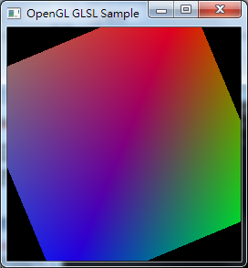
Hello World!
Fixed.vert
void main(void)
{
gl_FrontColor = gl_Color;
gl_Position = gl_ModelViewProjectionMatrix * gl_Vertex;
}
Fixed.frag
void main(void)
{
gl_FragColor = gl_Color;
}

Slide 23
OpenGL Shading Language API (1)
Shaders
Shader
glCreateShader
glShaderSource
glCompileShader
Program
glAttachShader
glLinkProgram
glUseProgram

Slide 24
1
2
3
4
5
6
7
8
9
10
11
12
13
14
15
16
17
18
19
20
21
glewInit();
GLuint v = glCreateShader(GL_VERTEX_SHADER);
GLuint f = glCreateShader(GL_FRAGMENT_SHADER);
char *vs = readTextFile(vert_filename);
char *fs = readTextFile(frag_filename);
glShaderSource(v, 1, (const char**)&vs, NULL);
glShaderSource(f, 1, (const char**)&fs, NULL);
free(vs);
free(fs);
glCompileShader(v);
glCompileShader(f);
GLuint p = glCreateProgram();
glAttachShader(p, v);
glAttachShader(p, f);
glLinkProgram(p);
glUseProgram(p);

Slide 25
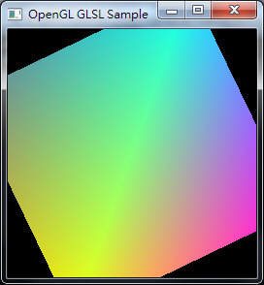
Color Manipulation (1)
Fixed.frag
void main(void)
{
gl_FragColor = gl_Color;
}
Invert.frag
void main(void)
{
gl_FragColor.rgb = 1.0 - gl_Color.rgb;
gl_FragColor.a = 1.0;
}

Slide 26
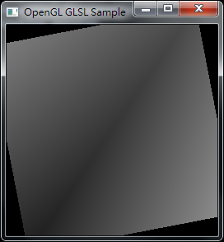
Color Manipulation (2)
Gray.frag
1
2
3
4
5
6
7
8
void main(void)
{
// Convert to grayscale using NTSC conversion weights
float gray = dot(gl_Color.rgb, vec3(0.299, 0.587, 0.114));
// replicate grayscale to RGB components
gl_FragColor = vec4(gray, gray, gray, 1.0);
}

Slide 27
OpenGL Shading Language API (2)
1
2
3
4
glActiveTexture(GL_TEXTURE0);
glBindTexture(GL_TEXTURE_2D, texture);
GLint sampler0 = glGetUniformLocation(p,"sampler0");
glUniform1i(sampler0, 0);
Texture
glActiveTexture
glBindTexture
glTexParameter*
glTexImage*
Pass texture coordinates as attributes
glTexCoord (always GL_TEXTURE0)
glMultiTexCoord
Use user-defined uniforms to get textures (samplers)
glGetUniformLocation*
glUniform*

Slide 28
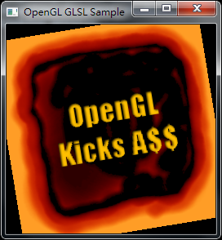
Texture Mapping
Tex.vert
void main(void)
{
gl_TexCoord[0] = gl_MultiTexCoord0;
gl_FrontColor = gl_Color;
gl_Position = gl_ModelViewProjectionMatrix * gl_Vertex;
}
Tex.frag
uniform sampler2D sampler0;
void main() {
gl_FragColor = texture2D(sampler0, gl_TexCoord[0].st);
}

Slide 29
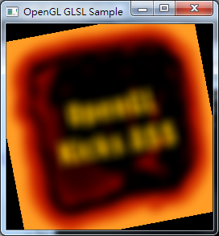
Image Blurring
1
2
3
4
5
6
7
8
9
10
11
12
13
14
15
16
17
18
19
uniform sampler2D sampler0;
uniform vec2 tc_offset;
void main(void)
{
const int k = 9;
const int w = 2*k+1;
vec4 sum = vec4(0.);
float weight_sum = 0.;
for (int i = -k; i <= k; ++i) {
for (int j = -k; j <= k; ++j) {
float weight = exp(-float(i*i+j*j)/float(k*k));
weight_sum += weight;
sum += weight * texture2D( sampler0, gl_TexCoord[0].st+tc_offset*vec2(i, j));
}
}
gl_FragColor = sum / weight_sum;
}
Blur.frag

Slide 30
More Examples
GLSLDemo
Download:
http://3dshaders.com/home/index.php?option=com_weblinks&catid=14&Itemid=34
We will use this program to run our shaders.

Slide 31
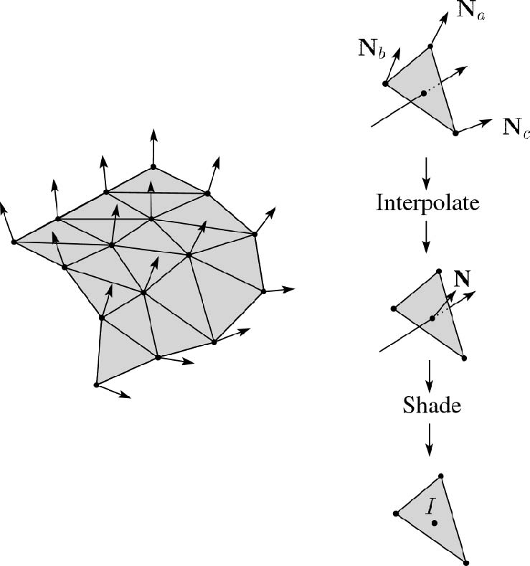
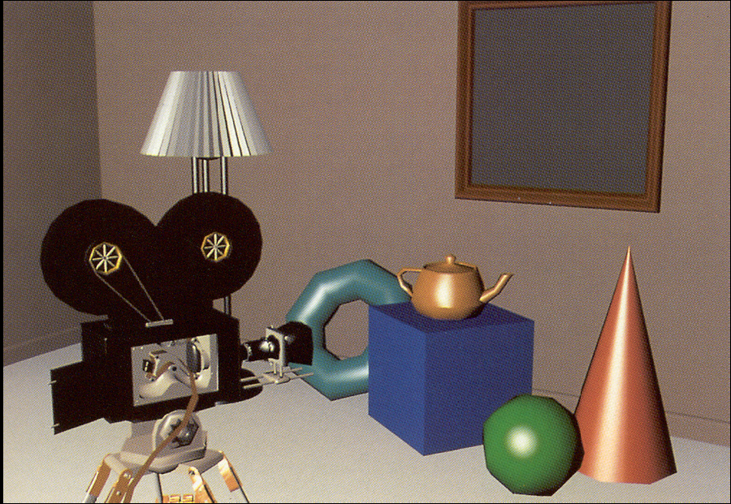
[Recap.] Phong Shading

Slide 32
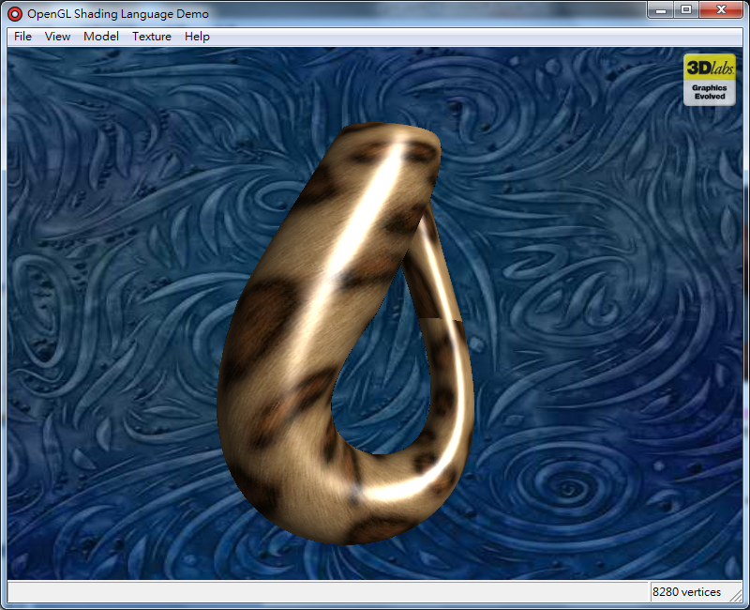
Phong Shading
Phong.vert
1
2
3
4
5
6
7
8
9
10
11
varying vec3 normal;
varying vec3 vertex;
void main() {
normal = normalize(gl_NormalMatrix * gl_Normal).xyz;
vertex = (gl_ModelViewMatrix * gl_Vertex).xyz;
gl_TexCoord[0] = gl_MultiTexCoord0;
gl_FrontColor = gl_Color;
gl_Position = gl_ModelViewProjectionMatrix * gl_Vertex;
}

Slide 33
1
2
3
4
5
6
7
8
9
10
11
12
13
14
15
16
17
18
19
20
21
uniform sampler2D sampler0;
varying vec3 normal, vertex;
uniform vec3 LightPosition;
uniform float Ia, Id, Is, shineness;
uniform vec3 Ic;
void main() {
vec3 c = texture2D(sampler0, gl_TexCoord[0].st).rgb;
vec3 I = vec3(0.0); vec3 n = normalize(normal);
vec3 l = normalize(LightPosition-vertex);
vec3 v = normalize(-vertex);
vec3 h = normalize(l+v);
if(dot(n,v) > 0.0) {
I += Ia*Ic*c; // ambient;
I += Id*Ic*c*max(dot(n,l),0.0); // diffuse
I += Is*Ic*pow(max(dot(n,h),0.0), shineness);
}
gl_FragColor = vec4(I, 1.0);
}
Phong.frag

Slide 34
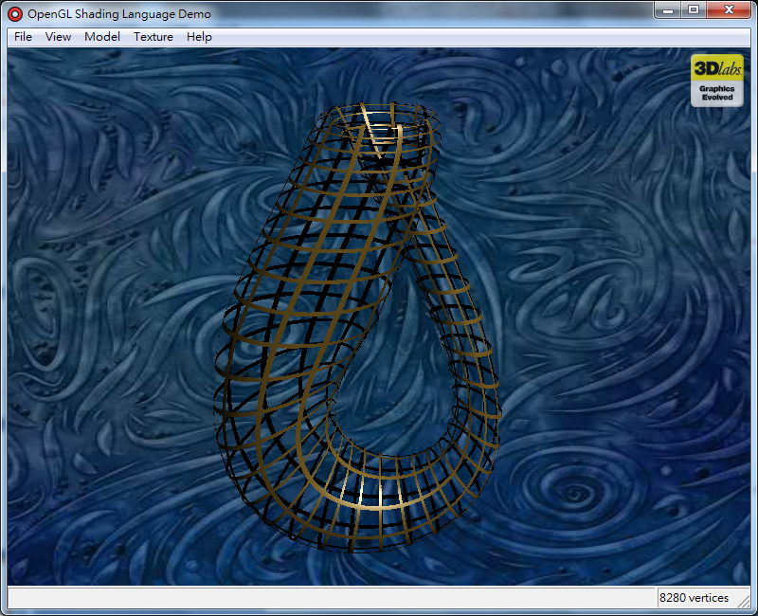
Lattice Effect
Lattice.vert = Phong.vert
Lattice.frag ~ Phong.frag
<deleted>
uniform vec2 Scale;
uniform vec2 Threshold;
void main() {
float ss = fract(gl_TexCoord[0].s * Scale.s);
float tt = fract(gl_TexCoord[0].t * Scale.t);
if ((ss > Threshold.s) && (tt > Threshold.t)) discard;
<deleted>
gl_FragColor = vec4(I, 1.0);
}
1
2
3
4
5
6
7
8
9
10

Slide 35
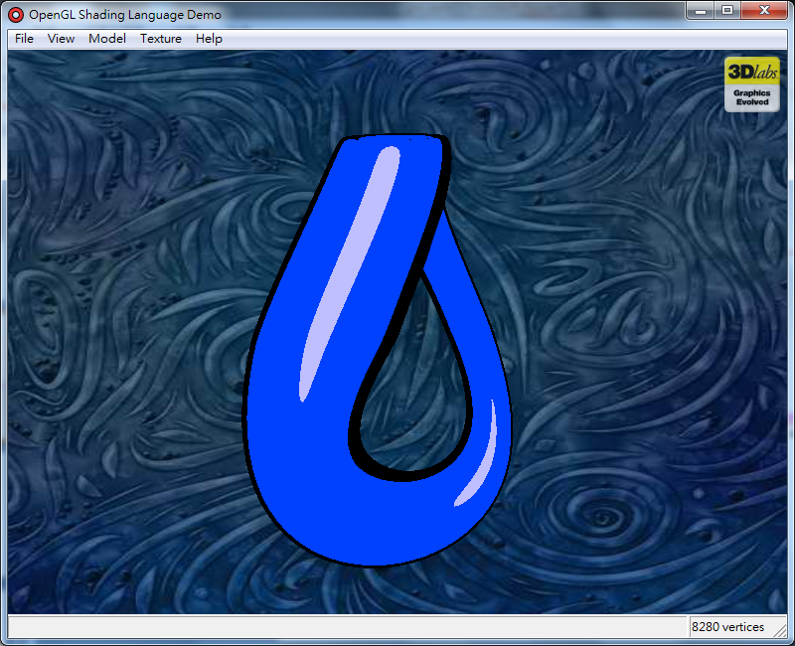
Toon Shading (1)
Toon.vert
1
2
3
4
5
6
7
varying vec3 normal;
void main(void)
{
normal = normalize(gl_NormalMatrix * gl_Normal);
gl_Position = gl_ModelViewProjectionMatrix * gl_Vertex;
}

Slide 36
Toon Shading (2)
Toon.frag
1
2
3
4
5
6
7
8
9
10
11
12
13
14
15
16
uniform vec3 DiffuseColor;
uniform vec3 PhongColor;
uniform float Edge;
uniform float Phong;
varying vec3 normal;
void main (void)
{
vec3 color = DiffuseColor;
float f = dot(vec3(0,0,1),normalize(normal));
if (abs(f) < Edge)
color = vec3(0);
if (f > Phong)
color = PhongColor;
gl_FragColor = vec4(color, 1);
}

Slide 37
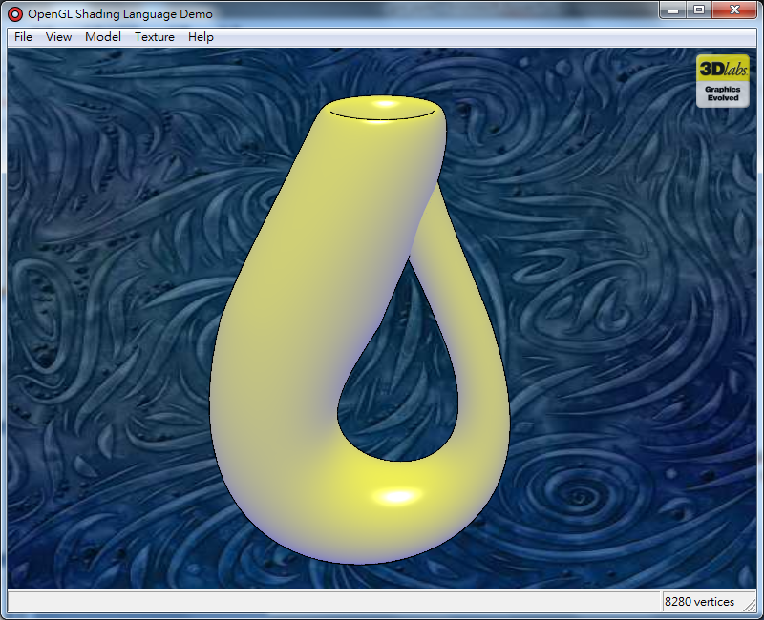
Gooch Effect
Gooch.vert
1
2
3
4
5
6
7
8
9
10
11
12
13
14
15
uniform vec3 LightPosition; // (0.0, 10.0, 4.0)
varying float NdotL;
varying vec3 R;
varying vec3 V;
void main(void)
{
vec3 ecPos = vec3 (gl_ModelViewMatrix * gl_Vertex);
vec3 tnorm = normalize(gl_NormalMatrix * gl_Normal);
vec3 L = normalize(LightPosition - ecPos);
R = normalize(reflect(-L, tnorm));
V = normalize(-ecPos);
NdotL = (dot(L, tnorm) + 1.0) * 0.5;
gl_Position = ftransform();
}

Slide 38
1
2
3
4
5
6
7
8
9
10
11
12
13
14
15
16
17
18
19
20
21
22
23
24
uniform vec3 SurfaceColor; // (0.75, 0.75, 0.75)
uniform vec3 WarmColor; // (0.6, 0.6, 0.0)
uniform vec3 CoolColor; // (0.0, 0.0, 0.6)
uniform float DiffuseWarm; // 0.45
uniform float DiffuseCool; // 0.45
varying float NdotL;
varying vec3 R;
varying vec3 V;
void main (void)
{
vec3 kcool = min(CoolColor+DiffuseCool*SurfaceColor,1.0);
vec3 kwarm = min(WarmColor+DiffuseWarm*SurfaceColor,1.0);
vec3 kfinal = mix(kcool, kwarm, NdotL);
vec3 nreflect = normalize(R);
vec3 nview = normalize(V);
float spec = max(dot(nreflect, nview), 0.0);
spec = pow(spec, 32.0);
gl_FragColor = vec4 (min(kfinal + spec, 1.0), 1.0);
}
Gooch.frag

Slide 39
OpenGL Shading Language API (3)
Binding variables
(Vertex) Attributes
glBindAttribLocation
glVertexAttribNT
glVertexAttribPointer
glEnableVertexAttribArray
glGetAttribLocation
Uniforms
glGetUniformLocation
glUniformNT
glUniformMatrixNT

Slide 40
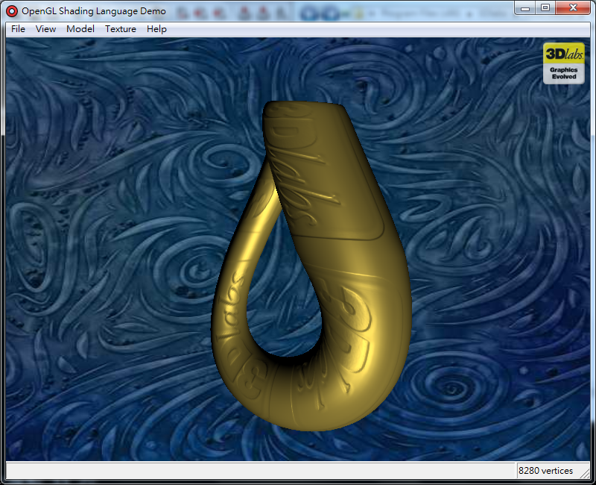
Bump Mapping
1
2
3
4
5
6
7
8
9
10
11
12
13
14
15
16
17
18
19
varying vec3 lightDir, viewDir;
attribute vec3 Tangent, Binormal;
uniform vec3 LightPosition;
void main(void) {
vec3 b, n, t, pos, lightVec, r, v;
gl_Position = gl_ModelViewProjectionMatrix * gl_Vertex;
gl_TexCoord[0] = gl_MultiTexCoord0;
t = normalize(gl_NormalMatrix * Tangent);
b = normalize(gl_NormalMatrix * Binormal);
n = normalize(gl_NormalMatrix * gl_Normal);
v.x = dot(LightPosition, t);
v.y = dot(LightPosition, b);
v.z = dot(LightPosition, n);
lightDir = normalize(v);
pos = vec3(gl_ModelViewMatrix * gl_Vertex);
v.x = dot(pos, t);
v.y = dot(pos, b);
v.z = dot(pos, n);
viewDir = normalize(v); }
Bumpmap.vert

Slide 41
Bumpmap.frag
1
2
3
4
5
6
7
8
9
10
11
12
13
14
15
16
17
18
19
20
21
22
uniform sampler2D NormalMap;
uniform float DiffuseFactor, SpecularFactor;
uniform vec3 BaseColor;
varying vec3 lightDir, viewDir;
void main (void) {
vec3 norm, r, color;
float intensity, spec, d;
norm = vec3(texture2D(NormalMap, vec2(gl_TexCoord[0])));
norm = (norm - 0.5) * 2.0;
norm.y = -norm.y;
intensity = max(dot(lightDir, norm), 0.0) * DiffuseFactor;
// Compute specular reflection component
d = 2.0 * dot(lightDir, norm);
r = d * norm;
r = lightDir - r;
spec = pow(max(dot(r, viewDir), 0.0),6.0)*SpecularFactor;
intensity += min(spec, 1.0);
// Compute color value
color = clamp(BaseColor * intensity, 0.0, 1.0);
// Write out final fragment color
gl_FragColor = vec4(color, 1.0);
}

Slide 42
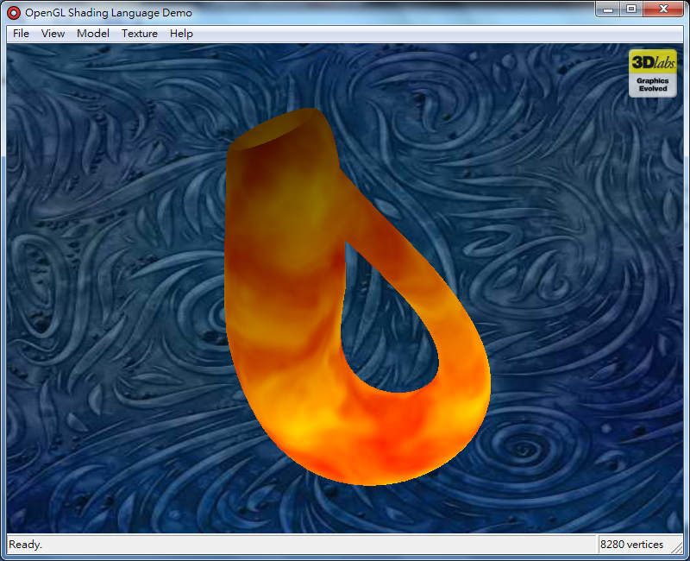
Inferno Effect
Inferno.vert
varying vec3 Position;
uniform float Scale;
void main(void)
{
Position = vec3(gl_Vertex) * Scale;
gl_Position = gl_ModelViewProjectionMatrix * gl_Vertex;
}
1
2
3
4
5
6
7
8

Slide 43
Inferno.frag
varying vec3 Position;
uniform float Offset;
uniform vec3 FireColor1, FireColor2;
uniform float Extent;
uniform sampler3D sampler3d;
void main (void)
{
vec4 noisevec = texture3D(sampler3d, Position);
noisevec = texture3D(
sampler3d,Position+noisevec+vec3(0,Offset,0));
float intensity = 0.75*dot(noisevec, vec4(1.0));
intensity = 1.95 * abs(2.0 * intensity - 0.35);
intensity = clamp(intensity, 0.0, 1.0);
float alpha = fract((Position.y+Extent)*0.65);
vec3 color = mix(FireColor1, FireColor2, intensity)*
(1.0 - alpha)*2.0;
gl_FragColor = vec4(color, 1.0f);
}

Slide 44
Wobble Effect
Wobble.vert
1
2
3
4
5
6
7
8
9
10
11
12
13
14
15
16
17
varying float LightIntensity;
uniform vec3 LightPosition;
const float specularContribution = 0.1;
const float diffuseContribution = 1.0 - specularContribution;
void main(void){
vec3 vertex = vec3 (gl_ModelViewMatrix * gl_Vertex);
vec3 N = normalize(gl_NormalMatrix * gl_Normal);
vec3 L = normalize(LightPosition - vertex);
vec3 R = normalize(reflect(-L, N));
vec3 V = normalize(-vertex);
float spec = pow(max(dot(R, V), 0.0), 16.0);
LightIntensity = diffuseContribution * max(dot(L, N), 0.0)
+ specularContribution * spec;
gl_TexCoord[0] = gl_MultiTexCoord0;
gl_Position = ftransform();
}

Slide 45
Wobble.frag
1
2
3
4
5
6
7
8
9
10
11
12
13
14
15
16
17
18
19
20
21
<skipped>
varying float LightIntensity;
uniform float StartRad;
uniform vec2 Freq;
uniform vec2 Amplitude;
uniform sampler2D WobbleTex;
void main (void) {
float rad;
vec2 perturb;
vec4 color;
rad =(gl_TexCoord[0].s+gl_TexCoord[0].t-1.0 + StartRad)*
Freq.x;
<skipped>
perturb.x = (rad - (rad * rad * rad / 6.0)) * Amplitude.x;
rad = (gl_TexCoord[0].s-gl_TexCoord[0].t+StartRad)*
Freq.y;
<skipped>
perturb.y = (rad - (rad * rad * rad / 6.0)) * Amplitude.y;
color = texture2D(WobbleTex, perturb + gl_TexCoord[0].st);
gl_FragColor = vec4(color.rgb * LightIntensity, color.a);
}

Slide 46
Particle Effect
1
2
3
4
5
6
7
8
9
10
11
12
13
14
15
16
17
varying vec4 Color;
const float maxy = 1.85;
const float rad = 1.75;
void main(void)
{
float t = time;
t = mod(clamp(t - gl_Color.a, 0.0, 10000.0), 1.0);
vec4 vertex = gl_Vertex;
vertex.x = rad*gl_Color.y*t*sin(gl_Color.x * 6.28);
vertex.z = rad*gl_Color.y*t*cos(gl_Color.x * 6.28);
float miny = ((gl_Color.y * t) > 1.0) ? -5000.0 : -1.0;
float h = gl_Color.z * maxy;
vertex.y = - (t - h) * (t - h) + h * h - 1.0;
vertex.y = clamp(vertex.y, miny, 100.0);
gl_Position = gl_ModelViewProjectionMatrix * vertex;
Color = vec4(1.0, 1.0 - h / maxy, 0.0, 1.0 - t / 1.75);
}
Particle.vert

Slide 47
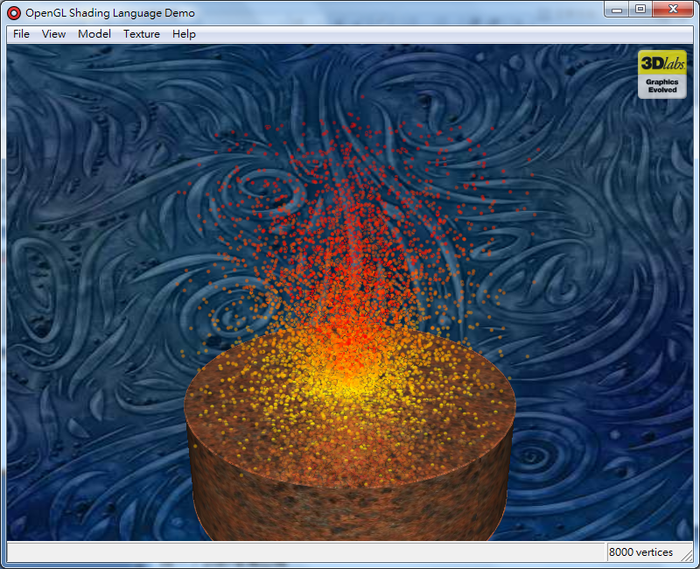
Particle.frag
1
2
3
4
5
6
varying vec4 Color;
void main (void)
{
gl_FragColor = Color;
}

