Slide 1
Computer Graphics
Ken-Yi Lee National Taiwan University

Slide 2
GPGPU and OpenCL
Introduction to GPGPU
Graphics Pipeline
GPGPU Programming
Introduction to OpenCL
OpenCL Framework
OpenCL C Language
Example: Dense Matrix Multiplication

Slide 3
Fixed Functionality Pipeline
API
Triangles/Lines/Points
Primitive
Processing
Vertices
Transform
and
Lighting
Primitive
Assembly
Rasterizer
Vertex
Buffer
Objects
Texture
Environment
Color
Sum
Fog
Alpha
Test
Depth
Stencil
Color
Buffer
Blend
Dither
Frame Buffer
Notes:
The slides are from http://people.freedesktop.org/~idr/GLSL_presentation/GLSL-Portland-Benj.PPT

Slide 4
Programmable Shader Pipeline
API
Triangles/Lines/Points
Primitive
Processing
Vertices
Vertex
Shader
Primitive
Assembly
Rasterizer
Vertex
Buffer
Objects
Fragment
Shader
Alpha
Test
Depth
Stencil
Color
Buffer
Blend
Dither
Frame Buffer

Slide 5
Programming Model
Attributes
(m * vec4)
Vertex
Shader
Uniforms
Primitive
Assembly
& Rasterize
Textures
Varyings
(n * vec4)
Fragment
Shader
Per-Sample
Operations

Slide 6
Give Me More Power
Attributes
(m * vec4)
Vertex
Shader
Vertex
Shader
Vertex
Shader
Uniforms
Primitive
Assembly
& Rasterize
Textures
Varyings
(n * vec4)
Fragment
Shader
Fragment
Shader
Fragment
Shader
Per-Sample
Operations

Slide 7
Introduction to GPGPU
GPGPU: General-Purpose Graphics Processing Unit
There is a GPU, don’t let it idle ! (better than none)
Will a program run faster with GPU than CPU ?
It depends. But note that we used to write programs for CPUs, not GPUs.
If you care about scalability…

Slide 8
GPGPU with GLSL: Matrix Addition
1 | 2 | 3
4 | 5 | 6
7 | 8 | 9
9 | 7 | 9
0 | 7 | 8
3 | 6 | 8
10 | 9 | 12
4 | 12 | 14
10 | 14 | 17
+
=
Texture0
Texture1
Frame Buffer
Attributes
Vertex
Shader
screen
Uniforms
Primitive
Assembly
& Rasterize
1. Draw a 3x3 rectangle!
Textures
Varyings
Fragment
Shader
2. Calculate in Fragment Shader
3. Output to ?
Per-Sample
Operations

Slide 9
Render to Texture (FBO)
CPU
GPU
CPU
GPU
Setup
Setup
glDraw*()
glDraw*()
Vertex Shader 1
Vertex Shader 1
Fragment Shader 1
Fragment Shader 1
Write to FB
Write to FBO
glReadPixels()
Setup
Setup
glDraw*()
glDraw*()
1
Vertex Shader 2
Vertex Shader 2
Fragment Shader 2
Fragment Shader 2
Write to FB
Write to FBO
glReadPixels()
glReadPixels()

Slide 10
Modern GPU Architecture
Unified Shader Model (Shader Model 4.0)
INPUT
Textures
Unified Shader
Buffers
Stage: VERTEX, FRAGMENT
OUTPUT

Slide 11
A Real Case: GeForce 8800
Host
Data Assembler
Setup / Rstr / ZCull
Vtx Thread Issue
Geom Thread Issue
Pixel Thread Issue
SP
SP
SP
SP
SP
SP
SP
SP
SP
SP
SP
SP
SP
SP
SP
SP
16 SM 128 SP
Thread Processor
TF
L1
TF
L1
TF
L1
TF
L1
TF
L1
TF
L1
TF
L1
TF
L1
TPC
SM
SP
L2
L2
L2
L2
L2
L2
TF
FB
FB
FB
FB
FB
FB

Slide 12
A Real Case: Explained
To hide memory latency
SM
SP
SP
Register File
SP
SP
SP
SP
SP
SP
TF
SP
SP
L1
SFU
SFU
Shared Memory

Slide 13
Modern GPGPU
Get rid of the graphics stuffs !
I am not a graphics expert but I want to utilize the GPU power !
Beyond graphics !
NVIDIA CUDA / AMD Stream SDK
OpenCL
However, you can’t really get rid of it.
Based on the same device

Slide 14
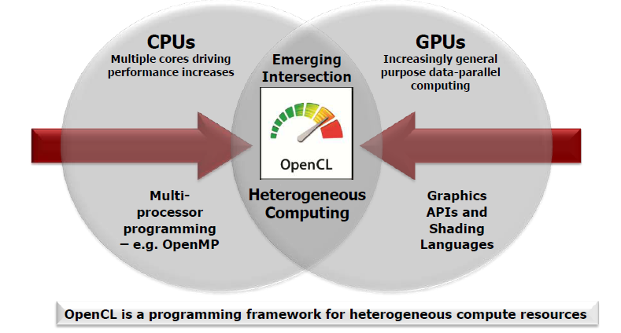
Introduction to OpenCL
OpenCL lets Programmers write a single portable program that uses ALL resources in the heterogeneous platform
From http://www.khronos.org/developers/library/overview/opencl_overview.pdf

Slide 15
How to Use OpenCL ?
To use OpenCL, you must
Define the platform
Execute code on the platform
Move data around in memory
Write (and build) programs

Slide 16
Platform Model
Define the platform:
Host (CPU)
Compute Device (8800)
Compute Unit (SM)
Processing Element (SP)
Ex. NVIDIA GeForce 8800
The OpenCL Specification 1.1 (Figure 3.1)

Slide 17
Execute a Kernel at Each Point
With a CPU
With a Processing Element
void vec_add( int n, const float *a, const float *b, float *c) {
for (int i=0; i<n; ++i){
c[i] = a[i] + b[i];
}
}
kernel void vec_add ( global const float *a, global const float *b, global float *c) {
int i = get_global_id(0);
c[i] = a[i] + b[i];
}
Execute over “n” work-items
The number of Processing Elements is device-dependent. The number of Work Items is problem-dependent.

Slide 18
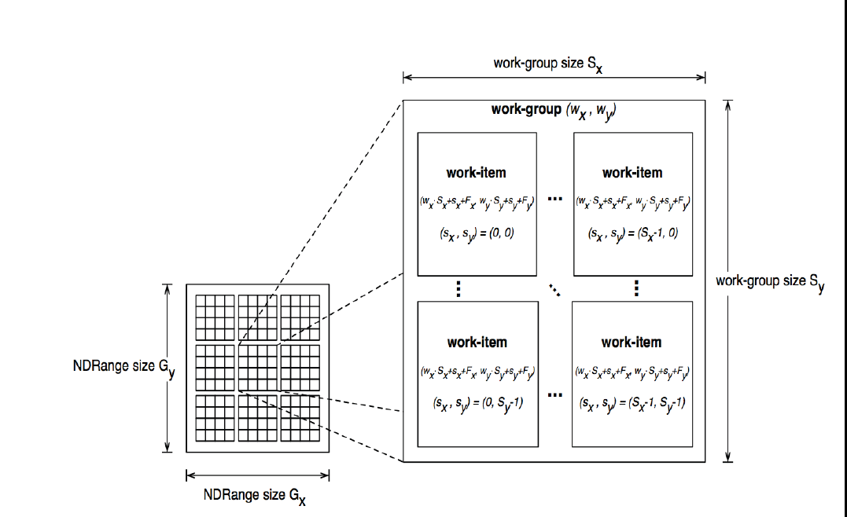
Execution Model
Execute code on the platform:
NDRange
Work-Group (CU)
Work-Item (PE)
The OpenCL Specification 1.1 (Figure 3.2)

Slide 19
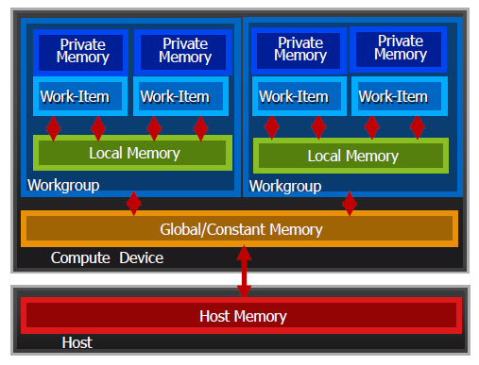
Memory Model
Move data around in memory
Host (Host)
Global / Constant (CD)
Local (CU)
Private (PE)
Memory management is Explicit

Slide 20
Programming Kernels: OpenCL C Language
A subset of ISO C99
But without some C99 features such as standard C99 headers, function pointers, recursion, variable length arrays, and bit fields
A superset of ISO C99
Work-items and workgroups
Vector types
Synchronization
Address space qualifier
Also include a large set of built-in functions

Slide 21
An Example: Vector Addition
__kernel void VectorAdd(
__global const float* a,
__global const float* b,
__global float* c,
int iNumElements)
{
// Get index into global data array
int iGID = get_global_id(0);
// Bound check (equivalent to the limit on a 'for' loop
// for standard/serial C code
if (iGID >= iNumElements)
return;
// Add the vector elements
c[iGID] = a[iGID] + b[iGID];
}
get_global_id(dim_idx)

Slide 22
Programming Kernels: Data Types
Scalar data types
char, int, long, float, uchar, …
bool, size_t, void, …
Image types
image2d_t, image3d_t, sampler_t
Vector data types
Vector lengths: 2, 4, 8 & 16
char2, short4, int8, float16, …

Slide 23
Memory Objects
Memory objects are categorized into two types:
Buffer object:
Stores a one-dimensional collection of elements
Sequential (directly accessing, pointer)
Image object:
Store two- or three- dimensional texture, frame-buffer or image (?)
Texture (indirectly accessing, built-in function)

Slide 24
Programming Flow (1)
Creating a context with a command queue:
clGetPlatformIDs()
clGetDeviceIDs()
clCreateContext()
clCreateCommandQueue()
Context
Device
Command Queue
Memory Objects
Notes:
Illustration of Context

Slide 25
Programming Flow (2)
Memory Allocation & Copying
clCreateBuffer()
clEnqueueWriteBuffer()
Asynchronous
Program Building
clCreateProgramWithSource()
clBuildProgram()
Kernel Setting
clCreateKernel()
clSetKernelArg()
Host
Device
Host
Global
Program
Kernel
Kernel

Slide 26
Programming Flow (3)
Kernel Execution:
clEnqueueNDRangeKernel()
Readback:
clEnqueueReadBuffer()

Slide 27
NVIDIA OpenCL Samples
Download webpage:
http://developer.download.nvidia.com/compute/cuda/3_0/sdk/website/OpenCL/website/samples.html
Used Examples:
OpenCL Device Query
OpenCL Vector Addition
OpenCL Matrix Multiplication
here

Slide 28
OpenCL Device Query
You can use this program to check your device ability for OpenCL
OpenCL SW Info:
CL_PLATFORM_NAME: NVIDIA CUDA
CL_PLATFORM_VERSION: OpenCL 1.0 CUDA 3.1.1
OpenCL SDK Revision: 7027912
OpenCL Device Info:
1 devices found supporting OpenCL:
---------------------------------
Device GeForce GTS 360M
---------------------------------
CL_DEVICE_NAME: GeForce GTS 360M
CL_DEVICE_VENDOR: NVIDIA Corporation
…

Slide 29
OpenCL Vector Addition
__kernel void VectorAdd(
__global const float* a,
__global const float* b,
__global float* c,
int iNumElements)
{
// Get index into global data array
int iGID = get_global_id(0);
// Bound check (equivalent to the limit on a 'for' loop
// for standard/serial C code
if (iGID >= iNumElements)
return;
// Add the vector elements
c[iGID] = a[iGID] + b[iGID];
}
Performance ?

Slide 30
Matrix Multiplication: Simple Version
B
__kernel void
matrixMul(
__global float* C,
__global float* A,
__global float* B,
int width_A, int width_B)
{
int row = get_global_id(1);
int col = get_global_id(0);
float Csub = 0.0f;
for (int k = 0; k < width_A; ++k) {
Csub += A[row*width_A + k] * B[k*width_B+col];
}
C[row*width_B+ col] = Csub;
}
A
C

Slide 31
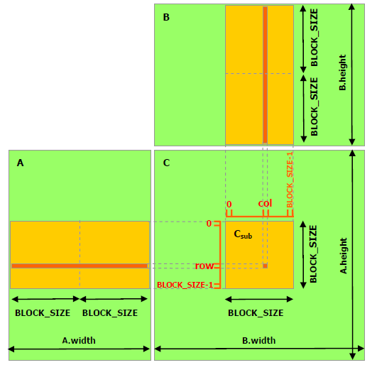
Matrix Multiplication: Local Memory (1)
Move a block from A
Move a block from B
Calculate block * block
If no finished, goto Step 1.
B
Memory Access
A
C

Slide 32
Matrix Multiplication: Local Memory (2)
__kernel void
matrixMul(
__global float* C, __global float* A, __global float* B, __local float* As, __local float* Bs, int width_A, int width_B) {
int Cx = get_group_id(0);
int Cy = get_group_id(1);
int cx = get_local_id(0);
int cy = get_local_id(1);
int Abegin = width_A * BLOCK_SIZE * Cy;
int Aend = Abegin + width_A - 1;
int Astep = BLOCK_SIZE;
int Bbegin = BLOCK_SIZE * Cx;
int Bstep = BLOCK_SIZE * width_B;

Slide 33
Matrix Multiplication: Local Memory (3)
float Csub = 0.0f;
for (int a = Abegin, b = Bbegin;
a <= Aend;
a += Astep, b += Bstep) {
AS(cy, cx) = A[a + width_A * cy + cx];
BS(cy, cx) = B[b + width_B * cy + cx];
#pragma unroll
for (int k = 0; k < BLOCK_SIZE; ++k)
Csub += AS(cy, k) * BS(k, cx);
}
C[get_global_id(1)*get_global_size(0)+get_global_id(0)] = Csub;
}
Process a block each time
Move
Compute

Slide 34
OpenCL Synchronization
There are two methods to synchronize between different work-items:
Local synchronization
Within the same work-group
Barrier
Global synchronization
Between different work-group / devices
Event

Slide 35
Matrix Multiplication: Local Memory (4)
float Csub = 0.0f;
for (int a = Abegin, b = Bbegin;
a <= Aend;
a += Astep, b += Bstep) {
AS(cy, cx) = A[a + width_A * cy + cx];
BS(cy, cx) = B[b + width_B * cy + cx];
barrier(CLK_LOCAL_MEM_FENCE);
#pragma unroll
for (int k = 0; k < BLOCK_SIZE; ++k)
Csub += AS(cy, k) * BS(k, cx);
barrier(CLK_LOCAL_MEM_FENCE);
}
C[get_global_id(1)*get_global_size(0)+get_global_id(0)] = Csub;
}

