Slide 1
Computer Graphics
Tz-Huan Huang National Taiwan University

Slide 2
Introduction to OpenGL
What is OpenGL?
History of OpenGL
The complexity of OpenGL
OpenGL resources
Notes:
This course provides a general introduction and overview to the OpenGL API (Application Programming Interface) and its features. OpenGL is a rendering library available on almost any computer which supports a graphics monitor.
Today, we’ll discuss the basic elements of OpenGL: rendering points, lines, polygons and images, as well as more advanced features as lighting and texture mapping.

Slide 3
What is OpenGL Graphics System?
OpenGL (for “Open Graphics Library”) is a software interface to graphics hardware. The interface consists of a set of several hundred procedures and functions that allow a programmer to specify the objects and operations involved in producing high-quality graphical images, specifically color images of three-dimensional objects.
The OpenGL Graphics System: A Specification (Version 4.1 (Core Profile) - July 25, 2010)
Notes:
OpenGL is a library for doing computer graphics. By using it, you can create interactive applications which render high-quality color images composed of 3D geometric objects and images.
OpenGL is window and operating system independent. As such, the part of your application which does rendering is platform independent. However, in order for OpenGL to be able to render, it needs a window to draw into. Generally, this is controlled by the windowing system on whatever platform you’re working on.

Slide 4
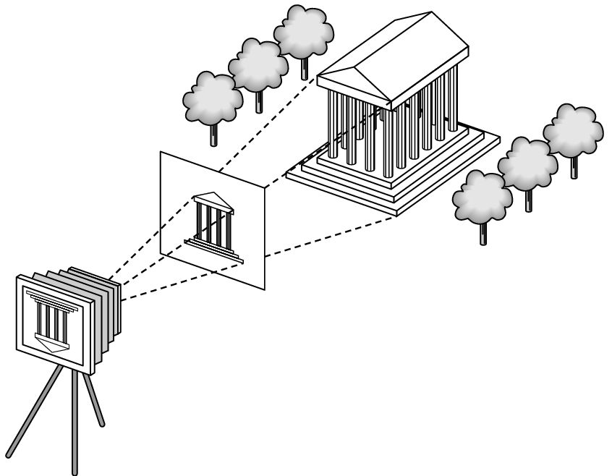
Recall the Rendering Pipeline
Scene graph Object geometry
Modeling Transforms
Lighting Calculations
Viewing Transform
Clipping
Projection Transform
Rasterization

Slide 5
History of OpenGL (1/5)
1990, IRIS GL by SGI
PHIGS by DEC, IBM, Sun, HP, etc
1992, OpenGL 1.0
OpenGL architectural review board (ARB)
(1995, DirectX 1.0)
(1996, DirectX 2.0, 2.0a, 3.0, 3.0a, 3.0b)
3.0 is the first version including Direct3D
Notes:
SGI is founded by Jim Clark with several Stanford students
DirectX 3.0 includes Direct 3D
John Carmack says D3D sucks

Slide 6
History of OpenGL (2/5)
1997, OpenGL 1.1 (NV3)
NVIDIA’s first success
(1997, DirectX 5.0, Fahrenheit project)
1998, OpenGL 1.2, 1.2.1
(1998, DirectX 5.2, 6.0, NV4)
(1999, DirectX 6.1, 6.1a, 7.0, NV5/10)
(2000, DirectX 7.0a, 7.1, 8.0, NV15)
8.0 is the first version supporting HLSL
Notes:
NV3: Riva128
NV4: Riva TNT
NV5: Riva TNT2
NV10: Geforce 256
NV15: Geforce2
8.0: the first version supports HLSL

Slide 7
History of OpenGL (3/5)
2001, OpenGL 1.3
(2001, DirectX 8.1, NV20)
NV20 is the first GPU of NVIDIA
(2002, DirectX 8.1a, 8.1b, NV25)
2002, OpenGL 1.4
(2002, DirectX 8.2, 9.0)
John Carmack admires DirectX from now on…
Notes:
NV20: Geforce3, pixel shader, XBOX
8.1: XBOX
9.0: John Carmack DX9 is really quite a good API level. Even with the D3D side of things, where I know I have a long history of people thinking I'm antagonistic against it. Microsoft has done a very, very good job of sensibly evolving it at each step—they're not worried about breaking backwards compatibility—and it's a pretty clean API. I especially like the work I'm doing on the 360, and it's probably the best graphics API as far as a sensibly designed thing that I've worked with.
NV20: first GPU, programmable pixel shader, used in xbox
NV25: Geforce4

Slide 8
History of OpenGL (4/5)
(2003, DirectX 9.0a, NV30)
2003, OpenGL 1.5
(2003, DirectX 9.0b)
(2004, DirectX 9.0c, NV40)
2004, OpenGL 2.0 (2005 G70/NV47)
2.0 is the first version supporting GLSL without extensions
Notes:
OpenGL 2.0: the first version supports GLSL
NV30: heat problem
G70: PS3

Slide 9
History of OpenGL (5/5)
2006, OpenGL 2.1
(2006, DirectX 10, G80)
G80 is the first GPGPU with CUDA support
(2008, Direct3D 10.1, GT200)
2008, OpenGL 3.0
(2009, Direct3D 10.2, G92)
2009, OpenGL 3.1, 3.2
(2009, DirectX 11)
2010, OpenGL 3.3/4.0, 4.1 (GF100)
Notes:
2006: SGI went into bankruptcy
G80: Geforce 8, fully support DX10, fully unified shader architecture, CUDA support
GT200: Geforce 200/300
GF100: Geforce 400, new fermi architecture

Slide 10
The complexity of OpenGL
OpenGL is a software interface to graphics hardware
application program
OpenGL Motif
widget or similar
GLUT
GLX, AGL or WGL
GLU
X, Win32, Mac O/S
GL
software and/or hardware

Slide 11
The complexity of OpenGL
Hardware manufactories
NVIDIA, ATI/AMD, SGI, Sun, IBM, 3dfx, Apple, S3, 3DLabs, …
OS/Graphical System
X (UNIX, Linux, BSD, etc), win32 (windows), Mac OS X, etc
Toolkits
glut, SDL, gtk+, Qt, cocoa, carbon, etc

Slide 12
The complexity of OpenGL
Compatibility and extension
Binary compatibility
Dynamic loading extensions
Extensions
ARB
EXT
NV, ATI, AMD, 3DFS, etc

Slide 13
OpenGL Resources
http://www.opengl.org/
The Red Book: OpenGL Programming Guide, 7th edition
The Blue Book: OpenGL Reference manual, 4th edition
The Green Book: OpenGL Programming for the X Window System
The Alpha Book: OpenGL Programming for Windows 95 and Windows NT
The Orange Book: OpenGL Shading Language, 3rd edition

