Slide 1
Computer Graphics
Bing-Yu Chen National Taiwan University

Slide 2
Introduction to OpenGL
General OpenGL Introduction
An Example OpenGL Program
Drawing with OpenGL
Transformations
Animation and Depth Buffering
Lighting
Evaluation and NURBS
Texture Mapping
Advanced OpenGL Topics
Imaging
modified from Dave Shreiner, Ed Angel, and Vicki Shreiner. An Interactive Introduction to OpenGL Programming. ACM SIGGRAPH 2001 Conference Course Notes #54. & ACM SIGGRAPH 2004 Conference Course Notes #29.
Notes:
This course provides a general introduction and overview to the OpenGL API (Application Programming Interface) and its features. OpenGL is a rendering library available on almost any computer which supports a graphics monitor.
Today, we’ll discuss the basic elements of OpenGL: rendering points, lines, polygons and images, as well as more advanced features as lighting and texture mapping.

Slide 3
What is OpenGL? & What can it do for me?
OpenGL is
a computer graphics rendering API
generate high-quality color images by rendering with geometric and image primitives
create interactive applications with 3D graphics
window system independent
operating system independent
Notes:
OpenGL is a library for doing computer graphics. By using it, you can create interactive applications which render high-quality color images composed of 3D geometric objects and images.
OpenGL is window and operating system independent. As such, the part of your application which does rendering is platform independent. However, in order for OpenGL to be able to render, it needs a window to draw into. Generally, this is controlled by the windowing system on whatever platform you’re working on.

Slide 4
OpenGL as a Renderer
Geometric primitives
points, lines and polygons
Image Primitives
images and bitmaps
separate pipeline for images & geometry
linked through texture mapping
Rendering depends on state
colors, materials, light sources, etc.
Notes:
As mentioned, OpenGL is a library for rendering computer graphics. Generally, there are two operations that you do with OpenGL:
draw something
change the state of how OpenGL draws
OpenGL has two types of things that it can render: geometric primitives and image primitives. Geometric primitives are points, lines and polygons. Image primitives are bitmaps and graphics images (i.e. the pixels that you might extract from a JPEG image after you’ve read it into your program.) Additionally, OpenGL links image and geometric primitives together using texture mapping, which is an advanced topic we’ll discuss this afternoon.
The other common operation that you do with OpenGL is setting state. “Setting state” is the process of initializing the internal data that OpenGL uses to render your primitives. It can be as simple as setting up the size of points and color that you want a vertex to be, to initializing multiple mipmap levels for texture mapping.

Slide 5
OpenGL Libraries
OpenGL core library
OpenGL32 on Windows
GL on most unix/linux systems
OpenGL Utility Library (GLU)
part of OpenGL
Provides functionality in OpenGL core but avoids having to rewrite code
NURBS, tessellators, quadric shapes, etc.
Notes:
As mentioned, OpenGL is window and operating system independent. To integrate it into various window systems, additional libraries are used to modify a native window into an OpenGL capable window. Every window system has its own unique library and functions to do this. Some examples are:
GLX for the X Windows system, common on Unix platforms
AGL for the Apple Macintosh
WGL for Microsoft Windows
OpenGL also includes a utility library, GLU, to simplify common tasks such as: rendering quadric surfaces (i.e. spheres, cones, cylinders, etc. ), working with NURBS and curves, and concave polygon tessellation.
Finally to simplify programming and window system dependence, we’ll be using the freeware library, GLUT. GLUT, written by Mark Kilgard, is a public domain window system independent toolkit for making simple OpenGL applications. It simplifies the process of creating windows, working with events in the window system and handling animation.

Slide 6
OpenGL Libraries
Links with window system
GLX for X window systems
WGL for Windows
AGL for Macintosh
glue between OpenGL & windowing systems

Slide 7
GLUT
OpenGL Utility Library (GLUT)
Provides functionality common to all window systems
Open a window
Get input from mouse and keyboard
Menus
Event-driven
Code is portable but GLUT lacks the functionality of a good toolkit for a specific platform
Slide bars

Slide 8
OpenGL and Related APIs
application program
OpenGL Motif
widget or similar
GLUT
GLX, AGL or WGL
GLU
X, Win32, Mac O/S
GL
software and/or hardware
Notes:
The above diagram illustrates the relationships of the various libraries and window system components.
Generally, applications which require more user interface support will use a library designed to support those types of features (i.e. buttons, menu and scroll bars, etc.) such as Motif or the Win32 API.
Prototype applications, or one which don’t require all the bells and whistles of a full GUI, may choose to use GLUT instead because of its simplified programming model and window system independence.

Slide 9
OpenGL Architecture
Geometric
pipeline
Per Vertex
Operations &
Primitive
Assembly
Polynomial
Evaluator
CPU
Display List
Rasterization
Per Fragment
Operations
Frame
buffer
Texture
Memory
Pixel
Operations
Notes:
This is the most important diagram you will see today, representing the flow of graphical information, as it is processed from CPU to the frame buffer.
There are two pipelines of data flow. The upper pipeline is for geometric, vertex-based primitives. The lower pipeline is for pixel-based, image primitives. Texturing combines the two types of primitives together.
There is a pull-out poster in the back of the OpenGL Reference Manual (“Blue Book”), which shows this diagram in more detail.

Slide 10
OpenGL Functions
Primitives
Points
Line Segments
Polygons
Attributes
Transformations
Viewing
Modeling
Control
Input (GLUT)

Slide 11
What is Required for your Programs
Headers Files
#include <GL/gl.h>
#include <GL/glext.h>
#include <GL/glu.h>
#include <GL/glut.h>
Libraries
Enumerated Types
OpenGL defines numerous types for compatibility
GLfloat, GLint, GLenum, etc.
Notes:
All of our discussions today will be presented in the C computer language.
For C, there are a few required elements which an application must do:
Header files describe all of the function calls, their parameters and defined constant values to the compiler. OpenGL has header files for GL (the core library), GLU (the utility library), and GLUT (freeware windowing toolkit).
Note: glut.h includes gl.h and glu.h. On Microsoft Windows, including only glut.h is recommended to avoid warnings about redefining Windows macros.
Libraries are the operating system dependent implementation of OpenGL on the system you’re using. Each operating system has its own set of libraries. For Unix systems, the OpenGL library is commonly named libGL.so and for Microsoft Windows, it’s named opengl32.lib.
Finally, enumerated types are definitions for the basic types (i.e. float, double, int, etc.) which your program uses to store variables. To simplify platform independence for OpenGL programs, a complete set of enumerated types are defined. Use them to simplify transferring your programs to other operating systems.

Slide 12
Lack of Object Orientation
OpenGL is not object oriented so that there are multiple functions for a given logical function,
e.g. glVertex3f, glVertex2i, glVertex3dv,…..
Underlying storage mode is the same
Easy to create overloaded functions in C++ but issue is efficiency

Slide 13
OpenGL Command Formats
glVertex3fv( v )
Number of
components
Data Type
Vector
b - byte
ub - unsigned byte
s - short
us - unsigned short
i - int
ui - unsigned int
f - float
d - double
omit “v” for
scalar form
glVertex2f( x, y )
2 - (x,y)
3 - (x,y,z)
4 - (x,y,z,w)
Notes:
The OpenGL API calls are designed to accept almost any basic data type, which is reflected in the calls name. Knowing how the calls are structured makes it easy to determine which call should be used for a particular data format and size.
For instance, vertices from most commercial models are stored as three component floating point vectors. As such, the appropriate OpenGL command to use is glVertex3fv( coords ).
As mentioned before, OpenGL uses homogenous coordinates to specify vertices. For glVertex*() calls which don’t specify all the coordinates ( i.e. glVertex2f()), OpenGL will default z = 0.0, and w = 1.0 .

Slide 14
OpenGL State
OpenGL is a state machine
OpenGL functions are of two types
Primitive generating
Can cause output if primitive is visible
How vertices are processes and appearance of primitive are controlled by the state
State changing
Transformation functions
Attribute functions

Slide 15
The OpenGL Pipeline
Vertex
Processing
Fragment
Processing
Framebuffer
Processing is controlled by setting OpenGL’s state
colors, lights and object materials, texture maps
drawing styles, depth testing
Notes:
OpenGL is a pipelined architecture, which means that the order of
operations is fixed. In general, OpenGL operations can be partitioned into two
“processing units”: vertex operations, and fragment operations.
The operation of each pipeline step is controlled by what’s commonly
referred to as state. State is just the collection of variables that OpenGL keeps
track of internally. They include colors, positions, texture maps, etc. We’ll
discuss many of these state groups during the course. Setting state comprises
about 80% of the OpenGL functions in the library.

Slide 16
GLUT Basics
Application Structure
Configure and open window
Initialize OpenGL state
Register input callback functions
render
resize
input: keyboard, mouse, etc.
Enter event processing loop
Notes:
Here’s the basic structure that we’ll be using in our applications. This is generally what you’d do in your own OpenGL applications.
The steps are:
1) Choose the type of window that you need for your application and initialize it.
2) Initialize any OpenGL state that you don’t need to change every frame of your program. This might include things like the background color, light positions and texture maps.
3) Register the callback functions that you’ll need. Callbacks are routines you write that GLUT calls when a certain sequence of events occurs, like the window needing to be refreshed, or the user moving the mouse. The most important callback function is the one to render your scene, which we’ll discuss in a few slides.
4) Enter the main event processing loop. This is where your application receives events, and schedules when callback functions are called.

Slide 17
Sequence of Most OpenGL Programs
configure
and open a
window
initialize
OpenGL’s
state
process
user events
update
OpenGL’s
state
(if necessary)
Draw an
image
Notes:
OpenGL was primarily designed to be able to draw high-quality images
fast enough so that an application could draw many of them a second, and
provide the user with an interactive application, where each frame could be
customized by input from the user.
The general flow of an interactive OpenGL application is:
1. Configure and open a window suitable for drawing OpenGL into.
2. Initialize any OpenGL state that you will need to use throughout
the application.
3. Process any events that the user might have entered. These could
include pressing a key on the keyboard, moving the mouse, or
moving or resizing the application’s window.
4. Draw your 3D image using OpenGL with values that may have
been entered from the user’s actions, or other data that the program
has available to it.

Slide 18
A Simple Program
Generate a square on a solid background

Slide 19
simple.c
#include <GL/glut.h>
void mydisplay(){
glClear(GL_COLOR_BUFFER_BIT);
glBegin(GL_POLYGON);
glVertex2f(-0.5, -0.5);
glVertex2f(-0.5, 0.5);
glVertex2f(0.5, 0.5);
glVertex2f(0.5, -0.5);
glEnd();
glFlush();
}
int main(int argc, char** argv){
glutCreateWindow("simple");
glutDisplayFunc(mydisplay);
glutMainLoop();
}

Slide 20
Event Loop
Note that the program defines a display callback function named mydisplay
Every glut program must have a display callback
The display callback is executed whenever OpenGL decides the display must be refreshed, for example when the window is opened
The main function ends with the program entering an event loop

Slide 21
Notes on Compilation
Unix/linux
Include files usually in …/include/GL
Compile with –lglut –lglu –lgl loader flags
May have to add –L flag for X libraries
Mesa implementation included with most linux distributions
Check web for latest versions of Mesa and glut

Slide 22
Compilation on Windows
Visual C++ / Borland C
Get glut.h, glut32.lib and glut32.dll
Create a console application
Add opengl32.lib, glu32.lib, glut32.lib to project settings (under link tab)
Cygwin (linux under Windows)
Can use gcc and similar makefile to linux
Use –lopengl32 –lglu32 –lglut32 flags

Slide 23
Another Sample Program
void main( int argc, char** argv )
{
int mode = GLUT_RGB|GLUT_DOUBLE;
glutInitDisplayMode( mode );
glutCreateWindow( argv[0] );
init();
glutDisplayFunc( display );
glutReshapeFunc( resize );
glutKeyboardFunc( key );
glutIdleFunc( idle );
glutMainLoop();
}
Notes:
Here’s an example of the main part of a GLUT based OpenGL application. This is the model that we’ll use for most of our programs in the course.
The glutInitDisplayMode() and glutCreateWindow() functions compose the window configuration step.
We then call the init() routine, which contains our one-time initialization. Here we initialize any OpenGL state and other program variables that we might need to use during our program that remain constant throughout the program’s execution.
Next, we register the callback routines that we’re going to use during our program.
Finally, we enter the event processing loop, which interprets events and calls our respective callback routines.

Slide 24
OpenGL Initialization
Set up whatever state you’re going to use
void init( void )
{
glClearColor( 0.0, 0.0, 0.0, 1.0 );
glClearDepth( 1.0 );
glEnable( GL_LIGHT0 );
glEnable( GL_LIGHTING );
glEnable( GL_DEPTH_TEST );
}
Notes:
Here’s the internals of our initialization routine, init(). Over the course of the day, you’ll learn what each of the above OpenGL calls do.

Slide 25
GLUT Callback Functions
Routine to call when something happens
window resize or redraw
user input
animation
“Register” callbacks with GLUT
glutDisplayFunc( display );
glutIdleFunc( idle );
glutKeyboardFunc( keyboard );
Notes:
GLUT uses a callback mechanism to do its event processing. Callbacks simplify event processing for the application developer. As compared to more traditional event driven programming, where the author must receive and process each event, and call whatever actions are necessary, callbacks simplify the process by defining what actions are supported, and automatically handling the user events. All the author must do is fill in what should happen when.
GLUT supports many different callback actions, including:
glutDisplayFunc() - called when pixels in the window need to be refreshed.
glutReshapeFunc() - called when the window changes size
glutKeyboardFunc() - called when a key is struck on the keyboard
glutMouseFunc() - called when the user presses a mouse button on the mouse
glutMotionFunc() - called when the user moves the mouse while a mouse button is pressed
glutPassiveMouseFunc() - called when the mouse is moved regardless of mouse button state
glutIdleFunc() - a callback function called when nothing else is going on. Very useful for animations.

Slide 26
Rendering Callback
Do all of your drawing here
glutDisplayFunc( display );
void display( void )
{
glClear( GL_COLOR_BUFFER_BIT );
glBegin( GL_TRIANGLE_STRIP );
glVertex3fv( v[0] );
glVertex3fv( v[1] );
glVertex3fv( v[2] );
glVertex3fv( v[3] );
glEnd();
glutSwapBuffers();
}
Notes:
One of the most important callbacks is the glutDisplayFunc() callback. This callback is called when the window needs to be refreshed. It’s here that you’d do all of your OpenGL rendering.
The above routine merely clears the window, and renders a triangle strip and then swaps the buffers for smooth animation transition. You’ll learn more about what each of these calls do during the day.

Slide 27
Idle Callbacks
Use for animation & continuous update
glutIdleFunc( idle );
void idle( void )
{
t += dt;
glutPostRedisplay();
}
Notes:
Animation requires the ability to draw a sequence of images. The glutIdleFunc()is the mechanism for doing animation. You register a routine which updates your motion variables (usually global variables in your program which control how things move) and then requests that the scene be updated.
glutPostRedisplay() requests that the callback registered with glutDisplayFunc() be called as soon as possible. This is preferred over calling your rendering routine directly, since the user may have interacted with your application and user input events need to be processed.

Slide 28
User Input Callbacks
Process user input
glutKeyboardFunc( keyboard );
void keyboard( unsigned char key, int x, int y )
{
switch( key ) {
case ‘q’ : case ‘Q’ :
exit( EXIT_SUCCESS );
break;
case ‘r’ : case ‘R’ :
rotate = GL_TRUE;
glutPostRedisplay();
break;
}
}
Notes:
Above is a simple example of a user input callback. In this case, the routine was registered to receive keyboard input. GLUT supports user input through a number of devices including the keyboard, mouse, dial and button boxes and spaceballs.

Slide 29
On-Line Resources
http://www.opengl.org/
start here; up to date specification and lots of sample code
news:comp.graphics.api.opengl
http://www.sgi.com/software/opengl/
http://www.mesa3d.org/
Brian Paul’s Mesa 3D
http://www.cs.utah.edu/~narobins/opengl.html
very special thanks to Nate Robins for the OpenGL Tutors
source code for tutors available here!

Slide 30
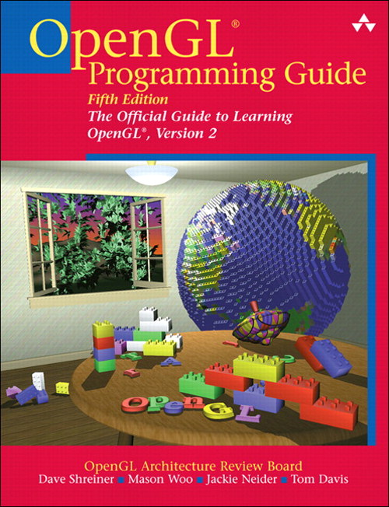
Books
D. Shreiner, M. Woo, J. Neider, T. Davis. OpenGL® Programming Guide: The Official Guide to Learning OpenGL, ver. 2, 5th. ed., Addison-Wesley, 2005.

Slide 31
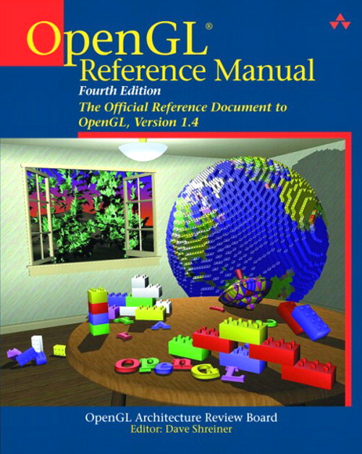
Books
D. Shreiner. OpenGL® Reference Manual: The Official Reference Document to OpenGL, ver. 1.4, 4th. ed., Addison-Wesley, 2004.

Slide 32
Books
R. Rost. OpenGL® Shading Language, 2nd. ed., Addison-Wesley, 2006.

Slide 33
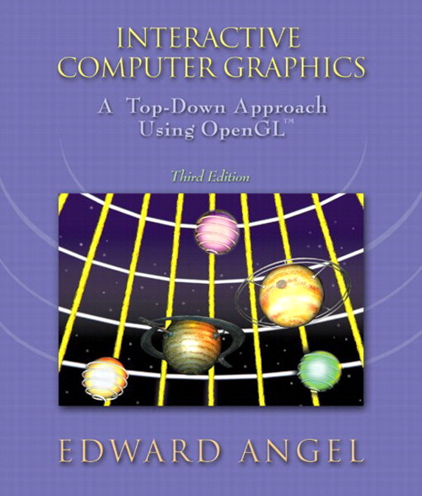
Books
E. Angel. Interactive Computer Graphics: A Top-Down Approach with OpenGL™, 3rd. ed., Addison-Wesley, 2002.

