Slide 1
Computer Graphics
Bing-Yu Chen National Taiwan University

Slide 2
Introduction to OpenGL
General OpenGL Introduction
An Example OpenGL Program
Drawing with OpenGL
Transformations
Animation and Depth Buffering
Lighting
Evaluation and NURBS
Texture Mapping
Advanced OpenGL Topics
Imaging
modified from Dave Shreiner, Ed Angel, and Vicki Shreiner. An Interactive Introduction to OpenGL Programming. ACM SIGGRAPH 2001 Conference Course Notes #54. & ACM SIGGRAPH 2004 Conference Course Notes #29.
Notes:
This course provides a general introduction and overview to the OpenGL API (Application Programming Interface) and its features. OpenGL is a rendering library available on almost any computer which supports a graphics monitor.
Today, we’ll discuss the basic elements of OpenGL: rendering points, lines, polygons and images, as well as more advanced features as lighting and texture mapping.

Slide 3
What can OpenGL Draw?
Geometric Primitives
points, lines and polygons
Image Primitives
images and bitmaps
Separate pipeline for images and geometry
linked through texture mapping
Rendering depends on state
colors, materials, light sources, etc.
Notes:
In this section, we’ll be discussing the basic geometric primitives that OpenGL uses for rendering, as well as how to manage the OpenGL state which controls the appearance of those primitives.
OpenGL also supports the rendering of bitmaps and images, which is discussed in a later section.
Additionally, we’ll discuss the different types of OpenGL buffers, and what each can be used for.

Slide 4
OpenGL Geometric Primitives
All geometric primitives are specified by vertices
GL_LINES
GL_POINTS
GL_POLYGON
GL_LINE_STRIP
GL_LINE_LOOP
GL_TRIANGLES
GL_TRIANGLE_STRIP
GL_QUADS
GL_QUAD_STRIP
GL_TRIANGLE_FAN
Notes:
Every OpenGL geometric primitive is specified by its vertices, which are homogenous coordinates. Homogenous coordinates are of the form ( x, y, z, w ). Depending on how vertices are organized, OpenGL can render any of the shown primitives.

Slide 5
Simple Example
void drawRhombus( GLfloat color[] )
{
glBegin( GL_QUADS );
glColor3fv( color );
glVertex2f( 0.0, 0.0 );
glVertex2f( 1.0, 0.0 );
glVertex2f( 1.5, 1.118 );
glVertex2f( 0.5, 1.118 );
glEnd();
}
Notes:
The drawRhombus() routine causes OpenGL to render a single quadrilateral in a single color. The rhombus is planar, since the z value is automatically set to 0.0 by glVertex2f().

Slide 6
Specifying Geometric Primitives
Primitives are specified using
glBegin( primType );
glEnd();
primType determines how vertices are combined
GLfloat red, green, blue;
Glfloat coords[3];
glBegin( primType );
for ( i = 0; i < nVerts; ++i ) {
glColor3f( red, green, blue );
glVertex3fv( coords );
}
glEnd();
Notes:
OpenGL organizes vertices into primitives based upon which type is passed into glBegin(). The possible types are:
GL_POINTS GL_LINE_STRIP
GL_LINES GL_LINE_LOOP
GL_POLYGON GL_TRIANGLE_STRIP
GL_TRIANGLES GL_TRIANGLE_FAN
GL_QUADS GL_QUAD_STRIP

Slide 7
OpenGL Color Models
Poly.
Per
Vertex
CPU
DL
Raster
Frag
FB
Texture
Pixel
RGBA or Color Index
color index mode
Red
Green
Blue
0
1
1
Display
2
2
4
8
3
ww
16
www
ww
24
123
219
74
25
26
www
RGBA mode
Notes:
Every OpenGL implementation must support rendering in both RGBA mode, ( sometimes described as TrueColor mode ) and color index ( or colormap ) mode.
For RGBA rendering, vertex colors are specified using the glColor*() call.
For color index rendering, the vertex’s index is specified with glIndex*().
The type of window color model is requested from the windowing system. Using GLUT, the glutInitDisplayMode() call is used to specify either an RGBA window ( using GLUT_RGBA ), or a color indexed window ( using GLUT_INDEX ).

Slide 8
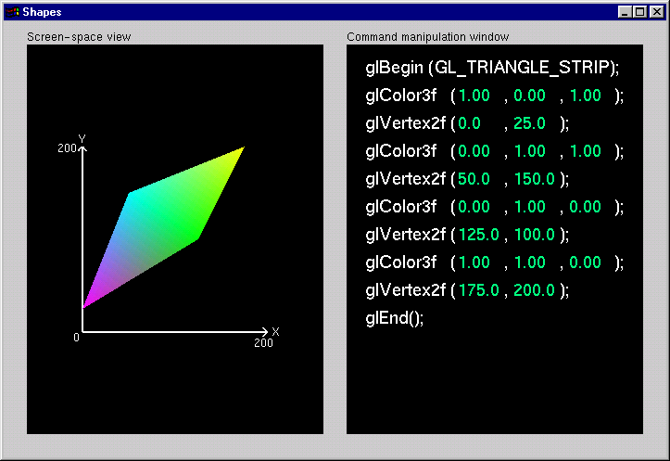
Shapes Tutorial
Notes:
This is the first of the series of Nate Robins’ tutorials. This tutorial illustrates the principles of rendering geometry, specifying both colors and vertices.
The shapes tutorial has two views: a screen-space window and a command manipulation window.
In the command manipulation window, pressing the LEFT mouse while the pointer is over the green parameter numbers allows you to move the mouse in the y-direction (up and down) and change their values. With this action, you can change the appearance of the geometric primitive in the other window. With the RIGHT mouse button, you can bring up a pop-up menu to change the primitive you are rendering. (Note that the parameters have minimum and maximum values in the tutorials, sometimes to prevent you from wandering too far. In an application, you probably don’t want to have floating-point color values less than 0.0 or greater than 1.0, but you are likely to want to position vertices at coordinates outside the boundaries of this tutorial.)
In the screen-space window, the RIGHT mouse button brings up a different pop-up menu, which has menu choices to change the appearance of the geometry in different ways.
The left and right mouse buttons will do similar operations in the other tutorials.

Slide 9
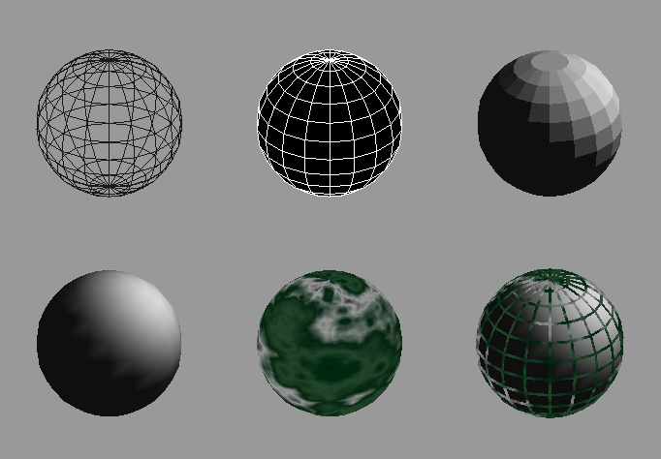
Controlling Rendering Appearance
From
Wireframe
to
Texture
Mapped
Notes:
OpenGL can render from a simple line-based wireframe to complex multi-pass texturing algorithms to simulate bump mapping or Phong lighting.

Slide 10
How OpenGL Works: The Conceptual Model
configure
how OpenGL
should draw
stuff
draw stuff
Notes:
Conceptually, OpenGL allows you, the application designer, to do two
things:
1. Control how the next items you draw will be processed. This is
done by setting the OpenGL’s state. OpenGL’s state includes the
current drawing color, parameters that control the color and
location of lights, texture maps, and many other configurable
settings.
2. Draw, or using the technical term, render graphical objects called
primitives.
Your application will consist of cycles of setting state, and rendering using
the state that you just set.

Slide 11
OpenGL’s State Machine
All rendering attributes are encapsulated in the OpenGL State
rendering styles
shading
lighting
texture mapping
Server-side vs. client-side
Notes:
Each time OpenGL processes a vertex, it uses data stored in its internal state tables to determine how the vertex should be transformed, lit, textured or any of OpenGL’s other modes.

Slide 12
Manipulating OpenGL State
Appearance is controlled by current state
for each ( primitive to render ) {
update OpenGL state
render primitive
}
Manipulating vertex attributes is most common way to manipulate state
glColor*() / glIndex*()
glNormal*()
glTexCoord*()
Notes:
The general flow of any OpenGL rendering is to set up the required state, then pass the primitive to be rendered, and repeat for the next primitive.
In general, the most common way to manipulate OpenGL state is by setting vertex attributes, which include color, lighting normals, and texturing coordinates.

Slide 13
Controlling current state
Setting State
glPointSize( size );
glLineStipple( repeat, pattern );
glShadeModel( GL_SMOOTH );
Enabling Features
glEnable( GL_LIGHTING );
glDisable( GL_TEXTURE_2D );
glEnableClientState( GL_VERTEX_ARRAY );
glDisableClientState( GL_COLOR_ARRAY );
Notes:
Setting OpenGL state usually includes modifying the rendering attribute, such as loading a texture map, or setting the line width. Also for some state changes, setting the OpenGL state also enables that feature ( like setting the point size or line width ).
Other features need to be turned on. This is done using glEnable(), and passing the token for the feature, like GL_LIGHT0 or GL_POLYGON_STIPPLE.

