Slide 1
Computer Graphics
Bing-Yu Chen National Taiwan University

Slide 2
Introduction to OpenGL
General OpenGL Introduction
An Example OpenGL Program
Drawing with OpenGL
Transformations
Animation and Depth Buffering
Lighting
Evaluation and NURBS
Texture Mapping
Advanced OpenGL Topics
Imaging
modified from Dave Shreiner, Ed Angel, and Vicki Shreiner. An Interactive Introduction to OpenGL Programming. ACM SIGGRAPH 2001 Conference Course Notes #54. & ACM SIGGRAPH 2004 Conference Course Notes #29.
Notes:
This course provides a general introduction and overview to the OpenGL API (Application Programming Interface) and its features. OpenGL is a rendering library available on almost any computer which supports a graphics monitor.
Today, we’ll discuss the basic elements of OpenGL: rendering points, lines, polygons and images, as well as more advanced features as lighting and texture mapping.

Slide 3
Transformations in OpenGL
Modeling
Viewing
orient camera
projection
Animation
Map to screen
Notes:
Transformations are used both by the applications programmer to move and orient objects (either statically or dynamically) and by OpenGL to implement the viewing pipeline.
Three transformations (model-view, perspective, texture) are part of the state. Their matrices can be set by application programs but the operations are carried out within the viewing pipeline.

Slide 4
Camera Analogy
3D is just like taking a photograph (lots of photographs!)
viewing
volume
camera
model
tripod
Notes:
This model has become know as the synthetic camera model.
Note that both the objects to be viewed and the camera are three-dimensional while the resulting image is two dimensional.

Slide 5
Camera Analogy & Transformations
Projection transformations
adjust the lens of the camera
Viewing transformations
tripod–define position and orientation of the viewing volume in the world
Modeling transformations
moving the model
Viewport transformations
enlarge or reduce the physical photograph
Notes:
Note that human vision and a camera lens have cone-shaped viewing volumes. OpenGL (and almost all computer graphics APIs) describe a pyramid-shaped viewing volume. Therefore, the computer will “see” differently from the natural viewpoints, especially along the edges of viewing volumes. This is particularly pronounced for wide-angle “fish-eye” camera lenses.

Slide 6
Coordinate Systems & Transformations
Steps in Forming an Image
specify geometry (world coordinates)
specify camera (camera coordinates)
project (window coordinates)
map to viewport (screen coordinates)
Each step uses transformations
Every transformation is equivalent to a change in coordinate systems (frames)
Notes:
Every transformation can be thought of as changing the representation of a vertex from one coordinate system or frame to another. Thus, initially vertices are specified in world or application coordinates. However, to view them, OpenGL must convert these representations to ones in the reference system of the camera. This change of representations is described by a transformation matrix (the model-view matrix). Similarly, the projection matrix converts from camera coordinates to window coordinates.

Slide 7
Affine Transformations
Want transformations which preserve geometry
lines, polygons, quadrics
Affine = line preserving
Rotation, translation, scaling
Projection
Concatenation (composition)
Notes:
The transformations supported by OpenGL are a special class that is important for graphical applications and for problems in science and engineering. In particular, affine transformations will not alter the type of object. A transformed line (polygon, quadric) is still a line (polygon, quadric).
Any composition of affine transformations is still affine. For example, a rotation followed by a translation followed by a projection preserves lines and polygons.

Slide 8
Homogeneous Coordinates
each vertex is a column vector
w is usually 1.0
all operations are matrix multiplications
directions (directed line segments) can be represented with w = 0.0
Notes:
A 3D vertex is represented by a 4-tuple vector (homogeneous coordinate system).
Why is a 4-tuple vector used for a 3D (x, y, z) vertex? To ensure that all matrix operations are multiplications.
If w is changed from 1.0, we can recover x, y and z by division by w. Generally, only perspective transformations change w and require this perspective division in the pipeline.

Slide 9
3D Transformations
A vertex is transformed by 4 x 4 matrices
all affine operations are matrix multiplications
all matrices are stored column-major in OpenGL
matrices are always post-multiplied
product of matrix and vector is
Notes:
Perspective projection and translation require 4th row and column, or operations would require addition, as well as multiplication.
For operations other than perspective projection, the fourth row is always (0, 0, 0, 1) which leaves w unchanged..
Because OpenGL only multiplies a matrix on the right, the programmer must remember that the last matrix specified is the first applied.

Slide 10
OpenGL Matrices
In OpenGL matrices are part of the state
Three types
Model-View (GL_MODEL_VIEW)
Projection (GL_PROJECTION)
Texture (GL_TEXTURE)
Color (GL_COLOR)
Single set of functions for manipulation
Select which to manipulated by
glMatrixMode(GL_MODEL_VIEW);
glMatrixMode(GL_PROJECTION);

Slide 11
Matrix Operations
Specify Current Matrix Stack
glMatrixMode( GL_MODELVIEW, GL_PROJECTION, etc )
Matrix operations
glLoadIdentity();
glLoadMatrix(); glLoadTransposeMatrix();
glMultiMatrix(); glMultTransposematrix();
glRotate(); glTranslate(); glScale();
glGet*v();
Matrix or Stack Operations
glPushMatrix()
glPopMatrix()
Notes:
glLoadMatrix*() replaces the matrix on the top of the current matrix stack. glMultMatrix*(), post-multiples the matrix on the top of the current matrix stack. The matrix argument is a column-major 4 x 4 double or single precision floating point matrix.
Matrix stacks are used because it is more efficient to save and restore matrices than to calculate and multiply new matrices. Popping a matrix stack can be said to “jump back” to a previous location or orientation.
glViewport() clips the vertex or raster position. For geometric primitives, a new vertex may be created. For raster primitives, the raster position is completely clipped.
There is a per-fragment operation, the scissor test, which works in situations where viewport clipping doesn’t. The scissor operation is particularly good for fine clipping raster (bitmap or image) primitives.

Slide 12
Transformation Pipeline
Poly.
Per
Vertex
CPU
DL
Raster
Frag
FB
Texture
Pixel
object
eye
clip
normalized
device
window
v
e
r
t
e
x
Modelview
Matrix
Projection
Matrix
Perspective
Division
Viewport
Transform
Modelview
Projection
other calculations here
material è color
shade model (flat)
polygon rendering mode
polygon culling
clipping
Modelview
l
l
l
Notes:
The depth of matrix stacks are implementation-dependent, but the Modelview matrix stack is guaranteed to be at least 32 matrices deep, and the Projection matrix stack is guaranteed to be at least 2 matrices deep.
The material-to-color, flat-shading, and clipping calculations take place after the Modelview matrix calculations, but before the Projection matrix. The polygon culling and rendering mode operations take place after the Viewport operations.
There is also a texture matrix stack, which is outside the scope of this course. It is an advanced texture mapping topic.

Slide 13
Modeling Transformations
Move object
glTranslate{fd}( x, y, z )
Rotate object around arbitrary axis
glRotate{fd}( angle, x, y, z )
angle is in degrees
Dilate (stretch or shrink) or mirror object
glScale{fd}( x, y, z )
Notes:
glTranslate(), glRotate(), and glScale() multiplies itself onto the current matrix, so it usually comes after glMatrixMode(GL_MODELVIEW). There are many situations where the modeling transformation is multiplied onto a non-identity matrix.
A vertex’s distance from the origin changes the effect of glRotate() or glScale(). These operations have a fixed point for the origin. Generally, the further from the origin, the more pronounced the effect. To rotate (or scale) with a different fixed point, we must first translate, then rotate (or scale) and then undo the translation with another translation.

Slide 14
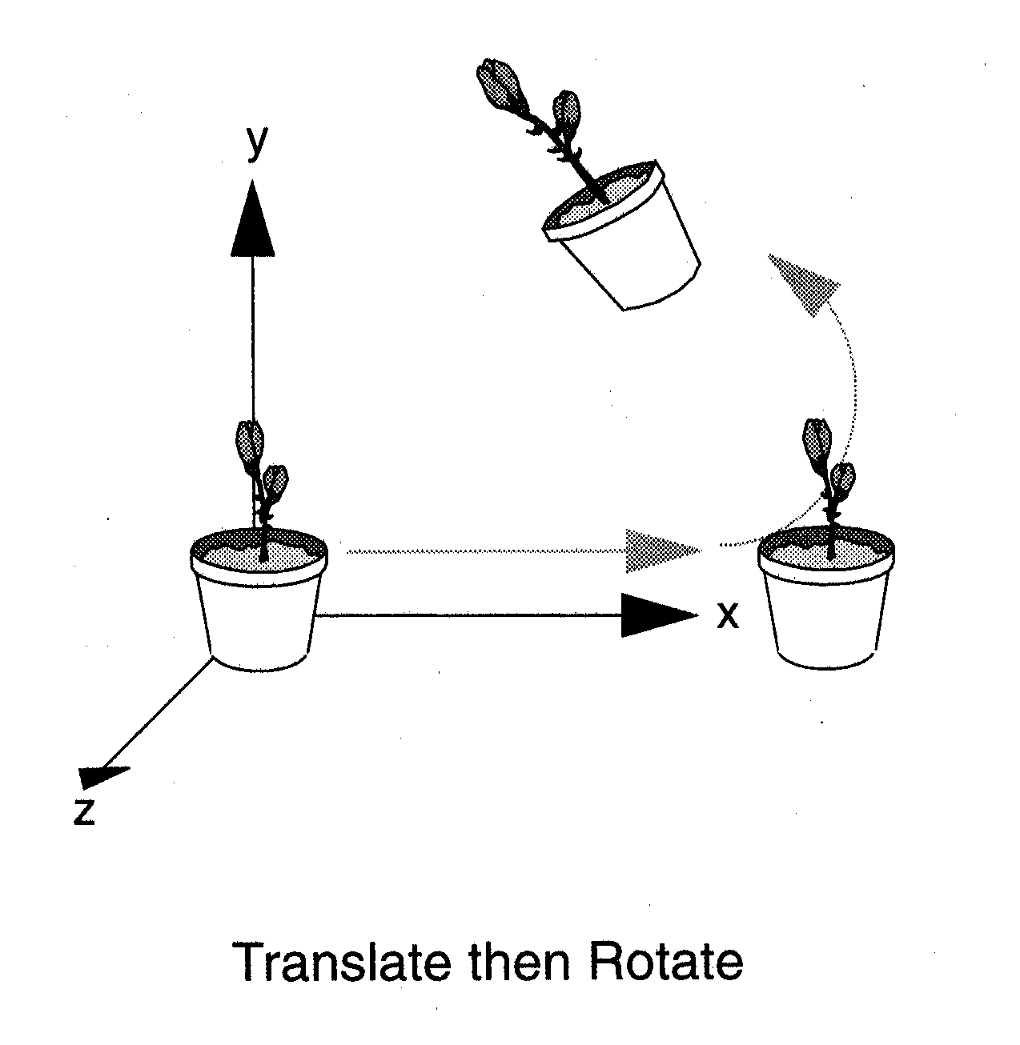
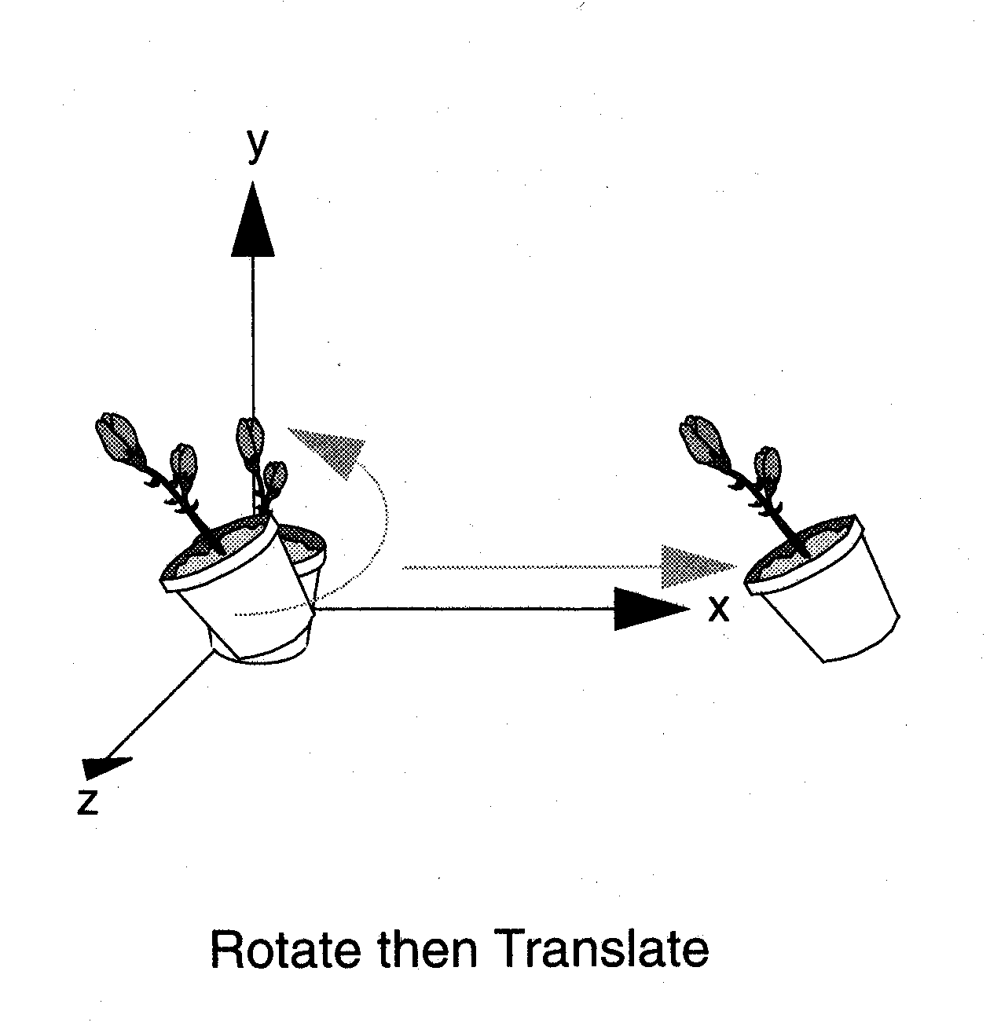
Examples
glRotate (30, 0, 0, 1);
glTranslate (10, 0, 0);
glTranslate (10, 0, 0);
glRotate (30, 0, 0, 1);

Slide 15
Viewing Transformations
OpenGL combines modeling and viewing transformation as MODELVIEW_MATRIX
Moving camera == moving the whole world according to the camera
gluLookAt( eyex, eyey, eyez,
aimx, aimy, aimz,
upx, upy, upz )
Notes:
gluLookAt() multiplies itself onto the current matrix, so it usually comes after glMatrixMode(GL_MODELVIEW) and glLoadIdentity().
Because of degenerate positions, gluLookAt() is not recommended for most animated fly-over applications.
An alternative is to specify a sequence of rotations and translations that are concatenated with an initial identity matrix.
Note: that the name modelview matrix is appropriate since moving objects in the model front of the camera is equivalent to moving the camera to view a set of objects.

Slide 16
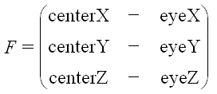
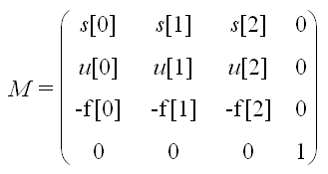
gluLookAt (eye, center, up)
Change of Basis
L
L^{T}
s
-f
Equivalent to:

Slide 17
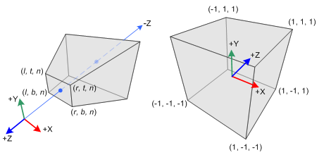
Projection Transformation
Perspective projection
glFrustum( left, right, bottom, top, zNear, zFar )
gluPerspective( fovy, aspect, zNear, zFar )
Notes:
For perspective projections, the viewing volume is shaped like a truncated pyramid (frustum). There is a distinct camera (eye) position, and vertexes of objects are “projected” to camera. Objects which are further from the camera appear smaller. The default camera position at (0, 0, 0), looks down the z-axis, although the camera can be moved by other transformations.
For gluPerspective(), fovy is the angle of field of view (in degrees) in the y direction. fovy must be between 0.0 and 180.0, exclusive. aspect is x/y and should be same as the viewport to avoid distortion. zNear and zFar define the distance to the near and far clipping planes.
glFrustum() is rarely used.
Warning: for gluPerspective() or glFrustum(), don’t use zero for zNear!
For glOrtho(), the viewing volume is shaped like a rectangular parallelepiped (a box). Vertexes of an object are “projected” towards infinity. Distance does not change the apparent size of an object. Orthographic projection is used for drafting and design (such as blueprints).

Slide 18
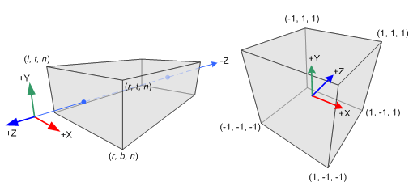
Projection Transformation
Orthographic parallel projection
glOrtho( left, right, bottom, top, zNear, zFar )
gluOrtho2D( left, right, bottom, top )
Notes:
For perspective projections, the viewing volume is shaped like a truncated pyramid (frustum). There is a distinct camera (eye) position, and vertexes of objects are “projected” to camera. Objects which are further from the camera appear smaller. The default camera position at (0, 0, 0), looks down the z-axis, although the camera can be moved by other transformations.
For gluPerspective(), fovy is the angle of field of view (in degrees) in the y direction. fovy must be between 0.0 and 180.0, exclusive. aspect is x/y and should be same as the viewport to avoid distortion. zNear and zFar define the distance to the near and far clipping planes.
glFrustum() is rarely used.
Warning: for gluPerspective() or glFrustum(), don’t use zero for zNear!
For glOrtho(), the viewing volume is shaped like a rectangular parallelepiped (a box). Vertexes of an object are “projected” towards infinity. Distance does not change the apparent size of an object. Orthographic projection is used for drafting and design (such as blueprints).

Slide 19
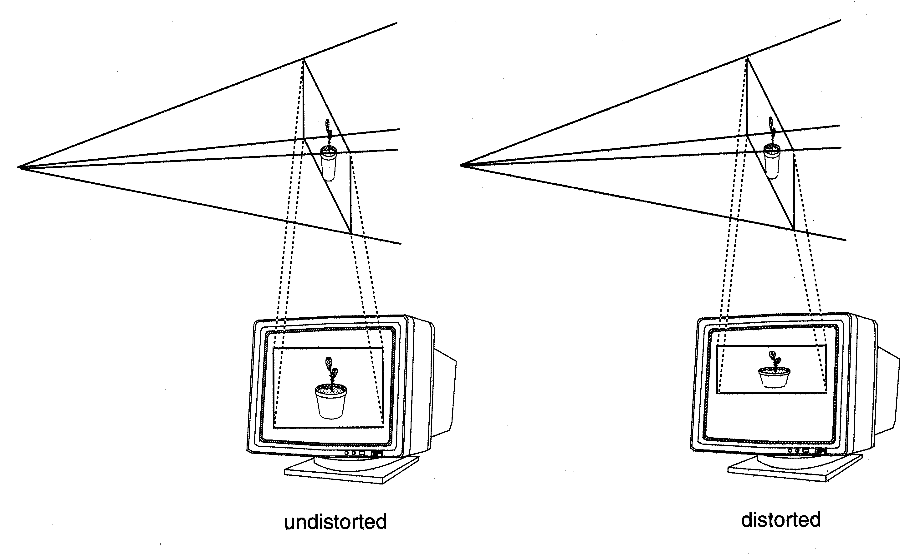
Viewport Transformation
Viewport
glViewport( x, y, width, height )

Slide 20
Matrix Stacks
In many situations we want to save transformation matrices for use later
Traversing hierarchical data structures
Avoiding state changes when executing display lists
OpenGL maintains stacks for each type of matrix
Access present type (as set by glMatrixMode) by
glPushMatrix()
glPopMatrix()

Slide 21
Example
Link1:
Rotate(z,θ₁);
draw
θ₃
Link2:
Rotate(z,θ₁);
Translate(h,0,0)
Rotate(z,θ₂);
draw
θ₂
Link3:
Rotate(z,θ₁);
Translate(h,0,0)
Rotate(z,θ₂);
Translate(h,0,0)
Rotate(z,θ₃);
draw
θ₁
Link at default pos

Slide 22
Link1:
Rotate(z,θ₁)
draw
PushMatrix
Rotate(z,θ₁)
draw // link1
Translate(h,0,0)
Rotate(z,θ₂)
draw // link2
Translate(h,0,0)
Rotate(z,θ₃)
draw // link3
PopMatrix
Link2:
Rotate(z,θ₁)
Translate(h,0,0)
Rotate(z,θ₂)
draw
Link3:
Rotate(z,θ₁)
Translate(h,0,0)
Rotate(z,θ₂)
Translate(h,0,0)
Rotate(z,θ₃)
draw

Slide 23
Reading Back Matrices
Can also access matrices (and other parts of the state) by enquiry (query) functions
glGetIntegerv
glGetFloatv
glGetBooleanv
glGetDoublev
glIsEnabled
For matrices, we use as
double m[16];
glGetFloatv(GL_MODELVIEW, m);

Slide 24
Projection is left handed
Projection transformations (gluPerspective, glOrtho) are left handed
think of zNear and zFar as distance from view point
Everything else is right handed, including the vertexes to be rendered
y
y
z+
left handed
right handed
x
x
z+
Notes:
If you get this wrong, you may see nothing in your image. Switching from right to left handed coordinates is equivalent to rotating the camera 180 degrees!
One way to think of problem is that the viewing system is left-handed so distances from the camera are measured from the camera to the object.

Slide 25
Reversing Coordinate Projection
Screen space back to world space
glGetIntegerv( GL_VIEWPORT, GLint viewport[4] )
glGetDoublev( GL_MODELVIEW_MATRIX, GLdouble mvmatrix[16] )
glGetDoublev( GL_PROJECTION_MATRIX, GLdouble projmatrix[16] )
gluUnProject( GLdouble winx, winy, winz, mvmatrix[16], projmatrix[16], GLint viewport[4], GLdouble *objx, *objy, *objz )
Notes:
Generally, OpenGL projects 3D data onto a 2D screen. Sometimes, you need to use a 2D screen position (such as a mouse location) and figure out where in 3D it came from. If you use gluUnProject() with winz = 0 and winz = 1, you can find the 3D point at the near and far clipping planes. Then you can draw a line between those points, and you know that some point on that line was projected to your screen position.
OpenGL Release 1.2 also introduced gluUnProject4(), which also returns the transformed world-space w coordinate.

Slide 26
Animation and Depth Buffering
Discuss double buffering and animation
Discuss hidden surface removal using the depth buffer
Notes:
In this section we talk about adding the necessary steps for producing smooth interactive animations with OpenGL using double buffering. Additionally, we discuss hidden surface removal using depth buffering.

Slide 27
Double Buffering
Poly.
Per
Vertex
CPU
DL
Raster
Frag
FB
Texture
Pixel
1
2
1
2
Front
Buffer
4
4
Back
Buffer
8
8
16
16
Display
Notes:
Double buffer is a technique for tricking the eye into seeing smooth animation of rendered scenes. The color buffer is usually divided into two equal halves, called the front buffer and the back buffer.
The front buffer is displayed while the application renders into the back buffer. When the application completes rendering to the back buffer, it requests the graphics display hardware to swap the roles of the buffers, causing the back buffer to now be displayed, and the previous front buffer to become the new back buffer.

Slide 28
Animation Using Double Buffering
Request a double buffered color buffer
glutInitDisplayMode( GLUT_RGB | GLUT_DOUBLE );
Clear color buffer
glClear( GL_COLOR_BUFFER_BIT );
Render scene
Request swap of front and back buffers
glutSwapBuffers();
Repeat steps 2 - 4 for animation
Notes:
Requesting double buffering in GLUT is simple. Adding GLUT_DOUBLE to your glutInitDisplayMode() call will cause your window to be double buffered.
When your application is finished rendering its current frame, and wants to swap the front and back buffers, the glutSwapBuffers() call will request the windowing system to update the window’s color buffers.

Slide 29
Depth Buffering and Hidden Surface Removal
1
2
1
2
Color
Buffer
4
4
Depth
Buffer
8
8
16
16
Display
Notes:
Depth buffering is a technique to determine which primitives in your scene are occluded by other primitives. As each pixel in a primitive is rasterized, its distance from the eyepoint (depth value), is compared with the values stored in the depth buffer. If the pixel’s depth value is less than the stored value, the pixel’s depth value is written to the depth buffer, and its color is written to the color buffer.
The depth buffer algorithm is: if ( pixel->z < depthBuffer(x,y)->z ) { depthBuffer(x,y)->z = pixel->z; colorBuffer(x,y)->color = pixel->color; }
OpenGL depth values range from [0, 1], with one being essentially infinitely far from the eyepoint. Generally, the depth buffer is cleared to one at the start of a frame.

Slide 30
Depth Buffering Using OpenGL
Request a depth buffer
glutInitDisplayMode( GLUT_RGB | GLUT_DOUBLE | GLUT_DEPTH );
Enable depth buffering
glEnable( GL_DEPTH_TEST );
Clear color and depth buffers
glClear( GL_COLOR_BUFFER_BIT | GL_DEPTH_BUFFER_BIT );
Render scene
Swap color buffers
Notes:
Enabling depth testing in OpenGL is very straightforward.
A depth buffer must be requested for your window, once again using the glutInitDisplayMode(), and the GLUT_DEPTH bit.
Once the window is created, the depth test is enabled using glEnable( GL_DEPTH_TEST ).

