Slide 1
Computer Graphics
Bing-Yu Chen National Taiwan University

Slide 2
Introduction to OpenGL
General OpenGL Introduction
An Example OpenGL Program
Drawing with OpenGL
Transformations
Animation and Depth Buffering
Lighting
Evaluation and NURBS
Texture Mapping
Advanced OpenGL Topics
Imaging
modified from Dave Shreiner, Ed Angel, and Vicki Shreiner. An Interactive Introduction to OpenGL Programming. ACM SIGGRAPH 2001 Conference Course Notes #54. & ACM SIGGRAPH 2004 Conference Course Notes #29.
Notes:
This course provides a general introduction and overview to the OpenGL API (Application Programming Interface) and its features. OpenGL is a rendering library available on almost any computer which supports a graphics monitor.
Today, we’ll discuss the basic elements of OpenGL: rendering points, lines, polygons and images, as well as more advanced features as lighting and texture mapping.

Slide 3
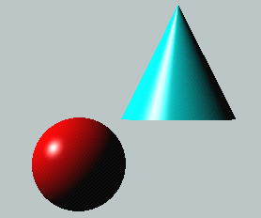
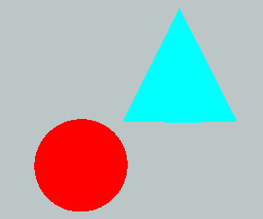
Lighting Principles
Lighting simulates how objects reflect light
material composition of object
light’s color and position
global lighting parameters
ambient light
two sided lighting
available in both color index and RGBA mode
Notes:
Lighting is an important technique in computer graphics. Without lighting, objects tend to look like they’re made out of plastic.
OpenGL divides lighting into three parts: material properties, light properties and global lighting parameters.
Lighting is available in both RGBA mode and color index mode. RGBA is more flexible and less restrictive than color index mode lighting.

Slide 4
How OpenGL Simulates Lights
Phong lighting model
Computed at vertices
Lighting contributors
Surface material properties
Light properties
Lighting model properties
Notes:
OpenGL lighting is based on the Phong lighting model. At each vertex in the primitive, a color is computed using that primitives material properties along with the light settings.
The color for the vertex is computed by adding four computed colors for the final vertex color. The four contributors to the vertex color are:
Ambient is color of the object from all the undirected light in a scene.
Diffuse is the base color of the object under current lighting. There must be a light shining on the object to get a diffuse contribution.
Specular is the contribution of the shiny highlights on the object.
Emission is the contribution added in if the object emits light (i.e. glows)

Slide 5
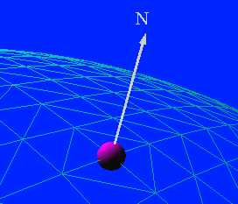
Surface Normals
Poly.
Per
Vertex
CPU
DL
Raster
Frag
FB
Texture
Pixel
Normals define how a surface reflects light
glNormal3f( x, y, z )
Current normal is used to compute vertex’s color
Use unit normals for proper lighting
scaling affects a normal’s length
glEnable( GL_NORMALIZE ) or glEnable( GL_RESCALE_NORMAL )
Notes:
The lighting normal tells OpenGL how the object reflects light around a vertex. If you imagine that there is a small mirror at the vertex, the lighting normal describes how the mirror is oriented, and consequently how light is reflected.
glNormal*() sets the current normal, which is used in the lighting computation for all vertices until a new normal is provided.
Lighting normals should be normalized to unit length for correct lighting results. glScale*() affects normals as well as vertices, which can change the normal’s length, and cause it to no longer be normalized. OpenGL can automatically normalize normals, by enabling glEnable(GL_NORMALIZE). or glEnable(GL_RESCALE_NORMAL). GL_RESCALE_NORMAL is a special mode for when your normals are uniformly scaled. If not, use GL_NORMALIZE which handles all normalization situations, but requires the computation of a square root, which can potentially lower performance
OpenGL evaluators and NURBS can provide lighting normals for generated vertices automatically.

Slide 6
Normal for Triangle
n
plane n ·(p - p₀ ) = 0
p₂
n = (p₂ - p₀ ) ×(p₁ - p₀ )
p
p₁
normalize n ← n/ |n|
p₀
Note that right-hand rule determines outward face

Slide 7
Material Properties
Define the surface properties of a primitive
glMaterialfv( face, property, value );
separate materials for front and back
GL_DIFFUSE
Base color
GL_SPECULAR
Highlight Color
GL_AMBIENT
Low-light Color
GL_EMISSION
Glow Color
GL_SHININESS
Surface Smoothness
Notes:
Material properties describe the color and surface properties of a material (dull, shiny, etc.). OpenGL supports material properties for both the front and back of objects, as described by their vertex winding.
The OpenGL material properties are:
GL_DIFFUSE - base color of object
GL_SPECULAR - color of highlights on object
GL_AMBIENT - color of object when not directly illuminated
GL_EMISSION - color emitted from the object (think of a firefly)
GL_SHININESS - concentration of highlights on objects. Values range from 0 (very rough surface - no highlight) to 128 (very shiny)
Material properties can be set for each face separately by specifying either GL_FRONT or GL_BACK, or for both faces simultaneously using GL_FRONT_AND_BACK.

Slide 8
Light Properties
glLightfv( light, property, value );
light specifies which light
multiple lights, starting with GL_LIGHT0
glGetIntegerv( GL_MAX_LIGHTS, &n );
properties
colors
position and type
attenuation
Notes:
The glLight() call is used to set the parameters for a light. OpenGL implementations must support at least eight lights, which are named GL_LIGHT0 through GL_LIGHTn, where n is one less than the maximum number supported by an implementation.
OpenGL lights have a number of characteristics which can be changed from their default values. Color properties allow separate interactions with the different material properties. Position properties control the location and type of the light and attenuation controls the natural tendency of light to decay over distance.

Slide 9
Light Sources (cont.)
Light color properties
GL_AMBIENT
GL_DIFFUSE
GL_SPECULAR
Notes:
OpenGL lights can emit different colors for each of a materials properties. For example, a light’s GL_AMBIENT color is combined with a material’s GL_AMBIENT color to produce the ambient contribution to the color - Likewise for the diffuse and specular colors.

Slide 10
Types of Lights
OpenGL supports two types of Lights
Local (Point) light sources
Infinite (Directional) light sources
Type of light controlled by w coordinate
Notes:
OpenGL supports two types of lights: infinite (directional) and local (point) light sources. The type of light is determined by the w coordinate of the light’s position.
A light’s position is transformed by the current ModelView matrix when it is specified. As such, you can achieve different effects by when you specify the position.

Slide 11
Turning on the Lights
Flip each light’s switch
glEnable( GL_LIGHTn );
Turn on the power
glEnable( GL_LIGHTING );
Notes:
Each OpenGL light is controllable separately, using glEnable() and the respective light constant GL_LIGHTn. Additionally, global control over whether lighting will be used to compute primitive colors is controlled by passing GL_LIGHTING to glEnable(). This provides a handy way to enable and disable lighting without turning on or off all of the separate components.

Slide 12
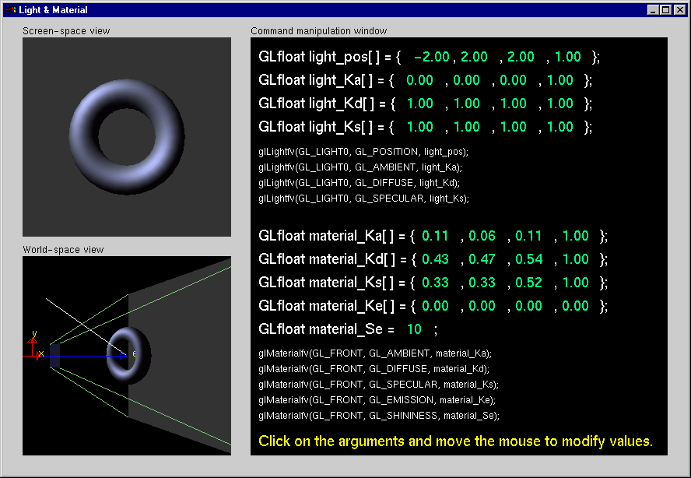
Light Material Tutorial
Notes:
In this tutorial, concentrate on noticing the affects of different material and light properties. Additionally, compare the results of using a local light versus using an infinite light.
In particular, experiment with the GL_SHININESS parameter to see its affects on highlights.

Slide 13
Controlling a Light’s Position
Modelview matrix affects a light’s position
Different effects based on when position is specified
eye coordinates
world coordinates
model coordinates
Push and pop matrices to uniquely control a light’s position
Notes:
As mentioned previously, a light’s position is transformed by the current ModelView matrix when it is specified. As such, depending on when you specify the light’s position, and what’s in the ModelView matrix, you can obtain different lighting affects.
In general, there are three coordinate systems where you can specify a light’s position/direction
1) Eye coordinates - which is represented by an identity matrix in the ModelView. In this case, when the light’s position/direction is specified, it remains fixed to the imaging plane. As such, regardless of how the objects are manipulated, the highlights remain in the same location relative to the eye.
2) World Coordinates - when only the viewing transformation is in the ModelView matrix. In this case, a light’s position/direction appears fixed in the scene, as if the light were on a lamppost.
3) Model Coordinates - any combination of viewing and modeling transformations is in the ModelView matrix. This method allows arbitrary, and even animated, position of a light using modeling transformations.

Slide 14
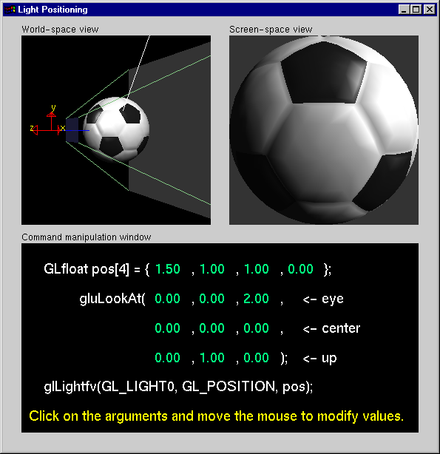
Light Position Tutorial
Notes:
This tutorial demonstrates the different lighting affects of specifying a light’s position in eye and world coordinates. Experiment with how highlights and illuminated areas change under the different lighting position specifications.

Slide 15
Advanced Lighting Features
Spotlights
localize lighting affects
GL_SPOT_DIRECTION
GL_SPOT_CUTOFF
GL_SPOT_EXPONENT
Notes:
A local light can also be converted into a spotlight. By setting the GL_SPOT_DIRECTION, GL_SPOT_CUTOFF, and GL_SPOT_EXPONENT, the local light will shine in a direction and its light will be limited to a cone centered around that direction vector.

Slide 16
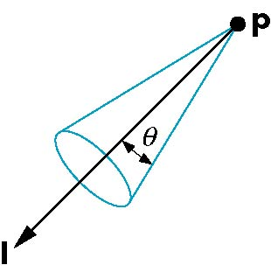
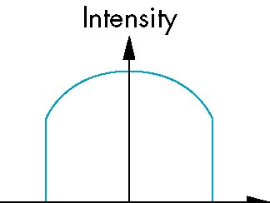
Spotlights
Use glLightv to set
Direction GL_SPOT_DIRECTION
Cutoff GL_SPOT_CUTOFF
Attenuation GL_SPOT_EXPONENT
Proportional to cos^{α}φ
−θ
φ
θ

Slide 17
Advanced Lighting Features
Light attenuation
decrease light intensity with distance
GL_CONSTANT_ATTENUATION
GL_LINEAR_ATTENUATION
GL_QUADRATIC_ATTENUATION
Notes:
Each OpenGL light source supports attenuation, which describes how light diminishes with distance. The OpenGL model supports quadratic attenuation, and utilizes the following attenuation factor, f_{i}, where d is the distance from the eyepoint to the vertex being lit:
where:
k_{c} is the GL_CONSTANT_ATTENUATION term
k_{l} is the GL_LINEAR_ATTENUATION term
k_{q} is the GL_QUADRATIC_ATTENUATION term

Slide 18
Light Model Properties
glLightModelfv( property, value );
Enabling two sided lighting
GL_LIGHT_MODEL_TWO_SIDE
Global ambient color
GL_LIGHT_MODEL_AMBIENT
Local viewer mode
GL_LIGHT_MODEL_LOCAL_VIEWER
Separate specular color
GL_LIGHT_MODEL_COLOR_CONTROL
Notes:
Properties which aren’t directly connected with materials or lights are grouped into light model properties. With OpenGL 1.2, there are four properties associated with the lighting model:
1) Two-sided lighting uses the front and back material properties for illuminating a primitive.
2) Global ambient color initializes the global ambient contribution of the lighting equation.
3) Local viewer mode disables an optimization which provides faster lighting computations. With local viewer mode on, you get better light results at a slight performance penalty.
4) Separate specular color is a mode for maintaining better specular highlights in certain texture mapped conditions. This is a new feature for OpenGL 1.2.

Slide 19
Front and Back Faces
The default is shade only front faces which works correct for convex objects
If we set two sided lighting, OpenGL will shaded both sides of a surface
Each side can have its own properties which are set by using GL_FRONT, GL_BACK, or GL_FRONT_AND_BACK in glMaterialf
back faces not visible
back faces visible

Slide 20
Efficiency
Because material properties are part of the state, if we change materials for many surfaces, we can affect performance
We can make the code cleaner by defining a material structure and setting all materials during initialization
We can then select a material by a pointer
typedef struct materialStruct {
GLfloat ambient[4];
GLfloat diffuse[4];
GLfloat specular[4];
GLfloat shineness;
} MaterialStruct;

Slide 21
Tips for Better Lighting
Recall lighting computed only at vertices
model tessellation heavily affects lighting results
better results but more geometry to process
Use a single infinite light for fastest lighting
minimal computation per vertex
Notes:
As with all of computing, time versus space is the continual tradeoff. To get the best results from OpenGL lighting, your models should be finely tessellated to get the best specular highlights and diffuse color boundaries. This yields better results, but usually at a cost of more geometric primitives, which could slow application performance.
To achieve maximum performance for lighting in your applications, use a single infinite light source. This minimizes the amount of work that OpenGL has to do to light every vertex.

Slide 22
Steps in OpenGL shading
Enable shading and select model
Specify normals
Specify material properties
Specify lights

Slide 23
Transparency
Material properties are specified as RGBA values
The A value can be used to make the surface translucent
The default is that all surfaces are opaque regardless of A

Slide 24
Polygonal Shading
Shading calculations are done for each vertex
Vertex colors become vertex shades
By default, vertex colors are interpolated across the polygon
glShadeModel(GL_SMOOTH);
If we use glShadeModel(GL_FLAT); the color at the first vertex will determine the color of the whole polygon

Slide 25
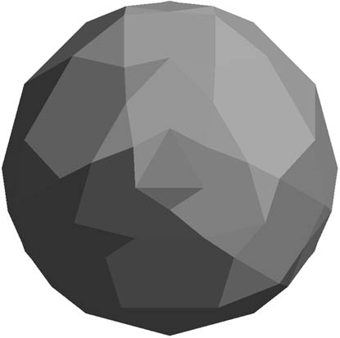
Polygon Normals
Polygons have a single normal
Shades at the vertices as computed by the Phong model can be almost same
Identical for a distant viewer (default) or if there is no specular component
Consider model of sphere
Want different normals at each vertex even though this concept is not quite correct mathematically

Slide 26
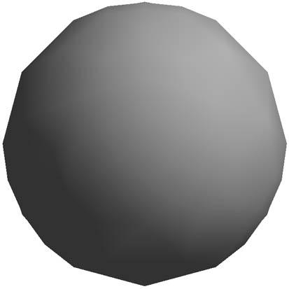
Smooth Shading
We can set a new normal at each vertex
Easy for sphere model
If centered at origin n = p
Now smooth shading works
Note silhouette edge

