Slide 1
Computer Graphics
Bing-Yu Chen National Taiwan University

Slide 2
Introduction to OpenGL
General OpenGL Introduction
An Example OpenGL Program
Drawing with OpenGL
Transformations
Animation and Depth Buffering
Lighting
Evaluation and NURBS
Texture Mapping
Advanced OpenGL Topics
Imaging
modified from Dave Shreiner, Ed Angel, and Vicki Shreiner. An Interactive Introduction to OpenGL Programming. ACM SIGGRAPH 2001 Conference Course Notes #54. & ACM SIGGRAPH 2004 Conference Course Notes #29.
Notes:
This course provides a general introduction and overview to the OpenGL API (Application Programming Interface) and its features. OpenGL is a rendering library available on almost any computer which supports a graphics monitor.
Today, we’ll discuss the basic elements of OpenGL: rendering points, lines, polygons and images, as well as more advanced features as lighting and texture mapping.

Slide 3
Imaging and Raster Primitives
Describe OpenGL’s raster primitives: bitmaps and image rectangles
Demonstrate how to get OpenGL to read and render pixel rectangles
Notes:
OpenGL is not only a complete interface for 3D rendering, it’s also a very capable image processing engine. In this section we discuss some of the basic functions of OpenGL for rendering color-pixel rectangles and single-bit bitmaps, as well as how to read color information from the framebuffer.
OpenGL doesn’t render images, per se, since images usually are stored in some file with an image format associated with it (for example, JPEG images). OpenGL only knows how to render rectangles of pixels, not decode image files.

Slide 4
Pixel-based primitives
Bitmaps
2D array of bit masks for pixels
update pixel color based on current color
Images
2D array of pixel color information
complete color information for each pixel
OpenGL doesn’t understand image formats
Notes:
In addition to geometric primitives, OpenGL also supports pixel-based primitives. These primitives contain explicit color information for each pixel that they contain. They come in two types:
Bitmaps are single bit images, which are used as a mask to determine which pixels to update. The current color, set with glColor()is used to determine the new pixel color.
Images are blocks of pixels with complete color information for each pixel.
OpenGL, however, doesn’t understand image formats, like JPEG, PNG or GIFs. In order for OpenGL to use the information contained in those file formats, the file must be read and decoded to obtain the color information, at which point, OpenGL can rasterize the color values.

Slide 5
Pixel Pipeline
Poly.
Per
Vertex
CPU
DL
Raster
Frag
FB
Texture
Pixel
Programmable pixel storage and transfer operations
glBitmap(), glDrawPixels()
Pixel
Storage
Modes
Pixel-Transfer
Operations
(and Pixel Map)
Rasterization
(including
Pixel Zoom)
Per Fragment Operations
Frame Buffer
CPU
TextureMemory
glCopyTex*Image();
glReadPixels(), glCopyPixels()
Notes:
Just as there’s a pipeline that geometric primitives go through when they are processed, so do pixels. The pixels are read from main storage, processed to obtain the internal format which OpenGL uses, which may include color translations or byte-swapping. After this, each pixel from the image is processed by the fragment operations discussed in the last section, and finally rasterized into the framebuffer.
In addition to rendering into the framebuffer, pixels can be copied from the framebuffer back into host memory, or transferred into texture mapping memory.
For best performance, the internal representation of a pixel array should match the hardware. For example, for a 24 bit frame buffer, 8-8-8 RGB would probably be a good match, but 10-10-10 RGB could be bad. Warning: non-default values for pixel storage and transfer can be very slow.

Slide 6
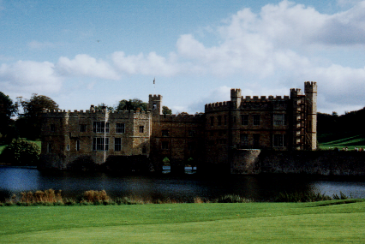
Positioning Image Primitives
glRasterPos3f( x, y, z )
raster position transformed like geometry
discarded if raster position is outside of viewport
may need to fine tune viewport for desired results
Raster Position
Notes:
Images are positioned by specifying the raster position, which maps the lower left corner of an image primitive to a point in space. Raster positions are transformed and clipped the same as vertices. If a raster position fails the clip check, no fragments are rasterized.

Slide 7
Rendering Bitmaps
glBitmap( width, height, xorig, yorig, xmove, ymove, bitmap )
render bitmap in current color at
advance raster position by after rendering
height
yorig
width
xorig
xmove
Notes:
Bitmaps are used as a mask to determine which pixels to update. A bitmap is specified as a packed array of bits in a byte array. For each value of one in the bitmap, a fragment is generated in the currently set color and processed by the fragment operations.
Bitmaps can have their own origin, which provides a relative position to the current raster position. Additionally, after the bitmap is rendered, the raster position is automatically updated by the offset provided in (xmove, ymove).
Bitmaps are particularly useful for rendering bitmapped text, which we’ll discuss in a moment.

Slide 8
Rendering Fonts using Bitmaps
OpenGL uses bitmaps for font rendering
each character is stored in a display list containing a bitmap
window system specific routines to access system fonts
glXUseXFont()
wglUseFontBitmaps()
Notes:
OpenGL uses bitmaps to do font rendering. The window system specific routines process system native font files, and create bitmaps for the different glyphs in the font. Each character is stored in a display list that is part of a set that is created when the font is processed.

Slide 9
Rendering Images
glDrawPixels( width, height, format, type, pixels )
render pixels with lower left of image at current raster position
numerous formats and data types for specifying storage in memory
best performance by using format and type that matches hardware
Notes:
Rendering images is done with the glDrawPixels()command. A block of pixels from host CPU memory is passed into OpenGL with a format and data type specified. For each pixel in the image, a fragment is generated using the color retrieved from the image, and further processed.
OpenGL supports many different formats for images including:
RGB images with an RGB triplet for every pixel
intensity images which contain only intensity for each pixel. These images are converted into greyscale RGB images internally.
depth images which are depth values written to the depth buffer, as compared to the color framebuffer. This is useful in loading the depth buffer with values and then rendering a matching color images with depth testing enabled.
stencil images which copy stencil masks in the stencil buffer. This provides an easy way to load a complicated per pixel mask.
The type of the image describes the format that the pixels stored in host memory. This could be primitive types like GL_FLOAT or GL_INT, or pixels with all color components packed into a primitive type, like GL_UNSIGNED_SHORT_5_6_5.

Slide 10
Reading Pixels
glReadPixels( x, y, width, height, format, type, pixels )
read pixels from specified (x,y) position in framebuffer
pixels automatically converted from framebuffer format into requested format and type
Framebuffer pixel copy
glCopyPixels( x, y, width, height, type )
Notes:
Just as you can send pixels to the framebuffer, you can read the pixel values back from the framebuffer to host memory for doing storage or image processing.
Pixels read from the framebuffer are processed by the pixel storage and transfer modes, as well as converting them into the format and type requested, and placing them in host memory.
Additionally, pixels can be copied from the framebuffer from one location to another using glCopyPixels(). Pixels are processed by the pixel storage and transfer modes before being returned to the framebuffer.

Slide 11
Pixel Zoom
glPixelZoom( x, y )
expand, shrink or reflect pixels around current raster position
fractional zoom supported
Raster Position
glPixelZoom(1.0, -1.0);
Notes:
OpenGL can also scale pixels as they are being rendered. glPixelZoom()will scale or shrink pixels as well as reflect them around the current raster position.

Slide 12
Storage and Transfer Modes
Storage modes control accessing memory
byte alignment in host memory
extracting a subimage
Transfer modes allow modify pixel values
scale and bias pixel component values
replace colors using pixel maps
Notes:
When pixels are read from or written to host memory, pixels can be modified by storage and transfer modes.
Storage modes control how host memory is accessed and written to, including byte swapping and addressing, and modifying how memory is accessed to read only a small subset of the original image.
Transfer modes allow pixel modifications as they are processed. This includes scaling and biasing the color component values, as well as replacing color values using color lookup tables.

Slide 13
Texture Mapping
Poly.
Per
Vertex
CPU
DL
Raster
Frag
FB
Texture
Pixel
Apply a 1D, 2D, or 3D image to geometric primitives
Uses of Texturing
simulating materials
reducing geometric complexity
image warping
reflections
Notes:
In this section, we’ll discuss texture ( sometimes also called image ) mapping. Texture mapping augments the colors specified for a geometric primitive with the colors stored in an image. An image can be a 1D, 2D, or 3D set of colors called texels. 2D textures will be used throughout the section for demonstrations, however, the processes described are identical for 1D and 3D textures.
Some of the many uses of texture mapping include:
simulating materials like wood, bricks or granite
reducing the complexity ( number of polygons ) of a geometric object
image processing techniques like image warping and rectification, rotation and scaling
simulating reflective surfaces like mirrors or polished floors

Slide 14
Texture Mapping
y
z
x
geometry
screen
t
image
s
Notes:
Textures are images that can be thought of as continuous and be one, two, three, or four dimensional. By convention, the coordinates of the image are s, t, r and q. Thus for the two dimensional image above, a point in the image is given by its (s, t) values with (0, 0) in the lower-left corner and (1, 1) in the top-right corner.
A texture map for a two-dimensional geometric object in (x, y, z) world coordinates maps a point in (s, t) space to a corresponding point on the screen.

Slide 15
Texture Mapping and the OpenGL Pipeline
Images and geometry flow through separate pipelines that join at the rasterizer
“complex” textures do not affect geometric complexity
vertices
geometry pipeline
rasterizer
image
pixel pipeline
Notes:
The advantage of texture mapping is that visual detail is in the image, not in the geometry. Thus, the complexity of an image does not affect the geometric pipeline (transformations, clipping) in OpenGL. Texture is added during rasterization where the geometric and pixel pipelines meet.

Slide 16
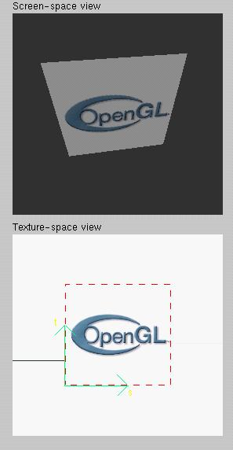
Texture Example
The texture (below) is a 256 x 256 image that has been mapped to a rectangular polygon which is viewed in perspective
Notes:
This example is from the tutorial demo.
The size of textures must be a power of two. However, we can use image manipulation routines to convert an image to the required size.
Texture can replace lighting and material effects or be used in combination with them.

Slide 17
Applying Textures I
Three steps
specify texture
read or generate image
assign to texture
enable texturing
assign texture coordinates to vertices
specify texture parameters
wrapping, filtering
Notes:
In the simplest approach, we must perform these three steps.
Textures reside in texture memory. When we assign an image to a texture it is copied from processor memory to texture memory where pixels are formatted differently.
Texture coordinates are actually part of the state as are other vertex attributes such as color and normals. As with colors, OpenGL interpolates texture inside geometric objects.
Because textures are really discrete and of limited extent, texture mapping is subject to aliasing errors that can be controlled through filtering.
Texture memory is a limited resource and having only a single active texture can lead to inefficient code.

Slide 18
Applying Textures II
specify textures in texture objects
set texture filter
set texture function
set texture wrap mode
set optional perspective correction hint
bind texture object
enable texturing
supply texture coordinates for vertex
coordinates can also be generated
Notes:
The general steps to enable texturing are listed above. Some steps are optional, and due to the number of combinations, complete coverage of the topic is outside the scope of this course.
Here we use the texture object approach. Using texture objects may enable your OpenGL implementation to make some optimizations behind the scenes.
As with any other OpenGL state, texture mapping requires that glEnable() be called. The tokens for texturing are:
GL_TEXTURE_1D - one dimensional texturing
GL_TEXTURE_2D - two dimensional texturing
GL_TEXTURE_3D - three dimensional texturing
2D texturing is the most commonly used. 1D texturing is useful for applying contours to objects ( like altitude contours to mountains ). 3D texturing is useful for volume rendering.

Slide 19
Texture Objects
Like display lists for texture images
one image per texture object
may be shared by several graphics contexts
Generate texture names
glGenTextures( n, *texIds );
Notes:
The first step in creating texture objects is to have OpenGL reserve some indices for your objects. glGenTextures() will request n texture ids and return those values back to you in texIds.
To begin defining a texture object, you call glBindTexture() with the id of the object you want to create. The target is one of GL_TEXTURE_{123}D(). All texturing calls become part of the object until the next glBindTexture() is called.
To have OpenGL use a particular texture object, call glBindTexture() with the target and id of the object you want to be active.
To delete texture objects, use glDeleteTextures( n, *texIds ), where texIds is an array of texture object identifiers to be deleted.

Slide 20
Texture Objects (cont.)
Create texture objects with texture data and state
glBindTexture( target, id );
Bind textures before using
glBindTexture( target, id );

Slide 21
Specify Texture Image
Poly.
Per
Vertex
CPU
DL
Raster
Frag
FB
Texture
Pixel
Define a texture image from an array of texels in CPU memory
glTexImage2D( target, level, components, w, h, border, format, type, *texels );
dimensions of image must be powers of 2
Texel colors are processed by pixel pipeline
pixel scales, biases and lookups can be done
Notes:
Specifying the texels for a texture is done using the glTexImage{123}D() call. This will transfer the texels in CPU memory to OpenGL, where they will be processed and converted into an internal format.
The array of texels sent to OpenGL with glTexImage*() must be a power of two in both directions. An optional one texel wide border may be added around the image. This is useful for certain wrapping modes.
The level parameter is used for defining how OpenGL should use this image when mapping texels to pixels. Generally, you’ll set the level to 0, unless you’re using a texturing technique called mipmapping, which we’ll discuss in a few slides.

Slide 22
Converting A Texture Image
If dimensions of image are not power of 2
gluScaleImage( format, w_in, h_in, type_in, *data_in, w_out, h_out, type_out, *data_out );
*_in is for source image
*_out is for destination image
Image interpolated and filtered during scaling
Notes:
If your image does not meet the power of two requirement for a dimension, the gluScaleImage() call will resample an image to a particular size. It uses a simple box filter to interpolate the new images pixels from the source image.
Additionally, gluScaleImage() can be used to convert from one data type ( i.e. GL_FLOAT ) to another type, which may better match the internal format in which OpenGL stores your texture.
Note that use of gluScaleImage() can also save memory.

Slide 23
Specifying a Texture: Other Methods
Use frame buffer as source of texture image
uses current buffer as source image
glCopyTexImage1D(...)
glCopyTexImage2D(...)
Modify part of a defined texture
glTexSubImage1D(...)
glTexSubImage2D(...)
glTexSubImage3D(...)
Do both with glCopyTexSubImage2D(...), etc.
Notes:
glCopyTexImage*() allows textures to be defined by rendering into any of OpenGL’s buffers. The source buffer is selected using the glReadBuffer() command.
Using glTexSubImage*() to replace all or part of an existing texture often outperforms using glTexImage*() to allocate and define a new one. This can be useful for creating a “texture movie” ( sequence of textures which changes appearance on an object’s surface ).
There are some advanced techniques using glTexSubImage*() which include loading an image which doesn’t meet the power of two requirement. Additionally, several small images can be “packed” into one larger image ( which was originally created with glTexImage*() ), and loaded individually with glTexSubImage*(). Both of these techniques require the manipulation of the texture transform matrix, which is outside the scope of this course.

Slide 24
Mapping a Texture
Poly.
Per
Vertex
CPU
DL
Raster
Frag
FB
Texture
Pixel
Based on parametric texture coordinates
glTexCoord*() specified at each vertex
Texture Space
Object Space
t
1, 1
(s, t) = (0.2, 0.8)
0, 1
A
a
c
(0.4, 0.2)
b
B
C
0, 0
1, 0
s
(0.8, 0.4)
Notes:
When you want to map a texture onto a geometric primitive, you need to provide texture coordinates. The glTexCoord*() call sets the current texture coordinates. Valid texture coordinates are between 0 and 1, for each texture dimension, and the default texture coordinate is ( 0, 0, 0, 1 ). If you pass fewer texture coordinates than the currently active texture mode ( for example, using glTexCoord1d() while GL_TEXTURE_2D is enabled ), the additionally required texture coordinates take on default values.

Slide 25
Generating Texture Coordinates
Automatically generate texture coords
glTexGen{ifd}[v]()
specify a plane
generate texture coordinates based upon distance from plane
generation modes
GL_OBJECT_LINEAR
GL_EYE_LINEAR
GL_SPHERE_MAP
Notes:
You can have OpenGL automatically generate texture coordinates for vertices by using the glTexGen() and glEnable(GL_TEXTURE_GEN_{STRQ}). The coordinates are computed by determining the vertex’s distance from each of the enabled generation planes.
As with lighting positions, texture generation planes are transformed by the ModelView matrix, which allows different results based upon when the glTexGen() is issued.
There are three ways in which texture coordinates are generated:
GL_OBJECT_LINEAR - textures are fixed to the object ( like wall paper )
GL_EYE_LINEAR - texture fixed in space, and object move through texture ( like underwater light shining on a swimming fish)
GL_SPHERE_MAP - object reflects environment, as if it were made of mirrors (like the shiny guy in Terminator 2)

Slide 26
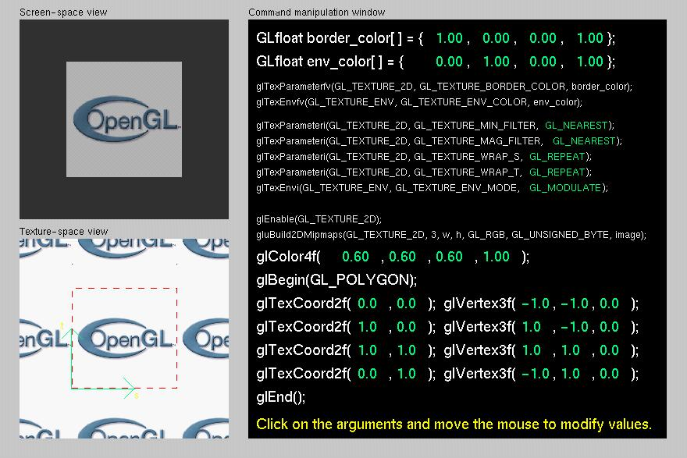
Tutorial: Texture

Slide 27
Texture Application Methods
Filter Modes
minification or magnification
special mipmap minification filters
Wrap Modes
clamping or repeating
Texture Functions
how to mix primitive’s color with texture’s color
blend, modulate or replace texels
Notes:
Textures and the objects being textured are rarely the same size ( in pixels ). Filter modes determine the methods used by how texels should be expanded ( magnification ), or shrunk ( minification ) to match a pixel’s size. An additional technique, called mipmapping is a special instance of a minification filter.
Wrap modes determine how to process texture coordinates outside of the [0,1] range. The available modes are:
GL_CLAMP - clamp any values outside the range to closest valid value, causing the edges of the texture to be “smeared” across the primitive
GL_REPEAT - use only the fractional part of the texture coordinate, causing the texture to repeat across an object
Finally, the texture environment describes how a primitives fragment colors and texel colors should be combined to produce the final framebuffer color. Depending upon the type of texture ( i.e. intensity texture vs. RGBA texture ) and the mode, pixels and texels may be simply multiplied, linearly combined, or the texel may replace the fragment’s color altogether.

Slide 28
Filter Modes
Example:
glTexParameteri( target, type, mode );
Texture
Polygon
Texture
Polygon
Magnification
Minification
Notes:
Filter modes control how pixels are minified or magnified. Generally a color is computed using the nearest texel or by a linear average of several texels.
The filter type, above is one of GL_TEXTURE_MIN_FILTER or GL_TEXTURE_MAG_FILTER.
The mode is one of GL_NEAREST, GL_LINEAR, or special modes for mipmapping. Mipmapping modes are used for minification only, and have values of: GL_NEAREST_MIPMAP_NEAREST
GL_NEAREST_MIPMAP_LINEAR
GL_LINEAR_MIPMAP_NEAREST
GL_LINEAR_MIPMAP_LINEAR
Full coverage of mipmap texture filters is outside the scope of this course.

Slide 29
Mipmapped Textures
Mipmap allows for prefiltered texture maps of decreasing resolutions
Lessens interpolation errors for smaller textured objects
Declare mipmap level during texture definition
glTexImage*D( GL_TEXTURE_*D, level, … )
GLU mipmap builder routines
gluBuild*DMipmaps( … )
OpenGL 1.2 introduces advanced LOD controls
Notes:
As primitives become smaller in screen space, a texture may appear to shimmer as the minification filters creates rougher approximations. Mipmapping is an attempt to reduce the shimmer effect by creating several approximations of the original image at lower resolutions.
Each mipmap level should have an image which is one-half the height and width of the previous level, to a minimum of one texel in either dimension. For example, level 0 could be 32 x 8 texels. Then level 1 would be 16 x 4; level 2 would be 8 x 2; level 3, 4 x 1; level 4, 2 x 1, and finally, level 5, 1 x 1.
The gluBuild*Dmipmaps() routines will automatically generate each mipmap image, and call glTexImage*D() with the appropriate level value.
OpenGL 1.2 introduces control over the minimum and maximum mipmap levels, so you don’t have to specify every mipmap level (and also add more levels, on the fly).

Slide 30
Wrapping Mode
Example:
glTexParameteri( GL_TEXTURE_2D, GL_TEXTURE_WRAP_S, GL_CLAMP )
glTexParameteri( GL_TEXTURE_2D, GL_TEXTURE_WRAP_T, GL_REPEAT )
t
s
GL_REPEAT
wrapping
GL_CLAMP
wrapping
texture
Notes:
Wrap mode determines what should happen if a texture coordinate lies outside of the [0,1] range. If the GL_REPEAT wrap mode is used, for texture coordinate values less than zero or greater than one, the integer is ignored and only the fractional value is used.
If the GL_CLAMP wrap mode is used, the texture value at the extreme (either 0 or 1) is used.

Slide 31
Texture Functions
Controls how texture is applied
glTexEnv{fi}[v]( GL_TEXTURE_ENV, prop, param )
GL_TEXTURE_ENV_MODE modes
GL_MODULATE
GL_BLEND
GL_REPLACE
Set blend color with GL_TEXTURE_ENV_COLOR
Notes:
The texture mode determines how texels and fragment colors are combined. The most common modes are:
GL_MODULATE - multiply texel and fragment color
GL_BLEND - linearly blend texel, fragment, env color
GL_REPLACE - replace fragment’s color with texel
If prop is GL_TEXTURE_ENV_COLOR, param is an array of four floating point values representing the color to be used with the GL_BLEND texture function.

Slide 32
Perspective Correction Hint
Texture coordinate and color interpolation
either linearly in screen space
or using depth/perspective values (slower)
Noticeable for polygons “on edge”
glHint( GL_PERSPECTIVE_CORRECTION_HINT, hint )
where hint is one of
GL_DONT_CARE
GL_NICEST
GL_FASTEST
Notes:
An OpenGL implementation may chose to ignore hints.

Slide 33
Is There Room for a Texture?
Query largest dimension of texture image
typically largest square texture
doesn’t consider internal format size
glGetIntegerv( GL_MAX_TEXTURE_SIZE, &size )
Texture proxy
will memory accommodate requested texture size?
no image specified; placeholder
if texture won’t fit, texture state variables set to 0
doesn’t know about other textures
only considers whether this one texture will fit all of memory
Notes:
GLint proxyComponents;
glTexImage2D(GL_PROXY_TEXTURE_2D, 0, GL_RGBA8, 64, 64, 0, GL_RGBA, GL_UNSIGNED_BYTE, NULL);
glGetTexLevelParameteriv(GL_PROXY_TEXTURE_2D, 0, GL_TEXTURE_COMPONENTS, &proxyComponents);

Slide 34
Texture Residency
Working set of textures
high-performance, usually hardware accelerated
textures must be in texture objects
a texture in the working set is resident
for residency of current texture, check GL_TEXTURE_RESIDENT state
If too many textures, not all are resident
can set priority to have some kicked out first
establish 0.0 to 1.0 priorities for texture objects
Notes:
Query for residency of an array of texture objects:
GLboolean glAreTexturesResident(GLsizei n, Gluint *texNums, GLboolean *residences)
Set priority numbers for an array of texture objects:
glPrioritizeTextures(GLsizei n, GLuint *texNums, GLclampf *priorities)
Lower priority numbers mean that, in a crunch, these texture objects will be more likely to be moved out of the working set.
One common strategy is avoid prioritization, because many implementations will automatically implement an LRU (least recently used) scheme, when removing textures from the working set.
If there is no high-performance working set, then all texture objects are considered to be resident.

