Slide 1
Computer Graphics
Tz-Huan Huang National Taiwan University

Slide 2
OpenGL ES and other topics
OpenGL ES
Shadow
Antialiasing
Text rendering

Slide 3
OpenGL ES and other topics
OpenGL ES
Shadow
Antialiasing
Text rendering

Slide 4
OpenGL ES
OpenGL for Embedded System
OpenGL ES 1.0 vs. OpenGL 1.3
OpenGL ES 1.1 vs. OpenGL 1.5
OpenGL ES 2.0 vs. OpenGL 2.0
1.X: fixed function hardware
2.X: programmable hardware
OpenGL ES 1.1 is fully backward compatible with 1.0, but 2.0 is NOT.

Slide 5
OpenGL ES 1.x
Common vs. Common-Lite profiles
Common:
single-precision floating point type
Common-lite
fixed point type
Khronos OpenGL ES API Registry
Difference specification

Slide 6
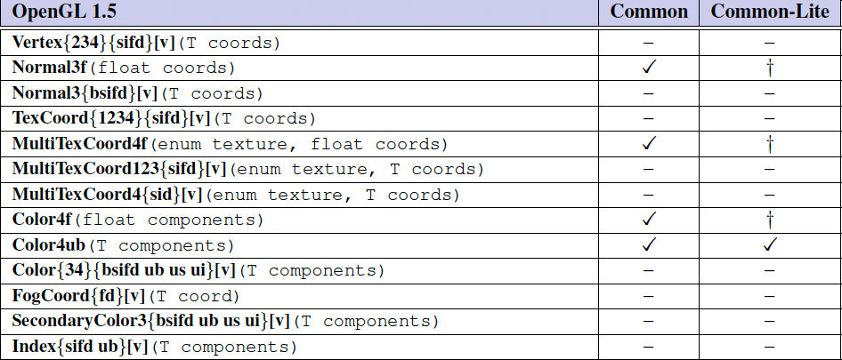
Difference specification

Slide 7
OpenGL operations (1/2)
In:
Vertex array related functions
VertexPointer, DrawArray, etc
Vertex buffer object realted functions
BindBuffer, GenBuffer, etc
ViewPort, Frustum, Ortho
Matrix stack related functions
Out:
Begin/End paradigm and related functions

Slide 8
OpenGL operations (2/2)
In:
ClipPlane
Coloring and lighting related functions
Out:
TexGen
RasterPos, WindowPos

Slide 9
Rasterization (1/2)
In:
antialiasing: MULTISAMPING, POINT_SMOOTH, LINE_SMOOTH
CullFace, PolygonOffset
PixelStorei
Out:
2D rasterization related functions
Image processing related functions

Slide 10
Rasterization (2/2)
In:
2D texture
Fog
Out:
1D/3D texture

Slide 11
Per-Fragment operations and the framebuffer
In:
Scissor/stencil/depth/alpha test
Blending, dither, logic operation
ReadPixels
Out:
Query
DrawBuffer/ReadBuffer/CopyPixels
Accumulation buffer

Slide 12
Special functions
In:
Flush/Finish
Hints
Out:
Evaluators
Selection
Feedback
Display Lists

Slide 13
State and state requests
Only states related to supported features and types can be queried
In:
GetIntegerv
GetFloatv
Out:
GetDoublev
GetMap

Slide 14
OpenGL ES 2.X
Only Common profile
single-precision floating point type
Khronos OpenGL ES API Registry
Difference specification

Slide 15
OpenGL operations (1/2)
In:
VertexAttrib/VertexAttribPointer
DrawArray/DrawElements
Vertex buffer object
Out:
Begin/End paradigm
VertexPointer, NormalPointer, … etc

Slide 16
OpenGL operations (2/2)
In:
Viewport
Vertex shader
Out:
Transform related function
matrix stack, frustrum, ortho, etc
ClipPlane
Lighting realted functions
RasterPos, WindowPos

Slide 17
Rasterization (1/2)
In:
antialiasing: MULTISAMPING, POINT_SMOOTH
CullFace, PolygonOffset
PixelStorei
Out:
2D rasterization related functions
Image processing related functions

Slide 18
Rasterization (2/2)
In:
2D texture
Mipmap generation
Fragment shader
Out:
1D/3D texture
Fog

Slide 19
Per-Fragment operations and the framebuffer
In:
Scissor/stencil/depth test
Blending, dither, logic operation
ReadPixels
Frame buffer object
Out:
alpha test/query
DrawBuffer/ReadBuffer/CopyPixels
Accumulation buffer

Slide 20
Special functions
In:
Flush/Finish
Hints: only GENERATE_MIPMAP_HINT
Out:
Evaluators
Selection
Feedback
Display Lists

Slide 21
State and state requests
Only states related to supported features and types can be queried
In:
GetIntegerv
GetFloatv
Out:
GetDoublev
GetMap

Slide 22
OpenGL ES and other topics
OpenGL ES
Shadow
Antialiasing
Text rendering

Slide 23
Review of OpenGL buffers
Color buffer
Depth buffer
Stencil buffer
Accumulation buffer

Slide 24
Color buffer
glClear
glBegin, glEnd, glVertex
glDraw*

Slide 25
Depth buffer
glEnable(GL_DEPTH_TEST)
glClear
glDepthFunc(func)
func: GL_NEVER, GL_LESS, GL_EQUAL, GL_LEQUAL, GL_GREATER, GL_NOTEQUAL, GL_GEQUAL, GL_ALWAYS

Slide 26
Stencil buffer
glStencilFunc(func, ref, mask)
func:
GL_NEVER: always fail
GL_LESS: pass if (ref&mask)<(stencil&mask)
GL_LEQUAL, GL_GREATER, GL_GEQUAL, GL_EQUAL, GL_NOTEQUAL, GL_ALWAYS
glStencilOp(sfail, dpfail, dppass)
Actions: GL_KEEP, GL_ZERO, GL_REPLACE, GL_INCR, GL_INCR_WRAP, GL_DECR, GL_DECR_WRAP

Slide 27
Accumulation buffer
glAccum(op, value)
op:
GL_ACCUM: accum += color*value
GL_LOAD: accum = color
GL_ADD: accum += value
GL_MULT: accum *= value
GL_RETURN: color = accum

Slide 28
OpenGL ES and other topics
OpenGL ES
Shadow
Antialiasing
Text rendering

Slide 29
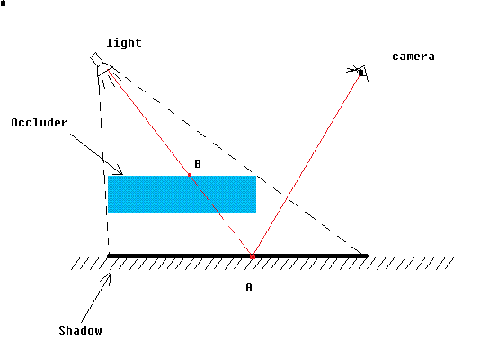
Shadow

Slide 30
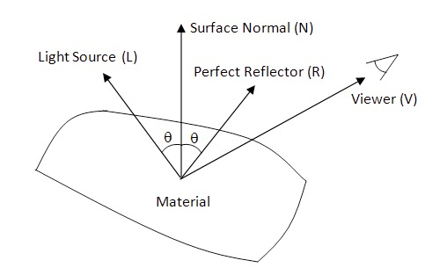
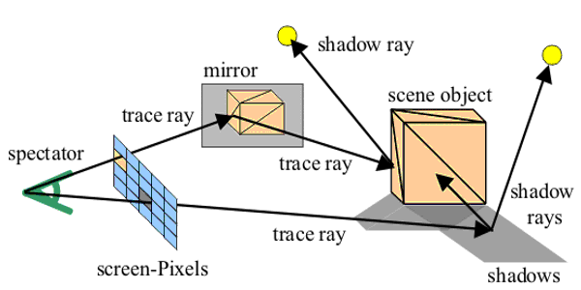
OpenGL vs. ray tracing
OpenGL:
local shading
Ambient+Diffuse+specular
Ray tracing:

Slide 31
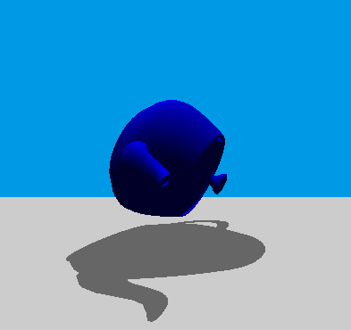
Simple case
Squish objects into plane

Slide 32
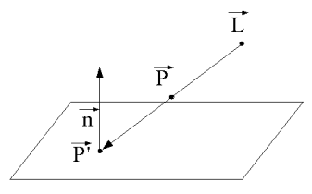
Shadow projection
L: location of light
n: normal vector of plane
P: vertex location
P’: location of the vertex shadow
Plane equation:
ax+by+cz+d=0

Slide 33
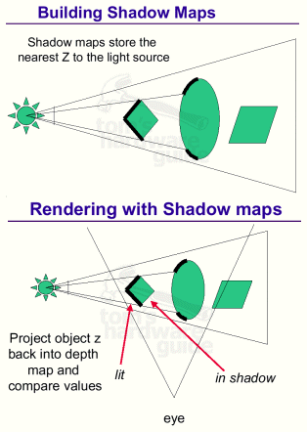
Shadow map
Idea:
render a depth map from light position
For every vertex, test if the z value is less then value from depth map

Slide 34
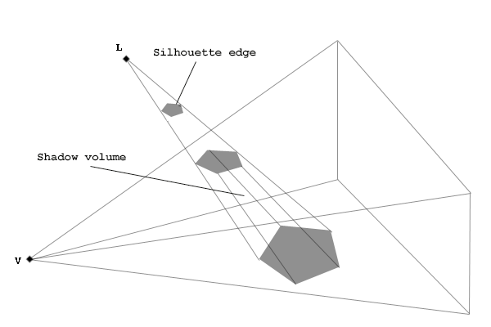
Shadow volume
Idea:
render a “volume” in the scene
test if object is in the volume or not and update the stencil buffer
render scene based on stencil buffer

Slide 35
OpenGL ES and other topics
OpenGL ES
Shadow
Antialiasing
Text rendering

Slide 36
Antialiasing
OpenGL specific
Vendor extension
Software-based antialiasing

Slide 37
OpenGL specific antialiasing
Point, line, polygon antialiasing
glHint():
GL_POINT_SMOOTH_HINT
GL_LINE_SMOOTH_HINT
GL_POLYGON_SMOOTH_HINT
Fullscreen antialiasing
glEnable(GL_MULTISAMPLE)

Slide 38
Vendor extensions
NVIDIA: __GL_FSAA_MODE
0: FSAA disabled
1: 2x Bilinear Multisampling
4: 4x Bilinear Multisampling
7: 4x Bilinear Multisampling by 4x Supersampling
9: 8x Bilinear Multisampling
13: 8x Bilinear Multisampling by 4x Supersampling

Slide 39
Software-based antialiasing
Blending
Accumulation buffer

Slide 40
Blending in OpenGL
glEnable(GL_BLEND)
glBlendFunc(sfactor, dfactor)
GL_ZERO
GL_ONE
GL_SRC_ALPHA
…

Slide 41
Blending example
glEnable(GL_BLEND);
glBlendFunc(GL_SRC_ALPHA, GL_ONE_MINUS_SRC_ALPHA);
// draw scene1
// draw scene2
…
Color =
SRC_ALPHA*SRC_COLOR +
(1-SRC_ALPHA)*NEW_COLOR

Slide 42
Accumulation buffer
Range = right – left
glTranslate(-0.2*range/width, -0.2*range/height, 0.0);
// draw scene
glAccum(GL_LOAD, 0.25);
glTranslate(-0.2*range/width, 0.2*range/height, 0.0);
// draw scene
glAccum(GL_ACCUM, 0.25);
glTranslate(0.2*range/width, -0.2*range/height, 0.0);
// draw scene
glAccum(GL_ACCUM, 0.25);
glTranslate(0.2*range/width, 0.2*range/height, 0.0);
// draw scene
glAccum(GL_ACCUM, 0.25);

Slide 43
OpenGL ES and other topics
OpenGL ES
Shadow
Antialiasing
Text rendering

Slide 44
Text rendering
Text rendering is important for presentation of textual information
However, there is no native font support in OpenGL.
The Reasons:
Font format: type1, type3, truetype, opentype, etc.
Font rendering: related to window system

Slide 45
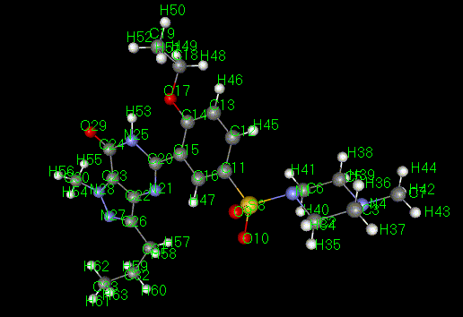
Text rendering in OpenGL
Bitmap font
Outline font
Texture mapped font

Slide 46
Bitmap font
Pros:
Very fast
Cons:
Doesn’t support scaling, rotation, etc
Quality
2D only
Requirements
glBitmap()
glRasterPos()

Slide 47
Outline font
Pros
Supports rotation, scaling, coloring, material, lighting, antialiasing, texture mapping, etc
Cons
Might be very slow
Requirements
Font format parsing/conversion

Slide 48
Texture mapped text
Pros
High quality text rendering results
Cons
Might be difficult to integrated into OpenGL scene
Requirements
Offline text rendering

Slide 49
3rd party libraries
GLX
WGL
GLUT
Queso GLC http://quesoglc.sourceforge.net
GLTT http://gltt.sourceforge.net
FTGL http://ftgl.wiki.sourceforge.net

Slide 50
GLX
X-window system only
Can use any X font in the system
Supports only bitmap font
Usage
XLoadQueryFont()
glXUseXFont()

Slide 51
WGL
Microsoft Windows only
Can use any windows font
Supports bitmap and outline font
Usage:
wglUseFontBitmaps()
wglUseFontOutlines()
Win32 api to load bitmap/truetype fonts

Slide 52
GLUT
Easy to use
Supports bitmap and outlines
Limited in choice of fonts
Usage:
glutBitmapCharacter()
glutStrokeCharacter()

Slide 53
Queso GLC
Free implementation of SGI IRIS GLC
Based on freetype2 and fontcnofig
Supports bitmap and outline font

Slide 54
GLTT and FTGL
GLTT uses freetype1, while FTGL uses freetype2
Supports bitmap and outline fonts

Slide 55
Thank you very much

